Slide 1
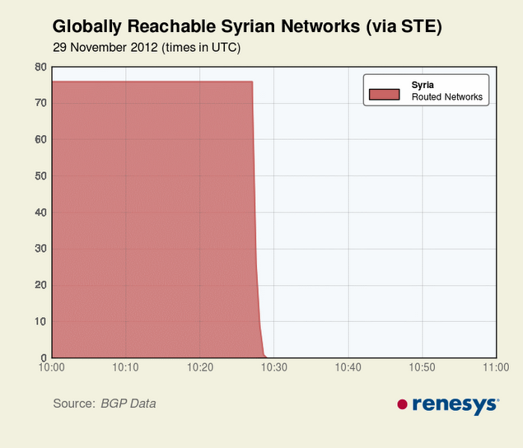
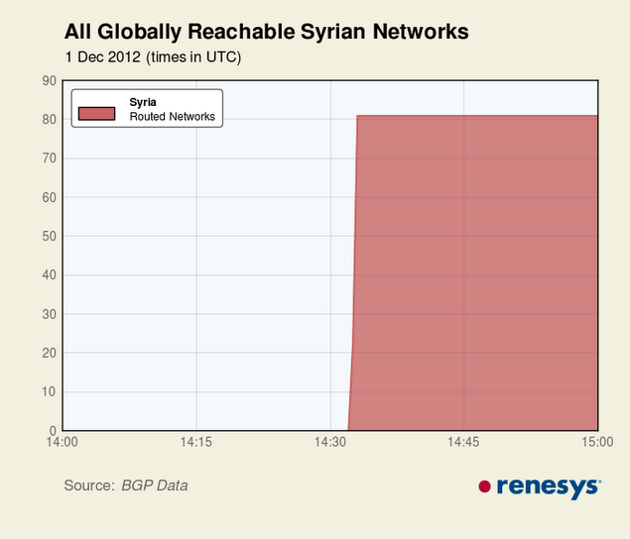
Syria – off, then back on the Net
29 November 2012 (times in UTC)
1 December 2012 (times in UTC)
Notes:
Last June, Syria was taken off the Internet, then connectivity restored (http://bit.ly/VutT6c).
They were cut off the Net again shortly before 10:30 UTC on November 29.
Connectivity was suddenly restored on December 1.
These figures are from Renesys, a company that tracks the status of the Internet:
http://www.renesys.com/blog/2012/12/restoration-in-syria-1.shtml
http://www.renesys.com/blog/2012/11/syria-off-the-air.shtml
Renesys could not say that it was government action with 100% certainty, but any other explanation would be a long shot.
For further discussion of the event, see this BGPmon blog post:
http://www.bgpmon.net/syria-shuts-down-the-internet/

Slide 2
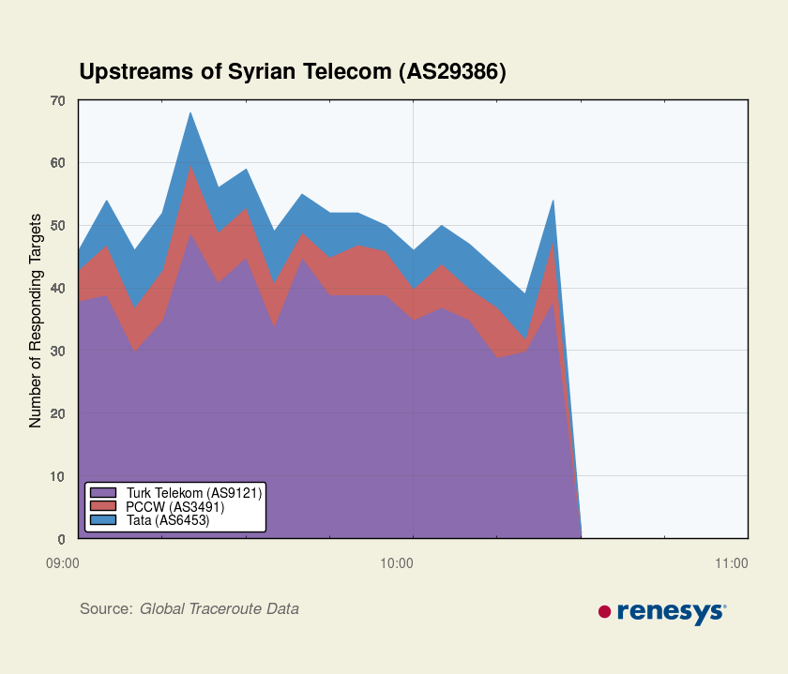
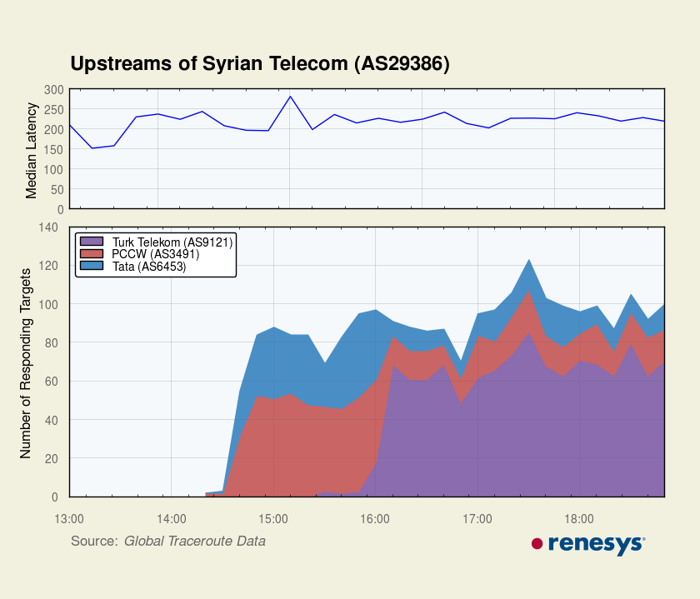
Syria – off, then back on the Net
29 November 2012 (times in UTC)
1 December 2012 (times in UTC)
Notes:
This figure shows the number of upstream providers connected through three networks falling off and being restored.
http://www.renesys.com/blog/2012/12/restoration-in-syria-1.shtml
http://www.renesys.com/blog/2012/11/syria-off-the-air.shtml

Slide 3
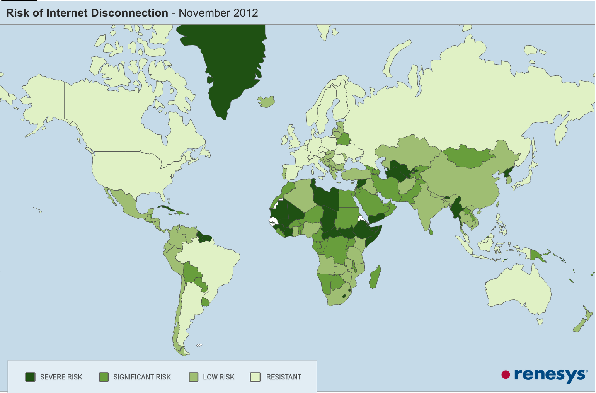
Number of domestic ISPs with direct connections to foreign networks
Severe risk: 1 or 2, Significant: 3-9, Low: 10-39, Resistant: 40 +
Notes:
This map approximates the difficulty of cutting a nation off from the Internet. It shows the number of networks in a nation that link directly to the outside. If only one network has an external link, only it must be cut off. If there were, say, 40 links, it would take 40 phone calls, court orders or infrastructure attacks to cut a nation off.
Syria was easily cut off because nearly all foreign connections were routed through one provider, The Syrian Telecommunications Establishment.
The other low-traffic connections were cut soon after.
http://www.renesys.com/blog/2012/11/could-it-happen-in-your-countr.shtml

Slide 4
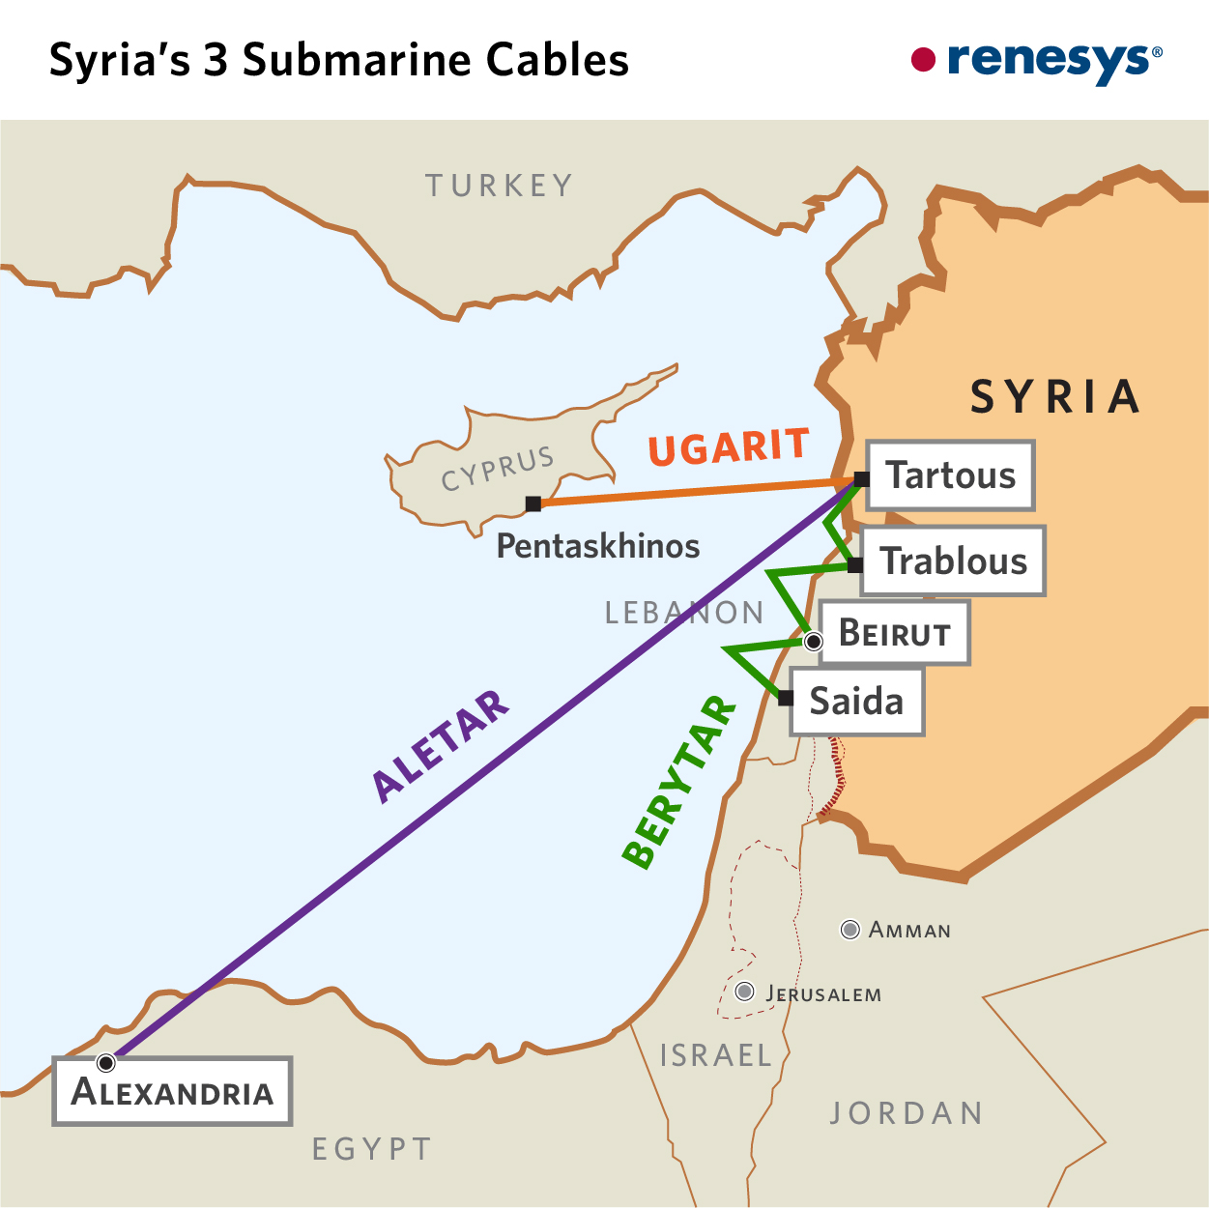
TeleGeography global undersea cable map
Notes:
Submarine and terrestrial cables also provide a connectivity concentration point.
You can see Telegeography’s terrific interactive map showing global undersea cables and landing points at : http://www.submarinecablemap.com/.

Slide 5
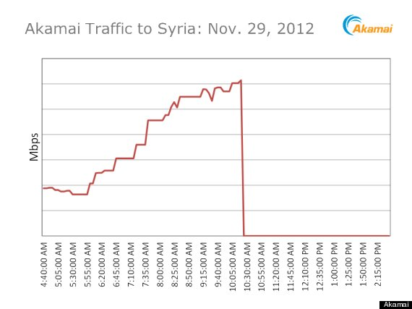
Clandestine connectivity
Notes:
While Akamai showed no normally routed traffic during the shut down, there was some very slow clandestine access through ham radio operators, dial-up telephone connections, small, low-speed satellite links owned by individuals and numbers where Syrians could leave audio recordings to be tweeted online.
This traffic was only a drop in the bucket and limited to a few people, but it was sufficient to get some information about conditions in Syria out to the rest of the world.
The Electronic Frontier Foundation posted an article (http://bit.ly/YgZjnU) on efforts to route around the Syrian Internet cuts, including ham operators, dial-up phone numbers andhttps://twitter.com/speak2tweet. They also referred to a Reuters report (http://reut.rs/Uxx6Fb) that State Department spokeswoman Victoria Nuland told a news briefing "We've provided some 2,000 communications kits, pieces of equipment, since this effort began." She said the equipment included computers, phones and cameras and the kits were designed to be "independent from and able to circumvent the Syrian domestic network." It would be nice to know more about those State Department communication kits and their means of connectivity. It calls to mind the USAID project, in which Alan Gross was caught bringing personal satellite ground stations into Cuba (http://bit.ly/Sw2djV). The Cuba Money project has had Freedom of Information Act requests for information on that fiasco for over 400 days and counting with no luck (http://bit.ly/VbGD1u).

