Slide 1
Images for demonstration of layers and transparency (enable editing to copy images)

Slide 2
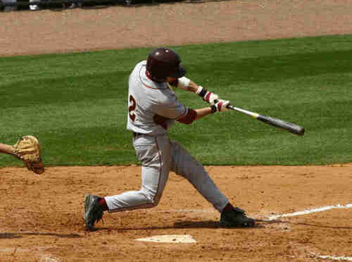
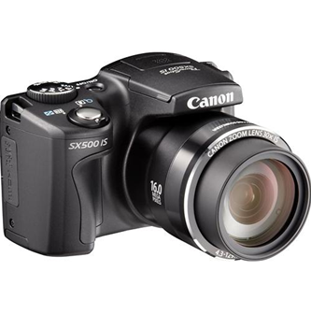
Images to play around with
Notes:
I’ll use these five images to demonstrate image transparency and layers.
Let’s start with the camera.

Slide 3
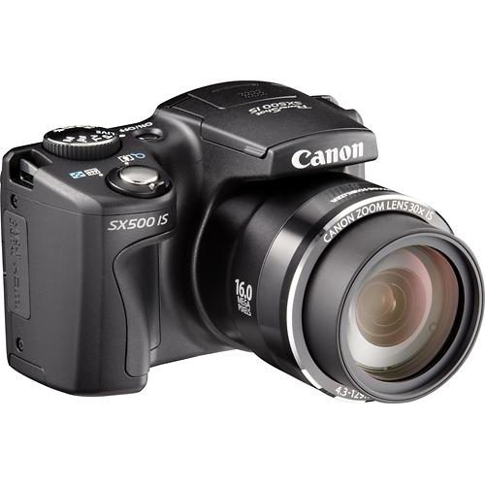
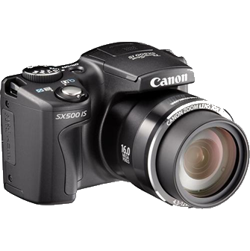
Move the cameras over the blue background. How did I do this? (Stop the presentation if you are viewing it as a slide show).

Slide 4
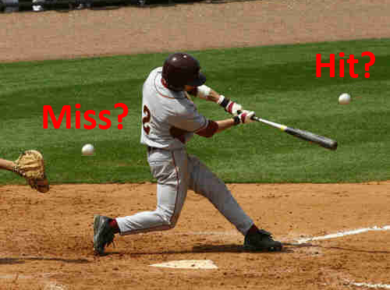
How did I make this image?
Notes:
I started with a picture of a baseball player swinging a bat and added two small images of baseballs and two text labels.
Each ball and label is on a different transparent layer “above” the background image.

Slide 5
How did I make this image?

