Slide 1
Using Twitter
Skills: familiarity with the Twitter user interface and major features, using the hashtag (#) and at-sign (@), searching and tweeting images and videos
Concepts: evolution of Twitter applications and access modes, citizen journalism, trending topics and finding people as well as information
This work is licensed under a Creative Commons Attribution-Noncommercial-Share Alike 3.0 License.
Notes:
We present Twitter’s major features by looking at the home, discover and connect views as well as the user’s profile view.
We will see that Twitter has evolved over the years and is now commonly used to discover interesting people and information. Citizen journalists use it to report on current events.

Slide 2
Where does this topic fit?
Internet concepts
Applications
Technology
Implications
Internet skills
Application development
Content creation
User skills (Twitter)
Notes:
We cover both skills and concepts in this presentation.

Slide 3
Watch this video first
http://www.commoncraft.com/twitter
Notes:
Pause and watch this video.
It explains what Twitter is.

Slide 4
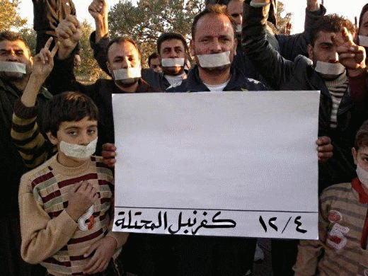
Not just personal friends
Notes:
The video stresses keeping up with your friends, but Twitter is used for much more.
You can follow celebrities like Lady Gaga, professionals like Bill Gates and current events like the Arab spring.
Twitter has become a significant tool for citizen journalism and professional communication.

Slide 5
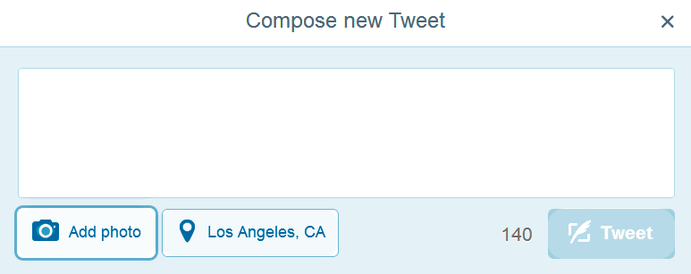
Twitter is a micro-blogging service
Posts are called “tweets.”
Tweets are limited to 140 characters.
URLs are automatically shortened.
You can attach up to 4 images.
Notes:
You should experiment with tweets – add an image, insert a URL, etc.
The second-fourth images do not take more characters.

Slide 6
You can mark, re-tweet, reply to or expand a tweet
What does each marked part of the tweet mean?
What are the “more” options?
Notes:
This tweet was posted by @BarackObama 11 hours ago.
It is tagged #LastCall2014 for searches.
Rolling your cursor over a tweet allows you to mark it as a favorite, re-tweet it, reply to or expand it.
If you re-tweet it, it will be posted in your tweet stream and your followers will see it.
Replying let’s you tweet a reply to the person who had posted it.
If they enable notifications, they will also receive your reply by email.
Expanding it shows information about the tweet.
Twitter counts messages, re-tweets and favorite in order to single out important or trending tweets.
Let’s look at another helpful video before checking out more Twitter features.

Slide 7
Watch this video
http://commoncraft.com/twitter-search
Notes:
Pause and watch this video.
It will show you how you can search for tweets and introduce two special characters # and @.

Slide 8
Two special characters
@username: specify a particular Twitter user
Hashtag (#): tag posts on a given topic
With Twitter, the hashtag has the same purpose as a Blogger feature – which one?
Notes:
Two special characters, @ and #, were used in the search video.
We mentioned earlier that, if you reply to a tweet, you send a message to the person who posted it.
Personal identifiers begin with an at sign (@) followed by the name of the Twitter user.
Hashtags are terms that are preceded by the number or hash sign (#).
If everyone agrees to include a certain hashtag in their tweets on a given topic, it will be easy to retrieve them.
Let’s look at a hashtag search example.

Slide 9
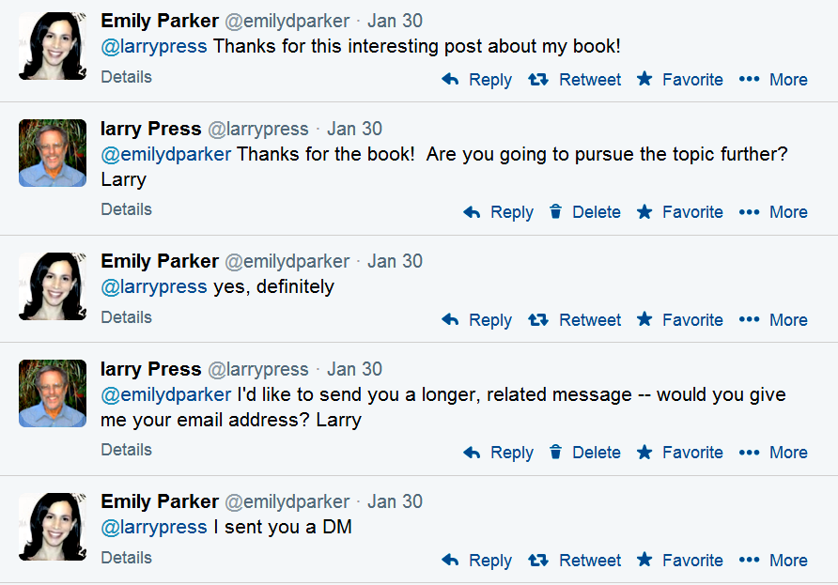
A Twitter conversation
Emily’s last tweet refers to a “DM” (direct message). What is a DM and why did she use a DM instead of a “reply?”
Notes:
@emilyparker replied to my tweet on a review of her book.
Note that she started her tweet with my Twitter name, which caused me to receive a Twitter notification and an email.
I replied and she did too.
Note that our tweets are open – part of our stream of posts that anyone can read.
When I asked for her email address, she sent me a direct message (DM)
DMs are hidden from view, and the parties must both follow each other.
Emily used a DM so only I would see her email address.

Slide 10
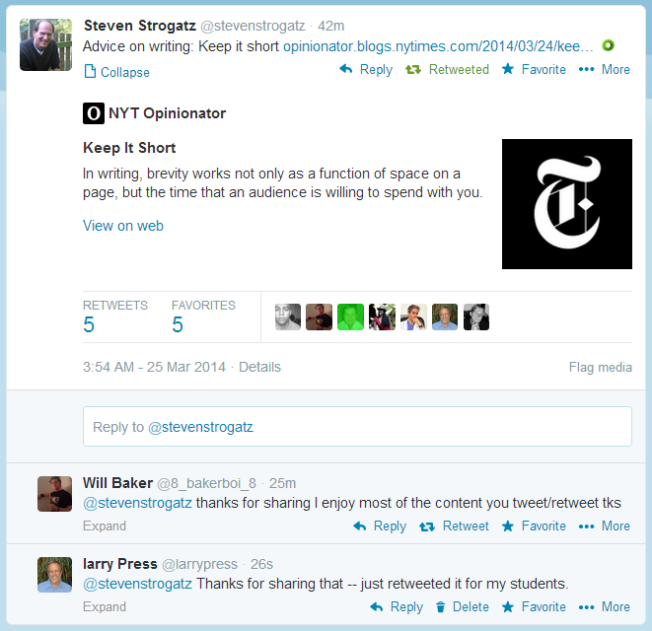
Twitter example – conversation and sharing
Strogatz retweets a link to a post on writing.
A picture of text is a way to get more words into a tweet.
Press retweets.
Baker and Press thank him.
Notes:
I saw a tweet by Steven Strogatz with a link to a post with a tip on writing.
I retweeted that for the benefit of my students and anyone else following me.
(I could have set up a separate Twitter account for use by my students only).
Baker and I both thanked Strogatz for the tip.
Note that the tweet has an image of some text – a way to get more words into a tweet.

Slide 11
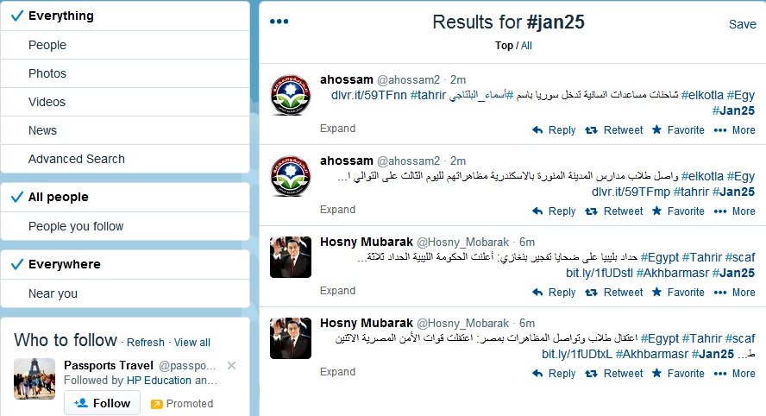
Search for #Jan25
Notes:
The hashtag #Jan25 was used to organize the first day of protests in Egypt’s 2011 political protests.
People agreed to use it in tweets relevant to the demonstrations and revolution.
As you see above, I searched for #Jan25.
The latest tweets are shown on the right.
On the left you see people – prominent journalists and activists – who have used the #Jan25 hashtag in tweets.
They are chosen automatically by a program that considers the number of people who like, re-tweet and reply to their posts.
Below those, you see links to similarly popular images and videos.

Slide 12
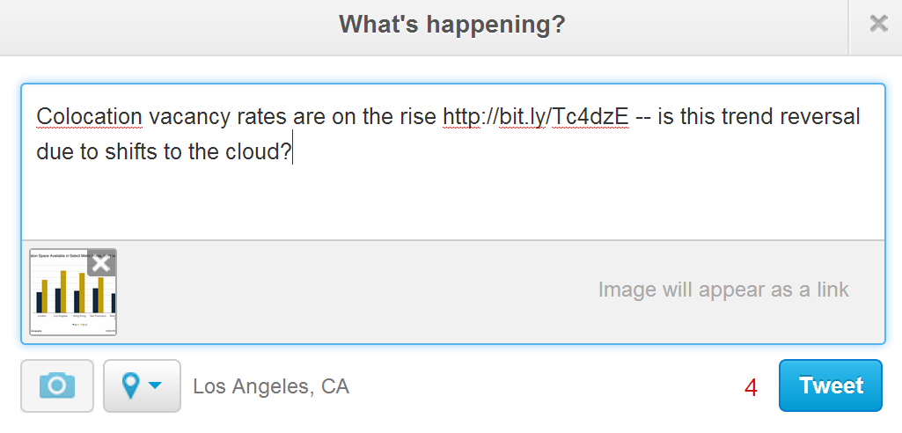
Tweets with images
I have only typed 117 characters, but Twitter says I have only four to spare. Why is it not giving me a full 140 characters?
Notes:
You can include a link to an image in a tweet by clicking on the camera icon.
Twitter will shorten the link automatically.

Slide 13
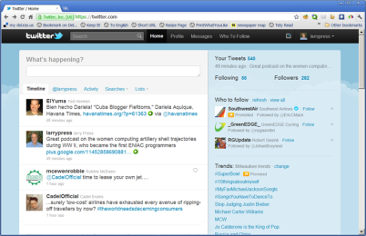
Twitter’s evolution
Notes:
When Twitter started out in 2006, the only way to post tweets was by sending SMS text messages.
That is why the length limit is 140 characters.
Next came the Web interface that we have been using in our examples.
Today, there are Twitter clients for all major smart phones and tablets.

Slide 14
Twitter’s evolution
Notes:
The Twitter prompt changed from “what are you doing” to “what’s happening” to “compose new tweet.”
The first users tended to talk about what they were doing, and no one, including Twitter’s founders had a clear picture of how the service would be used.
As users discovered impersonal applications, like citizen journalism and organizing events, the prompt became impersonal.

Slide 15
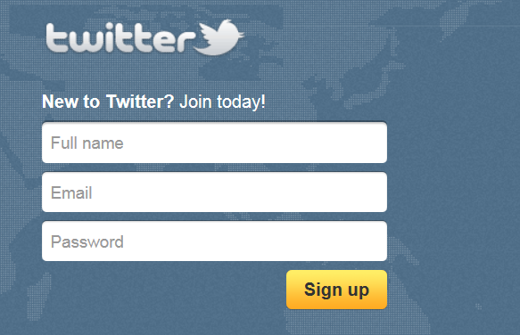
Accounts are free
Notes:
If you don’t already have one, sign up for a Twitter account.
Pick your user name carefully, because you will be stuck with it.

Slide 16
Play time
Notes:
We have looked at some of Twitter’s features, but not all.
You need to spend time playing with the program.
Click on all the hot spots and see what happens and exchange experimental tweets with your friends and see what happens.
Also step back and consider the way Twitter’s designers have laid the screen out – make a wire-frame diagram.
What types of thing are on the left, the right, the top and bottom, etc.?

Slide 17
Summary
Notes:
We’ve introduced Twitter’s primary features and gone over its user interface as shown here. (You can learn Twitter by clicking on each of the above icons and seeing what the corresponding command does). We also mentioned applications like citizen journalism and following news or professionally important people.

Slide 18
Self-study questions
What is the URL (Web address) of your new Twitter account?
How many tweets have I posted to the class Twitter stream at twitter.com/larrypress?
What URL (Web address) do you go to if you want to post a tweet?
If you post a tweet, who will see it?
Does Twitter use text search, tag search or a taxonomy to find discover tweets?
What are the current trending topics in New York?
Are the trending topics the same in London?
When you go to post a tweet, an odd icon next to the image inclusion icon. What does it do?
Who is Andy Carvin and what does he use Twitter for?
What is the most recent tweet by The President?

Slide 19
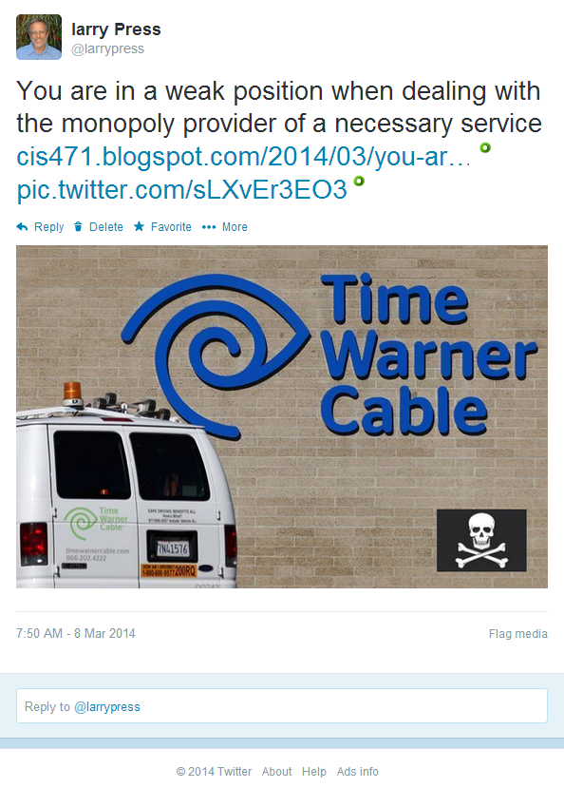
This is a permalink to the tweet shown above:
https://twitter.com/larrypress/statuses/442341650673577985
How did I get the permalink?

Slide 20
Resources
Twitter support: https://support.twitter.com/
A video introduction to Twitter: http://screencast.com/t/Sf1wAW8ta
A “Prezi” of the above video: http://bit.ly/fQ3pbK
Another video introduction to Twitter http://www.howcast.com/videos/149055-How-to-Use-Twitter
Book about the use of Twitter in business by tech journalist Julio Ojeda-Zapata: http://yourtech.typepad.com/twitinbiz/
Interview of Juilio Ojeda Zapata on his use of Twitter as a journalist (audio and transcript). http://www.onthemedia.org/transcripts/2008/08/22/06
Introduction to Twitter in business: http://business.twitter.com/
Twitter search in plain English (3m 19s video): http://commoncraft.com/twitter-search
Talk by Clay Shirky, which includes examples of Twitter in citizen journalism: http://cis275topics.blogspot.com/2010/09/how-social-media-can-make-history.html
Interview of Twitter co-founders on their backgrounds, Twitter evolution and plans for the future: http://cis275topics.blogspot.com/2010/09/evolution-and-impact-of-twitter.html

