Slide 1
Excerpt from a talk by Michael Wesch
Skills: none
Concepts: student expectations in a classroom, the role of networked applications in encouraging discussion
This work is licensed under a Creative Commons Attribution-Noncommercial-Share Alike 3.0 License.
Notes:
Michael Wesch argues that the architecture of our classrooms shapes students and professors expectations.
He outlines those expectations in a short excerpt from a longer talk, and suggests that the Internet may lead to improved classroom questioning and discussion.

Slide 2
Where does this topic fit?
Skills
Application development
Content creation
User skills
Concepts
Applications
Technology
Implications
Notes:
The presentation deals with possible applications of the Internet in education.
If the Internet improves education, individuals, organizations and society will benefit.

Slide 3
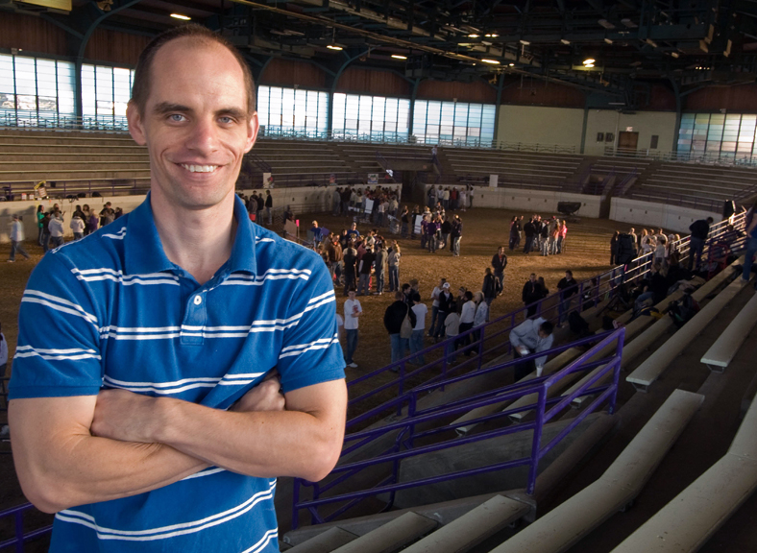
Michael Wesch
A vision of students today (4 m 45 s)
Notes:
This is Michael Wesch, an anthropology professor at Kansas State University.
He is an award winning teacher and a big fan of network applications in teaching and the importance of questions in learning.
He also thinks the architecture of our classrooms – teacher in front of students facing forward – shapes our expectations.
He has made several “viral” videos with his students.
To get to know him a bit, watch “A vision of students today” before continuing this presentation:

Slide 4
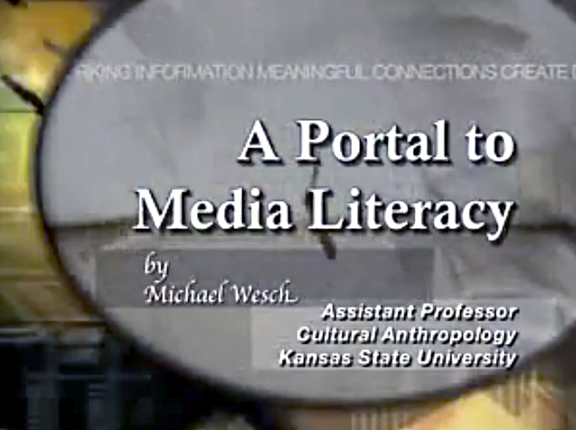
Talking to a room full of professors
University of Manitoba, June 17th 2008
An excerpt from the talk (3m 46s)
Notes:
Wesch gave a talk entitled “A Portal to Media Literacy” to a gathering of professors in Canada.
Pause this presentation now, and listen to the excerpt from his talk.
I’ll give a quick summary of what I heard after you listen to the talk
If you like what you hear, you can listen to the entire talk later.

Slide 5
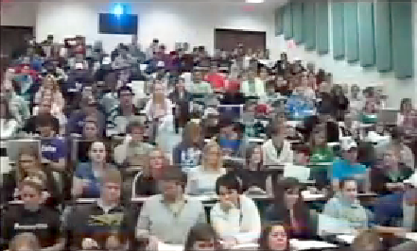
What these walls say
To learn is to acquire information.
Information is scarce and hard to find.
Trust authority for good information.
Authorized information is beyond discussion.
Obey authority.
Follow along.
Notes:
The excerpt began with Wesch asking what the implicit message of the classroom architecture is.
This was his answer – it suggests that professors are responsible for learning and the source of all information presented.
The students are there to soak up what the professor presents and they worry a lot about grades.

Slide 6
Small classes are also affected
Notes:
The message carries over from lecture halls to smaller classrooms where discussion should be possible.
Students act as they do in large lecture halls.

Slide 7
Good questions lead to good discussion
What does Wesch think of these questions?
Notes:
The key to good discussion and learning is asking good questions.
These questions are typical, and Wesch doesn’t like them – they focus on grades and minimizing work.
Not on learning.

Slide 8
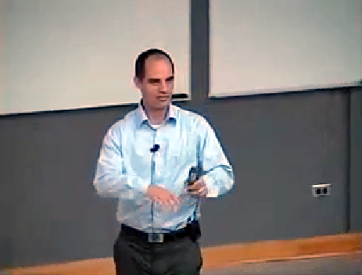
Wesch thinks the Internet might help
How might we use the Internet in our class?
Notes:
Wesch concludes the excerpt on an optimistic note – he thinks the Internet will improve the situation.

Slide 9
Can network applications foster discussion?
List servers
Threaded discussions
Blog comments
Wikis
Google Docs
Teleconferences
Facebook
Other applications and services?
Notes:
Do you agree – can network applications like these facilitate discussion and learning?

Slide 10
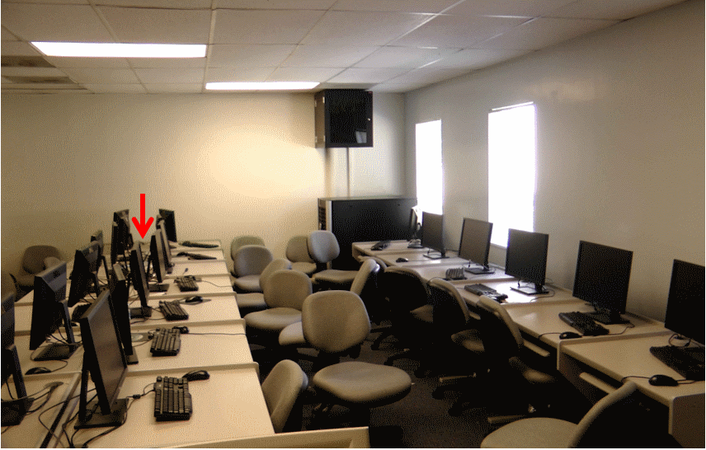
How a broken projector improved my class
Notes:
When the projector in my classroom broke, the students and I all gathered around a single computer (arrow).
We covered the material I had planned for the day, but the altered seating arrangement made the class more lively and informal.
I am not sure if the students learned or retained more, but I am sure we all had a better time.

Slide 11
Self-study questions
How did listening to Michael Wesch make you feel? Do you recognize yourself in what he says?
What stops you from participating in class discussion?
What could you tell Michael Wesch? Could you discuss his talk with him?
I summarized the talk – what did I say that you disagree with?
Which online discussion tools have you used? What were the pros and cons of each relative to fruitful discussion?
Wesch stresses the importance of asking good questions. What other questions might I have asked about this talk?

Slide 12
Resources
An excerpt from “A portal to media literacy” (3m 46s):
http://som.csudh.edu/fac/lpress/recording/weschdiscussion/weschdiscussion.html
A portal to media literacy (the entire talk 1:06:12): www.youtube.com/watch?v=J4yApagnr0s
A vision of students today (4 m 45 s)
http://www.youtube.com/watch?v=dGCJ46vyR9o&feature=player_embedded
About Michael Wesch
http://ksuanth.weebly.com/wesch.htm
A blog post on the characteristics of today’s students:
http://cis471.blogspot.com/2008/03/characteristics-of-todays-students.html
Server

