Slide 1
Evolution of a wiki page
Skills: none
Concepts: wiki evolution (two examples), page edit options
This work is licensed under a Creative Commons Attribution-Noncommercial-Share Alike 3.0 License.
Notes:
We’ll look at the evolution of a Wikipedia page from a single sentence into a 1,600 word document with six sub-headings and over 1,000 authors.
Our intent is to convey a feeling for the way in which a wiki can evolve.
We’ll also review the types of change one can make when editing a page.

Slide 2
Where does this topic fit?
Internet concepts
Applications (wiki)
Technology
Implications
Internet skills
Application development
Content creation
User skills
Notes:
This presentation concerns an application, wikis.

Slide 3
The heavy metal umlaut
Notes:
I’ll use the Wikipedia page on the heavy metal umlaut as our example of page evolution.
(You’ll see why I picked this page below).
In case you don’t know what an umlaut is, it’s the two dots over a letter, like in the logo of the heavy metal band, Motörhead.

Slide 4
April 15, 2003
The "heavy metal umlaut" over the ö in the names of Motörhead, and the Blue Öyster Cult has led to the term "spandex and umlaut circuit" being used to describe the heavy metal band touring scene.
http://en.wikipedia.org/wiki/Metal_umlaut
Notes:
The Metal Umlaut page in Wikipedia began with a single sentence posted by an anonymous author on April 15, 2003.
Pause for a minute to check the page today before you go on with the presentation.

Slide 5
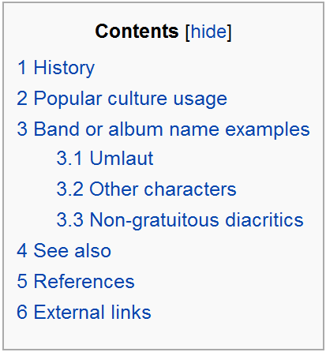
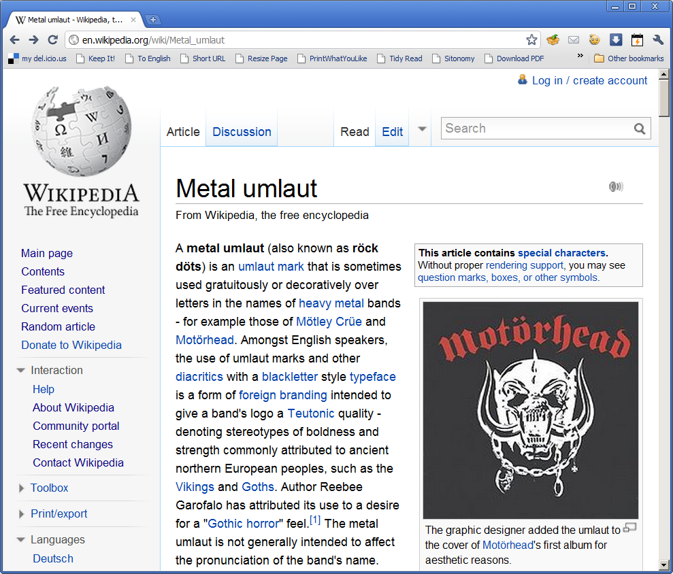
Today
Notes:
This is the page today.
It’s just under 1,600 words long, and has six sub-headings and three sub-sub headings.
It’s been edited over 1,600 times by 1,023 different authors.
Two of those authors have made 50 or more changes, but most (767 of them) have made only one change to the page.
People are still following the page.
It was viewed 8,757 times during January 2011.
I gathered these statistics using the External Tools in the Edit History page of the article.

Slide 6
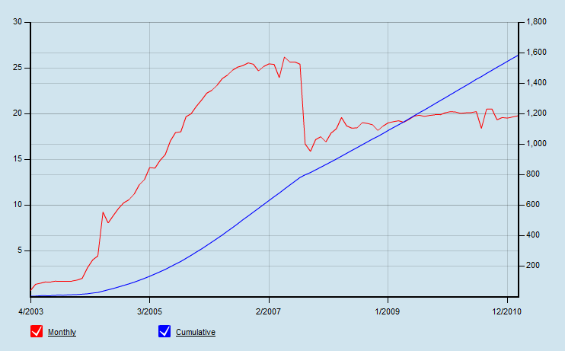
Article size over time
Notes:
This graph shows how the size of the article has changed over time.
As you see, it was just under 1,600 words long at the end of 2010.
The number of words added in a typical month rose through early 2007, and has now leveled off to around 20 words per month.

Slide 7
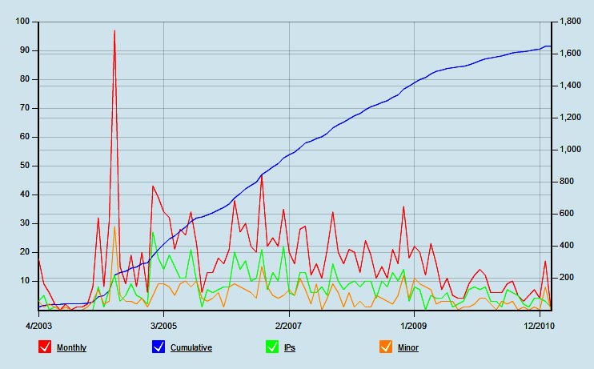
Number of edits over time
Notes:
This graph shows that there have been over 1,600 edits since the page was created.
The red line shows the number of edits per month.
As you see, activity spiked in 2004 then dropped off.
The green line shows the number of unique addresses from which edits were made.
The number of edits is greater than the number of editors in any month, indicating that there are “conversations” among those making the changes.
This was particularly notable when edits spiked.
Minor edits are shown in ochre.

Slide 8
Vandalism on June 26, 2004
Time | Author | Action
21:51 |  | the article is clean
23:20 | Dj28 | Add one obscene sentence
23:20 | Mirv | Delete the obscene sentence
23:22 | Dj28 | Add several obscene sentences
23:23 | Mirv | Delete the obscene sentences
23:24 | Dj28 | Add more obscene sentences
23:24 | Mirv | Delete the obscene sentences
Notes:
This vandalism event illustrates Wikipedia’s robustness.
In June 2004, an author named DJ28 added an obscene sentence to the page.
An author named Mirv removed the change almost immediately.
DJ28 tried twice more, but Mirv immediately reverted the changes.
The entire edit war lasted under 2 minutes.
This was possible because Mirv had requested automatic notification of changes to this page, a page that he or she was interested in.

Slide 9
Jon Udell’s video of the article evolution
Original version (8 m 29 s, some X-rated footage)
Edited version (X-rated material hidden)
Notes:
I chose the Metal Umlaut page because Jon Udell has made a time-lapse screencast illustrating its evolution.
The screencast captures the feeling of the evolution, and Udell adds valuable commentary on the sorts of changes he observes.
The links shown here are to Udell’s original video and to an edited version with the obscene words hidden.

Slide 10
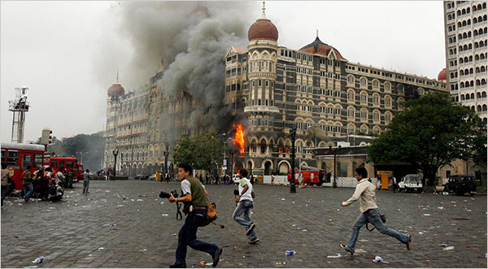
Wikipedia: the Mumbai terrorist attacks
Kensplanet: “The 26 November 2008 Mumbai terrorist attacks were a series of attacks by terrorists in Mumbai, India. 25 are injured and 2 killed.”
Notes:
Citizen journalists frequently report on Wikipedia and the pages evolve rapidly as events unfold.
Take for example, the Wikipedia article on the 2008 Pakistani terrorist attacks in Mumbai, India.
The topic began with two sentence posted by “Kensplanet” at 18:20 on November 26, 2008.
He revised his initial post 5 times during the next ten minutes, then others began to contribute.
The situation escalated rapidly and many people observed the events and edited the wiki during the next day.

Slide 11
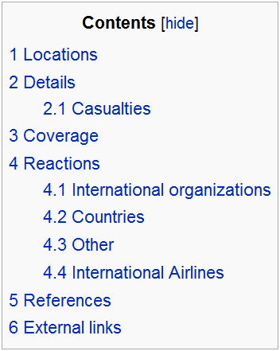
Wikipedia after 21 hours 44 minutes
4,780 words
942 edits
149 anonymous
93 unidentifiable
Notes:
By 15:44, 27 November 2008, the article was 4,780 words long with many links.
During this time, there had been 942 edits.
199 people had made only one edit, but two contributors had made over 50.
“Kensplanet,” who started the article, had made 57.
The organization of the article had evolved from two sentences to 6 major sections with 5 sub-sections.
Today the article is longer and more complex.

Slide 12
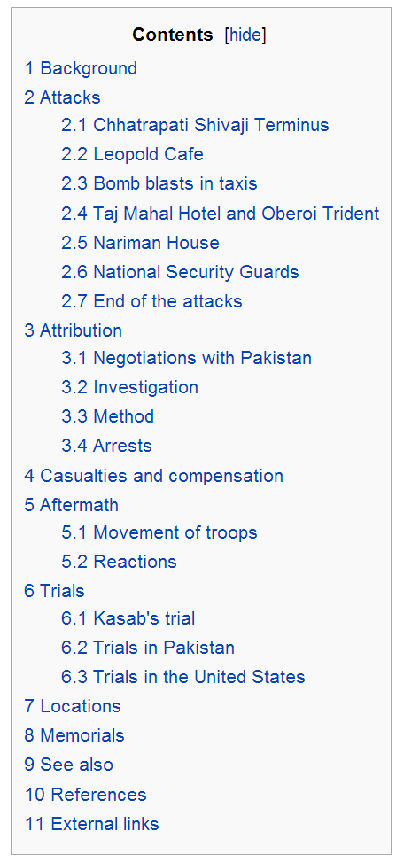
Subsequent refinement
Notes:
Collaboration using Wikipedia continued after the initial news coverage.
Today (October 10, 2012) the article is much longer and more complexly organized.
It contains analysis as well as reporting and includes links to hundreds of other documents and 197 references.
As you see here, it is regarded as quite thorough, objective, complete and well written.
That is noteworthy given the divisions of opinion between many Indians and Pakistanis.
No doubt it will continue growing in length and complexity.

Slide 13
Summary
Notes:
We’ve seen the evolution of a Wikipedia page from a single sentence to a complex document.
Over 1,000 authors have edited the page, and most of their changes were improvements.
We concluded by listing several ways in which one can improve a wiki page when editing it.

Slide 14
Self-study questions
Has the Metal Umlaut page improved over time (explain)?
I listed several ways to improve a wiki page, from simple things like correcting a spelling error to complex things like reorganizing the page. How many do you recall?
I found the statistics for this presentation using the External Tools on the Edit History page of the article. Go to the Edit History page of a Wikipedia articles and find the External Tools. Write a short description of what each does.

Slide 15
Resources
Wikipedia article on the Metal Umlaut:
http://en.wikipedia.org/wiki/Metal_umlaut
Jon Udell’s video of the evolution of the Metal Umlaut page (8 m 29 s):
http://jonudell.net/udell/gems/umlaut/umlaut.html
Udell’s video with the X-rated comments hidden:
http://bpastudio.csudh.edu/fac/lpress/471/hout/apps/udellpg849x637/udellpg849x637.html

