Slide 1
Using a wiki
Skills: using a wiki
Concepts: operations common to all wikis, wiki administration, “freemium” business model
This work is licensed under a Creative Commons Attribution-Noncommercial-Share Alike 3.0 License.
Notes:
We will see how to work with a wiki – how to create a new page, edit a page, discuss a page, view the history of a page and revert to previous versions and request notification when a page changes.
We use the Wikispaces service to illustrate these operations, but they are common to all wikis.
We will conclude with a brief look at wiki administration and Wikispace’s “freemium” business model.

Slide 2
Where does this topic fit?
Internet concepts
Applications
Technology
Implications
Internet skills
Application development
Content creation
User skills
Notes:
We will review the common operations in creating a wiki application.

Slide 3
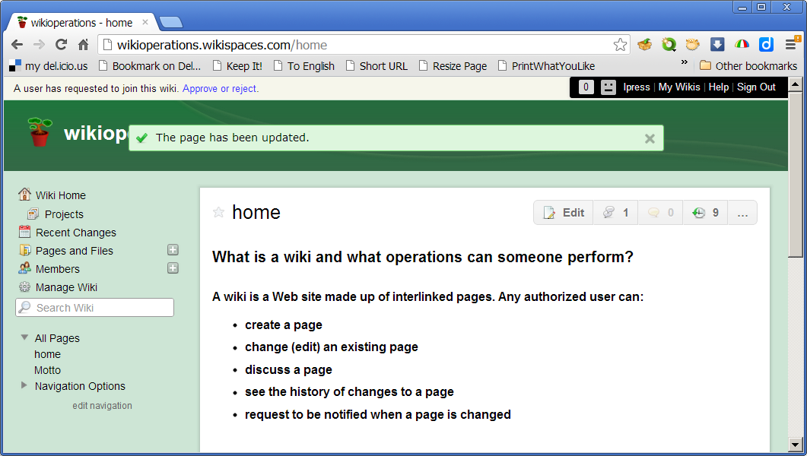
Five common operations
Notes:
All wikis provide these operations.

Slide 4
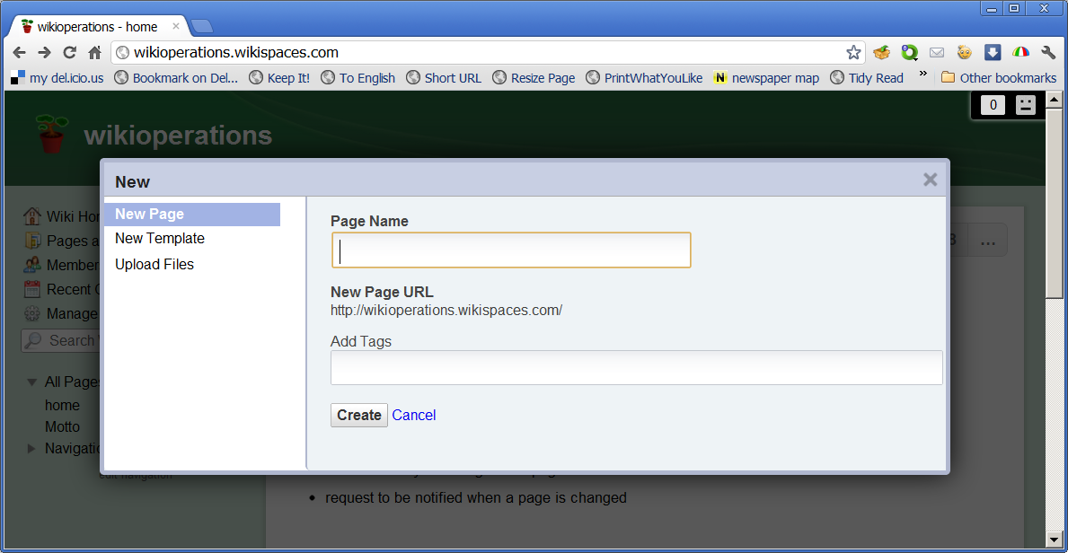
Create a new page
Notes:
When you click on the plus icon to create a new page, you see this form.
All you have to do is give the page a unique name.
That name will be used to create the Web address (URL) for the new page.
Each page has its own URL, making it easy to link to from other wiki pages or other Web sites.
Note that you can also add keyword tags to a page for later retrieval.
For example, if you have a wiki about baseball, you could add the tag Dodgers to pages that relate to the LA Dodgers.
When you click Create, you will be taken to the word processor view, where you can enter any content you wish, clicking Save when you finish.

Slide 5
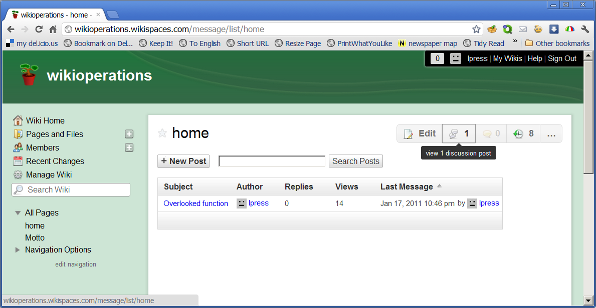
Discuss a page
Notes:
Clicking the Discussion icon, brings up a discussion forum for the page.
If you make a major change, it’s a good idea to explain why you did it.
If you and your colleagues are uncertain how to approach a topic, work it out in the discussion forum.
If there’s a controversy over something on the page, work it out here too.
Don’t get into “edit wars” – in which one person makes a change and another deletes it.
Use the discussion page to arrive at a consensus.

Slide 6
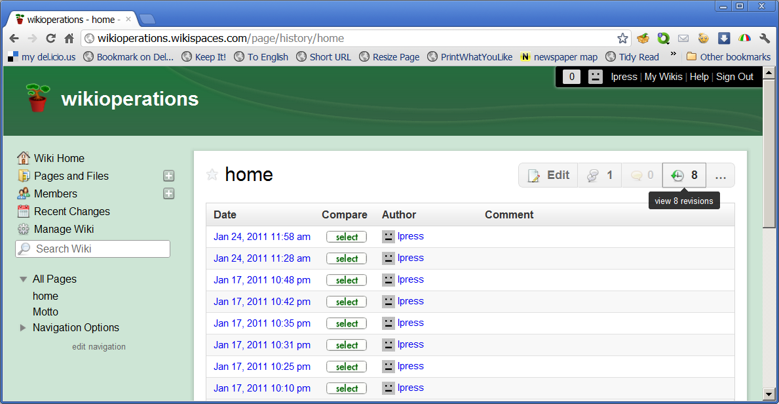
View revision history
Notes:
The history page is another collaboration aid.
Clicking the History icon displays a list of all previous edits, showing their dates and authors.
If someone makes a mistake or vandalizes a page, it can be reverted to a previous version with a single click.

Slide 7
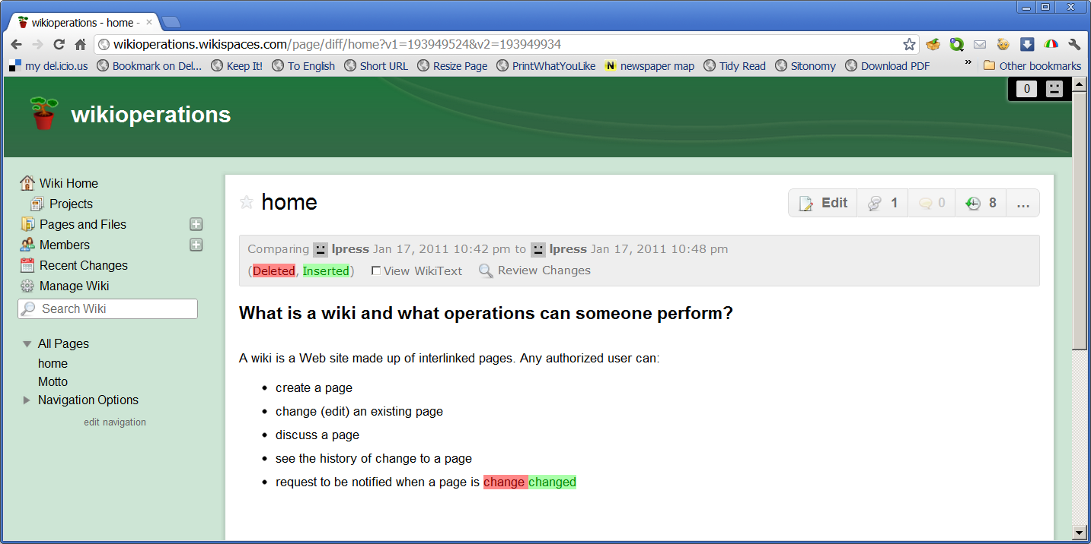
Compare previous versions
Notes:
You can also compare any two versions of the page.
Here we see the additions (shown in green) and deletions (red) I made when I corrected a typo and added the discuss operation.
It’s easy to see what someone did when they edited a page.
If someone has vandalized the wiki or made an inappropriate change, you can revert to any previous version with a single click.
If you do that, you should enter a discussion comment stating why.

Slide 8
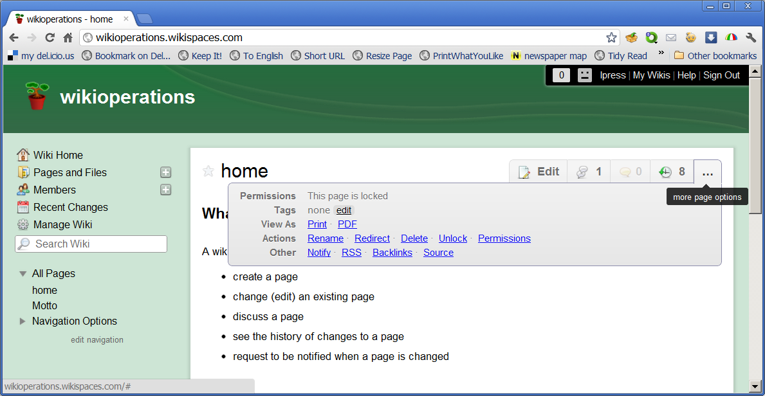
Other options
Notes:
Clicking on the ellipses brings up other options as shown here.
You can explore them on your own, but let’s take a look at one, Notify.

Slide 9
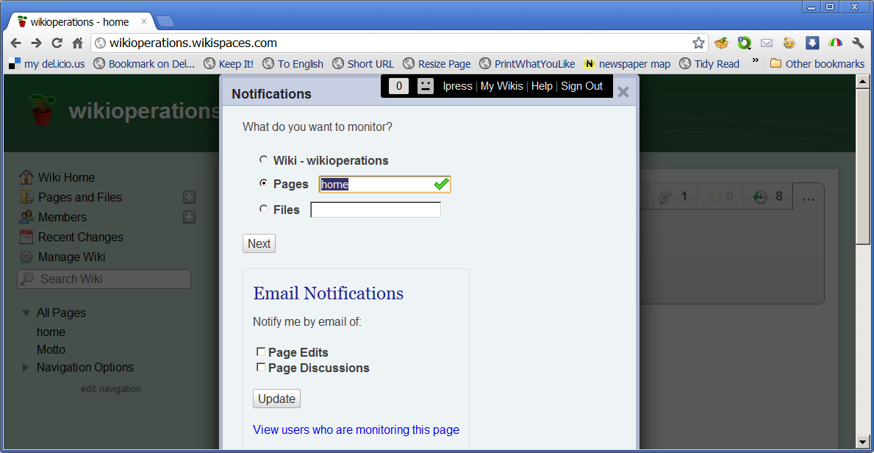
Change notification
Notes:
As shown here, you can elect to be notified whenever the wiki is changed, when a specific page is changed or when a specific file is changed.
Notification can be through email or an RSS subscription.
Wikipedians keep up this way.

Slide 10
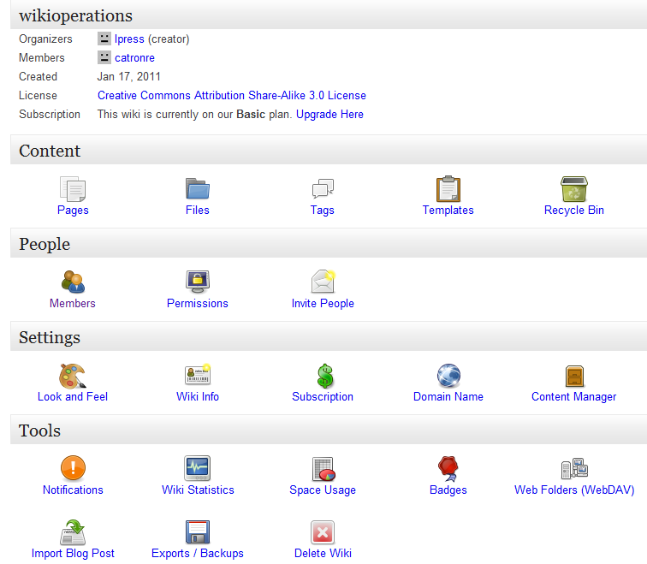
Wiki administration
Notes:
This is the wiki administration page.
You get to it by clicking Manage Wiki in the navigation column on the left side of the screen.
The wiki administrator can do many things, for example, set access and editing permissions for users, change the appearance – the colors and layout – of the wiki, see usage statistics like page views, lock, unlock and delete pages, and even delete the entire wiki.

Slide 11
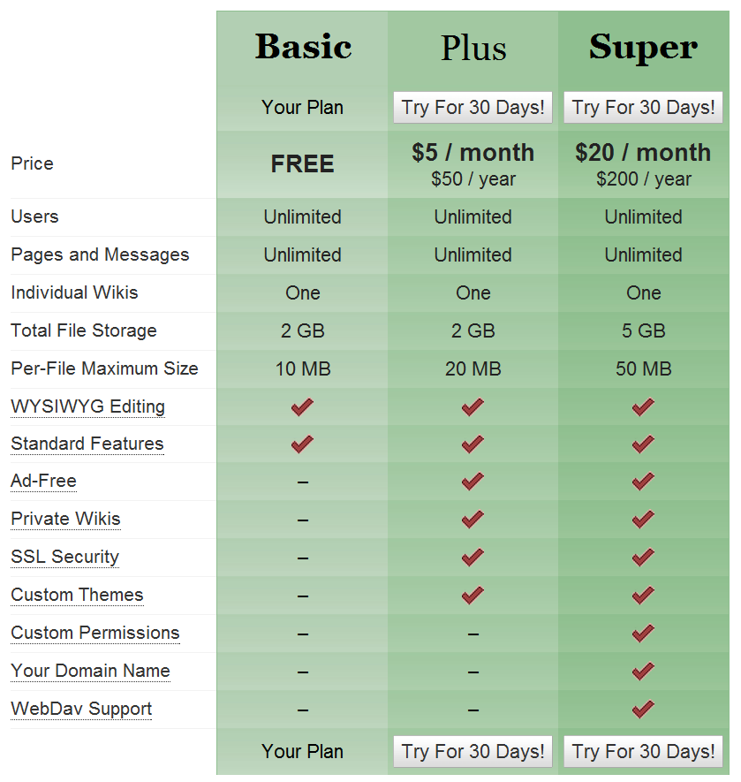
The freemium business model
Notes:
Basic wikis are free on Wikispaces.
Free wikis may be viewed by the general public, so they can make money by advertising on them.
They also make money by charging a monthly fee for wikis with premium features, like being ad free.
Offering a free basic service and charging for premium upgrades is called a “freemium” business model.
Content sites often do something similar.
They will present limited content for free, and charge for expanded content.
For example, a magazine might display one article each month and charge for access to the others.
Other content sites charge a subscription fee for access.

Slide 12
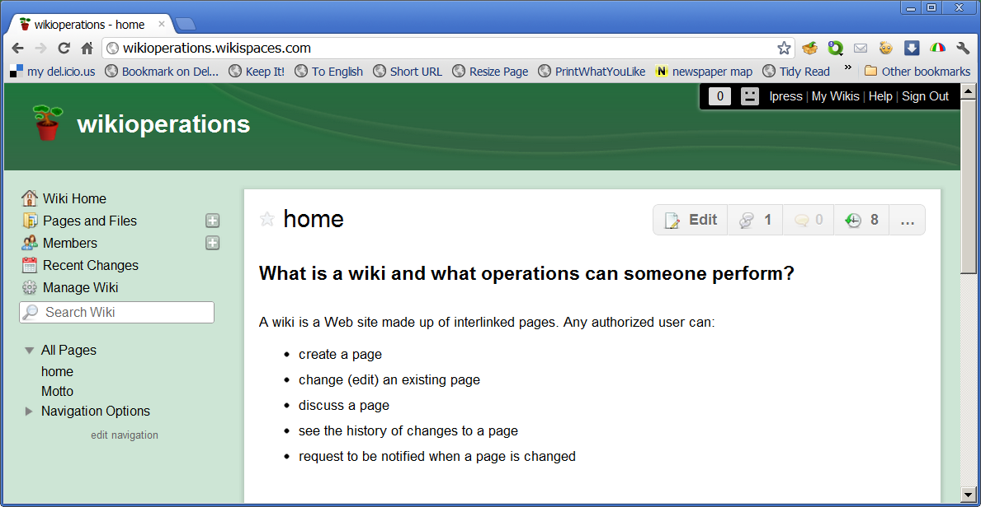
Summary
Notes:
We’ve reviewed the features that are common to all wikis using Wikispaces as an example.
We also took a quick look at Wikispaces administration options and business model.

Slide 13
Self study questions
Every wiki service provides five operations. Without looking back, do you recall them?
What are the three steps in editing a page?
Is a wiki a one-many medium?
Wikipedia is useful, but can you find other useful wikis on the Web?
The administrator of a private wiki can view a list of members – what other member operations are available?
How would the same operations apply to a shared Google Doc?
Notes:
250 5 ave – n of rose east of rose 310-3962200

Slide 14
Resources
Introduction to Wikispaces (2m 1s):
http://www.wikispaces.com/content/wiki-tour
Wikis in Plain English (3m 40s)
http://commoncraft.com/video-wikis-plain-english
The demonstration wiki used in this presentation:
http://wikioperations.wikispaces.com/
Wikispaces help wiki, including videos:
https://help.wikispaces.com/
The Hawaiian busses that gave wikis their name:
http://en.wikipedia.org/wiki/Wiki_Wiki_Shuttle

