Slide 1
Collaborative writing
Skills: organizing and starting a collaborative writing project
Concepts: compiled versus co-authored documents, structured versus unstructured data, wiki evolution, synchronous and asynchronous collaborative writing tools, Doug Engelbart’s contribution
This work is licensed under a Creative Commons Attribution-Noncommercial-Share Alike 3.0 License.
Notes:
Collaborative writing is more common on the Internet than in print.
It’s also more complex than individual writing because you must decide how to organize the effort and how to start the document.
We’ll look at some examples of collaborative documents and tools for creating them and different ways to organize a writing project.
We will distinguish between synchronous and asynchronous collaboration and mention the contribution of Doug Engelbart.

Slide 2
Where does this topic fit?
Internet concepts
Applications
Technology
Implications
Internet skills
Application development
Content creation (text)
User skills
Notes:
This presentation deals with content creation.

Slide 3
Collaborative writing examples
A collection of independent articles like Wikipedia
An article or report written by two or more people
The manual for a program
The evolving plan for a project
The description of an event as it is occurring
Students sharing lecture notes
Students compiling a list of points needing clarification (What was confusing in today’s lecture?)
Students compiling a list of possible exam questions
Students co-authoring a term paper or answering an essay question
Students gathering examples of valuable resources on the Internet
Let’s look at a couple of examples …
Notes:
Collaborative writing may be done by a small team or a large group.
These are a few examples of documents written by groups of people.
Note that several of the examples are by students in a class.
You might want to do some of these yourself.
Let’s consider some ways you might work.

Slide 4
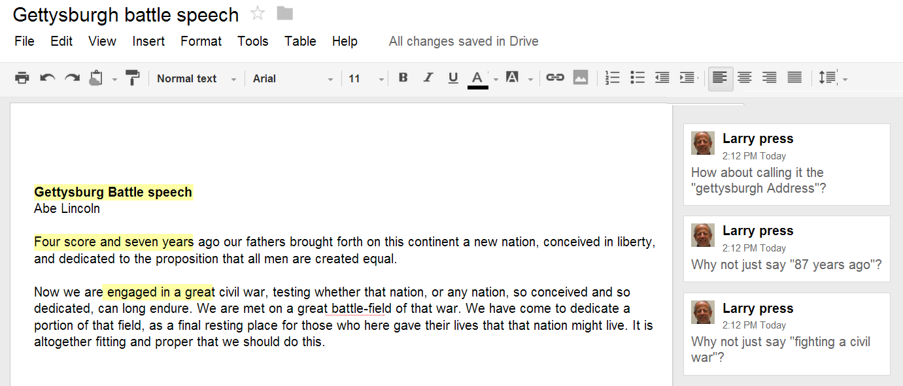
Primary author retains control
Shared document word processor
Notes:
In this example, Abe Lincoln is the primary author, and he has invited Larry Press to give him feedback.
Abe retains control and responsibility.
This example uses Google Docs and is shared online, but stand alone word processors like Microsoft Word have even more elaborate discussion/comment facilities.
Using a stand alone word processor requires that the co-authors email the corrected version of the document to their colleagues or post them in a common spot.

Slide 5
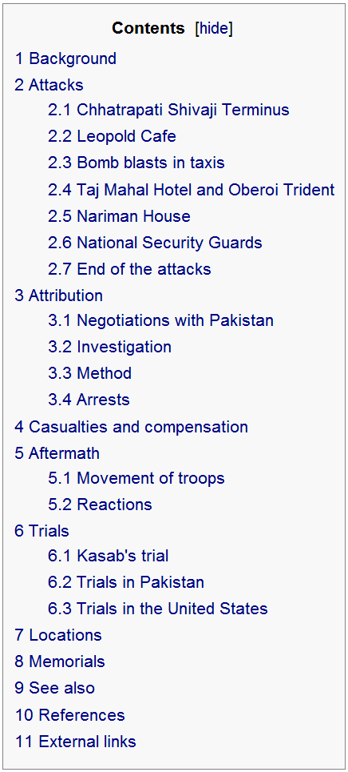
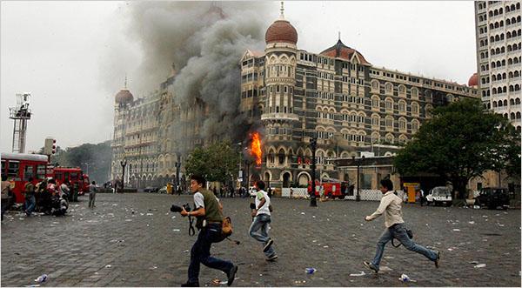
Joint authors, no structure
Began with a single sentence:
“The 26 November 2008 Mumbai terrorist attacks were a series of attacks by terrorists in Mumbai, India. 25 are injured and 2 killed.”
Today:
Notes:
This Wikipedia article on the Mumbai terrorist attack began with a single sentence.
There was no single author and no initial structure.

Slide 6
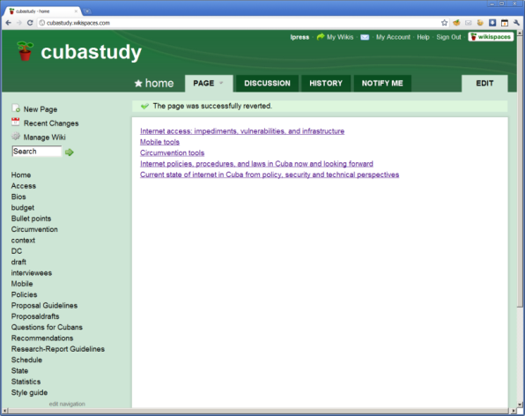
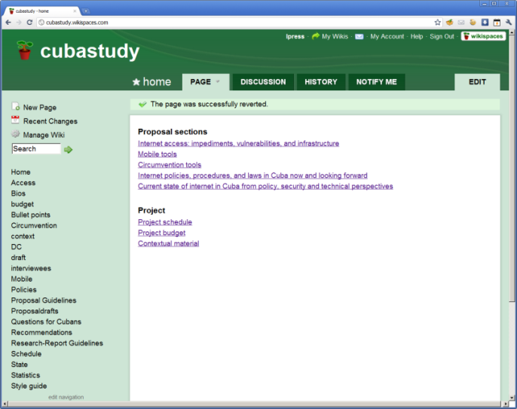
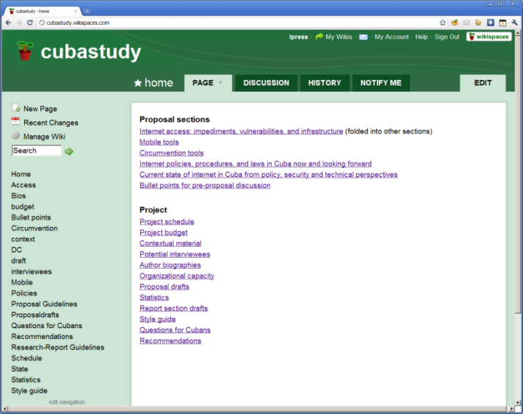
One person in charge of structure, team contributes
August 13, 2010
August 27, 2010
December 3, 2011
Notes:
This wiki was set up to support a study of the Internet in Cuba.
There were four collaborators, but one person controlled the overall structure.
When the wiki was established in August 2010 it had a home page and five sub pages.
At first we were only working on a proposal.
When the proposal was funded on August 27, we reorganized the wiki, separating proposal pages from project pages.
By the completion of the project in December 2011, an extra page had been added to the Proposal section and the Project section had expanded from three to twelve pages.
Of course, each of those twelve pages links to other pages and documents.
One of those links was to the final report, which was submitted to the sponsor on December 3, 2011.
For an excellent video on the evolution of a wiki, see the resource link to Jon Udell’s video at the end of this presentation.

Slide 7
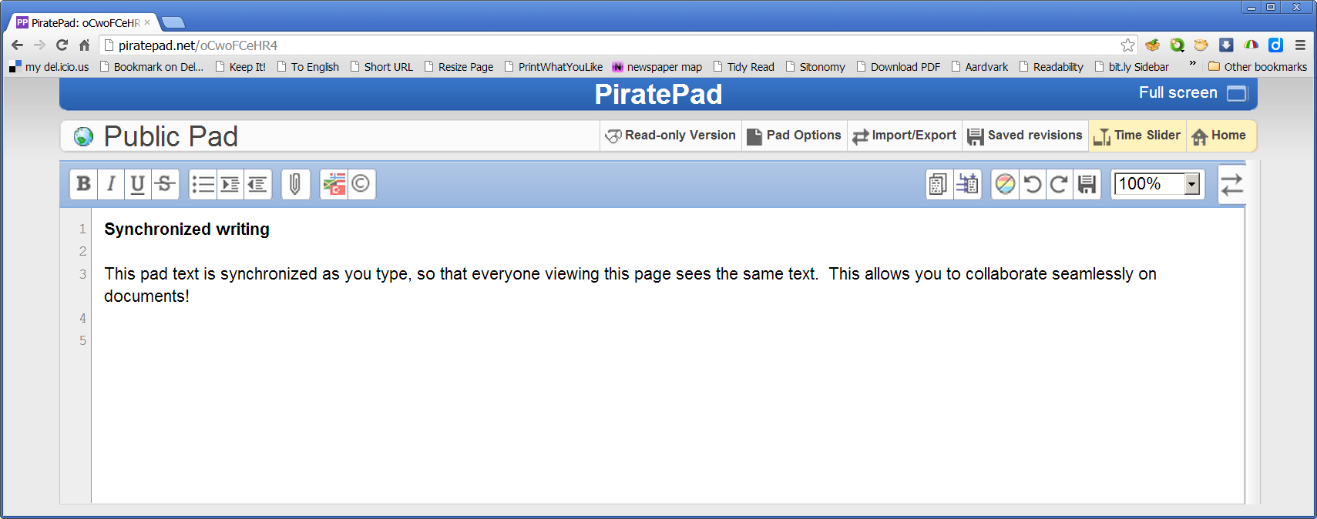
Synchronous writing
http://piratepad.net/front-page/
Let’s try it.
Notes:
We have been speaking of asynchronous applications, but people have also tried synchronous writing.
Google bought Etherpad, a synchronous writing program, but dropped support and open sourced it.

Slide 8
A synchronous collaboration example
Audio description of synchronous collaboration (1m 46s)
Notes:
Wikis are typically used asynchronously, but they can be used synchronously as well.
In this short audio clip, a man describes his routine collaboration with a distant colleague.
Note that they share a wiki, but work synchronously.
Listen to the audio several times until you have a clear picture of how they work together and of the tools they use.

Slide 9
Compiled and co-authored documents
Chapter 1
Chapter 2
Chapter 3
Notes:
The simplest way to organize a collaborative writing project, is to divide the document into sections and assign one person to each.
This could be a written document with chapters or a database where people independently add records.
A variation on this theme is to have each person write a first draft, then allow others to make suggestions for changes or edits.
With a co-authored document, like a Wikipedia page, every author is free to make suggestions and edits.

Slide 10
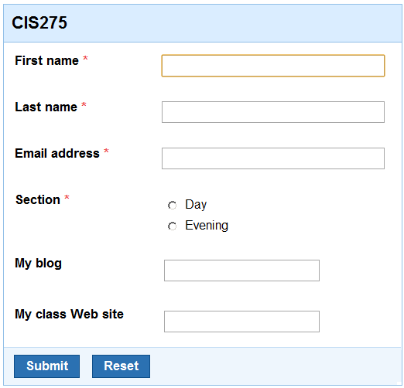
Light and tight structure
Wiki or word processor
Database
Title
Introduction
History
Description
Recommendations
Notes:
A project might begin with a blank page or a page with a sentence or two, but one often begins with some sort of structure.
The most highly structured would be a database in which authors complete and edit records in a strict format.
A starting outline is less constraining, but still lends some organization to the document.
You might also decide to change the outline itself during the project, for example adding a new section or dividing a section into two parts if it gets too long.

Slide 11
Preliminary meeting
Notes:
Most collaborative writing projects begin with a meeting -- face to face or online – to organize the project.
You have to decide which tools to use, how to organize the team, and how to start the writing process.

Slide 12
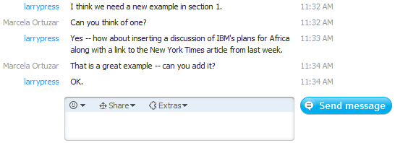
Side discussion is necessary
Notes:
Collaborative writing requires a means of discussion other than the document itself.
Authors must be able to talk about the document as well as edit it.
They may need to resolve a conflict, explain why they made a change, decide on who will add a section, and so forth.
Side discussion is necessary regardless of how it is done.
This slide shows some side discussion tools – voice over the Internet using Skype, email, the discussion page on a wiki, face-to-face conversation, Internet chat or any other means.
Now let’s look at some collaborative writing tools, starting with asynchronous tools – tools where collaborators work at different times.

Slide 13
Improve the document with every edit
Fix a typo or spelling error
Fix a grammatical error
Rewrite an awkward or ambiguous sentence
Add a reference
Add a link
Add a clarifying example
Add a new section to the document
Reorganize or rearrange the document
Notes:
Every time you edit a co-authored document, you should improve it in some way.
It might be something simple, like fixing a spelling or grammar error.
Or you might add something like a clarifying example or a link or reference to another document.
You might even modify the organization of the document, perhaps adding a new section or rearranging it.

Slide 14
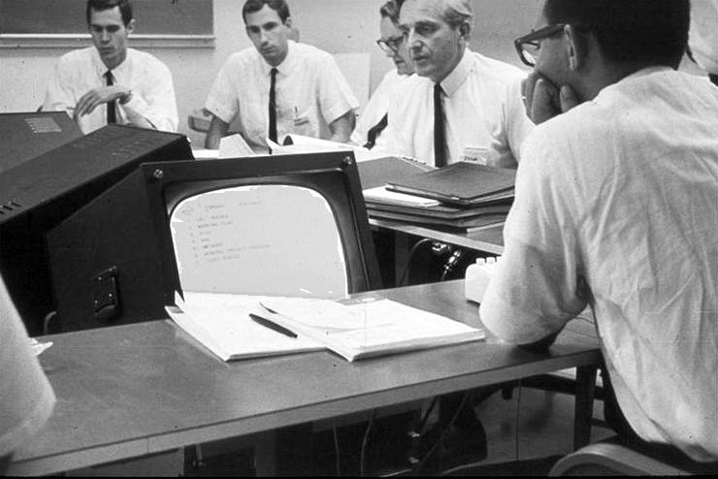
Same time, same place
Doug Englebart, a computer augmented meeting
Notes:
We can also use networked computers for collaborative writing when in the same place at the same time.
This picture was taken Doug Engelbart’s lab in the mid 1960s.
Engelbart invented many of the tools we take for granted today – windowed user interfaces, the mouse, word processing with formatting on the screen and many other tools for individual and group productivity.
(photo: http://gcc.upb.de/www/WI/WI2/wi2_lit.nsf/KPoolKeywords/B317D00B9D22344D41256575003EEF04?OpenDocument)

Slide 15
Collaborative writing tools
 | Same time (synchronous) | Different time (asynchronous)
Same place | Shared screen in class or conference room
Different place | Teleconference with shared document | Wiki, Google Doc and other word processors, shared data base
Notes:
We can classify collaborative writing tools as to whether they are used synchronously or asynchronously and at the same or different place.
Wikis, word processors and shared databases can be used at the same time, but they are generally used asynchronously.
Screens may be shared by collaborators who are in the same room (like a classroom or business meeting room) or geographically dispersed.

Slide 16
Summary
Notes:
We’ve seen various types of collaboratively authored documents– structured and unstructured, co-authored and compiled.
We also saw several synchronous and asynchronous writing tools, and learned a bit about the contributions of Doug Engelbart.
Regardless of the type of document you write or the tools you use, you should strive to improve the document with every edit, and we saw an example of the evolution of a wiki.
Finally, you’ll need a planning meeting and some sort of side-communication channel to discuss your work.

Slide 17
Self-study questions
What is the difference between compiled and co-authored documents?
What is the difference between structured and unstructured documents?
Have you written anything in collaboration with someone else? If so, what was it and how did you organize the project? How did you divide the work? Did you run into any practical or people problems?
How might the students in your class use a wiki to share knowledge and effort and improve the learning process?
List the collaboration tools used by the man in the audio you listened to and state what each is and how he and his colleague use them.
Google Doug Engelbart and list some of the tools he invented that you use today.

Slide 18
Resources
People are trying to find ways to contribute to structured documents in discussion of political issues and legislation. None have been particularly successful to date, but here is a link to further discussion.
Engelbart, Douglas C.; English, W. K.: A research center for augmenting human intellect, in: Proceedings of the Fall Joint Computer Conference, San Francisco, Calif., Dec. 9-11, AFIPS, Reston, VA 1968:
http://www.dougengelbart.org/pubs/augment-3954.html
Video of the highly influential demonstration of Engelbart’s work at the above conference:
http://sloan.stanford.edu/MouseSite/1968Demo.html
List of Etherpad servers: http://etherpad.com/
Topic module featuring Jon Udell’s video on the evolution of a wiki page:
http://cis275topics.blogspot.com/2011/02/evolution-of-wiki-page.html

