Slide 1
Writing short documents
Skills: short document writing technique, tips
Concepts: types of Internet writing
This work is licensed under a Creative Commons Attribution-Noncommercial-Share Alike 3.0 License.
Notes:
We are covering three general types of Internet writing – conversational and collaborative writing and the writing of short documents.
This presentation focuses on techniques for improving our short documents.

Slide 2
Where does this topic fit?
Internet concepts
Applications
Technology
Implications
Internet skills
Application development
Content creation (text)
User skills
Notes:
This topic falls under content creation – creating text content.

Slide 3
Internet writing
On the Internet we
Write short documents
Co-author documents
Participate in written conversation
The Internet has made writing more important than it was before.
Notes:
This presentation focuses on writing short documents.
We write many documents on the Internet, but they’re typically short – an email, Web page, blog post or tweet rather than an article or report.
Writing good short documents takes time – first drafts are seldom finished documents.

Slide 4
Short document examples
A blog post or comment
A tweet or Facebook wall note
The initial message in an email conversation or a new thread in a discussion forum
The initial post on a Wikipedia topic or your own wiki
A press release
The “about” page on a blog or Web site
Class notes for a day or on a topic
A description of your background in an Internet profile
Notes:
We are constantly writing short documents on the Internet.
I’m sure you’ve written email messages.
How many of these others have you written?

Slide 5
Internet reading -- bad news and good news
People scan Web pages, reading quickly and superficially.
You have an advantage if you read important things carefully.
You have an advantage if you write with people’s reading habits in mind.
Notes:
One cannot write well on the Internet without being aware of the way people read.
People don’t generally read carefully -- they glance, skim and quickly click away.
Keep those reading habits in mind when writing.
Furthermore, you should read important things carefully, even if others do not.
Doing so will give you an advantage over careless readers.
Let’s look at some tips for writing short documents.

Slide 6
Notes:
I write a lot of short documents.
Let me give you a few tips based on my experience.

Slide 7
Before you start writing
Think about the reader.
Read carefully before you write.
Notes:
Before you write a first draft, take some time to think and read.
Think about your readers – what’s their background and what’s their interest in your topic? Write with them in mind.
If you’re responding to a request or assignment, read it carefully, and let it shape your response.
Don’t ignore parts of it and don’t get off the subject – we tend to free associate when writing.
If you’re responding as part of a conversation, read the previous statements carefully.

Slide 8
First
Drafts
Notes:
I guarantee that your first draft is bad.
Save time for revision.
Set the draft aside for as long as you can.

Slide 9
Review and revise
Every sentence and word counts – shorten when revising.
Read out loud in addition to spell and grammar checking.
Get feedback from someone else.
Notes:
Question every sentence in a short document – why did you include it? Is it necessary? Can you shorten it? Should it be moved?
Read the draft aloud – your ear will hear things that sound bad.
Get someone else to read it and give you feedback.

Slide 10
Focus on the title and first sentences
1
Notes:
Remember that people read superficially on the Internet.
Pay particular attention to the title and first sentence.
If the title and first sentence don’t sound interesting and relevant, the reader may click away from your document.
Let them know what you are writing about and why it is relevant to them.

Slide 11
Don’t forget, it’s the Internet
Search terms
Links
Pictures, tables, bullets, etc.
Stay “above the fold.”
Notes:
If you want search engines to find your document, use typical search terms in the title and first sentence.
Keep it short by adding links to other documents for those who want more details.
Be sure your link text gives the reader an accurate picture of what they will find if they click on it.
Include a picture, table or bulleted list in an Internet document if it would focus the reader’s attention.
Put the important things in the first screen – readers scroll infrequently.

Slide 12
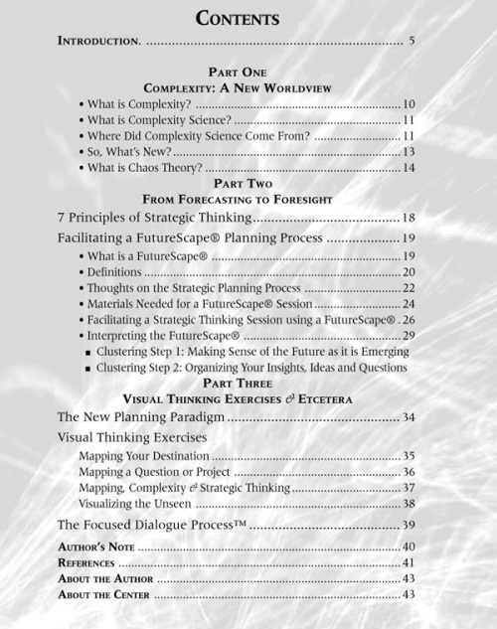
Internet writing is easily copied
Notes:
A final characteristic of Internet writing is that it is easy to copy and spread around, so only write things you’re proud of.
You’re responsible for what you write and it reflects on you.

Slide 13
Take pride in what you write
A CIS 275 student blog post:
Would you be proud to have written this?
How many mistakes can you find?
Notes:
People see what you write on the Internet.
Don’t write something you’re not proud of.
This is an example of bad Internet writing.
Pause and look it over – would you be proud to put your name on this?

Slide 14
No pride, no Zen
Six of the 78 words are misspelled – no Zen.
Read each sentence aloud – is it grammatically correct?
Is the last “sentence” a sentence?
Could you make the same points correctly and more clearly?
Notes:
The person packed a lot of errors into a small space.
He did not take the time to run a spell and grammar check.
Perhaps they he was not a native English speaker.
If you are not a native speaker, it is even more important to take the time to check your work.

Slide 15
From the CSUDH course catalog:
CIS 520 - Data Communication for Management (3)
Focuses on the applications and implications of networks for individuals, organizations and society. It covers the historical aspects of networks and their applications, the emerging network applications, and the impact of network applications on individuals, organizations and society.
I did not write this -- could it be shortened?

Slide 16
From the CSUDH course catalog:
CIS 520 - Data Communication for Management (3)
Focuses on the applications and implications of networks for individuals, organizations and society. It covers the historical aspects of networks and their applications, the emerging network applications, and the impact of network applications on individuals, organizations and society.
I did not write this!

Slide 17
In summary, being concise takes time
I would not have made this so long except that I do not have the leisure to make it shorter.
Blaise Pascal
The best way to go fast is to go slow.
Chinese proverb
Go slow now, go fast later.
German proverb
Notes:
We began with a brief discussion of the types of Internet writing and the way people read on the Internet, then went on to give tips on writing short documents.
The bottom line is that it takes time to write a good short document and you should only post things you are proud of.

Slide 18
Summary of tips
Think about the reader -- what are they interested in and what is their background?
Read any instructions carefully before you write.
No first drafts -- revise after a day or two:
Run a spell and grammar check.
Read it aloud.
Get feedback from someone else.
Remember, it is being read on the Internet:
Be concise -- delete redundancy
Focus on the title and first sentence
Make the first screen compelling -- most people click away without scrolling down.
Include links, pictures, tables, bullets, videos, etc.
Take pride in your work!

Slide 19
Self-study questions
I suggested two things to do before writing a first draft – what were they?
I suggested several ideas for revising a first draft -- which do you recall?
I listed several writing tips – what were they?
Which, if any, of those tips are relevant when writing for print instead of the Internet?

Slide 20
Resources
Jakob Nielsen is an Internet usability researcher and consultant who offers many tips on writing for the Internet.
Jakob Nielsen, Writing for the Web, http://www.useit.com/papers/webwriting/
Jakob Nielsen, How users read on the Web:
http://www.useit.com/alertbox/9710a.html
Jakob Nielsen, The world’s best headlines, http://www.useit.com/alertbox/headlines-bbc.html).
Subscribe to Nielsen’s bi-weekly newsletter:
http://www.useit.com/alertbox/subscribe.html

