Slide 1
Creating community with Yahoo Groups
Skills: Using Yahoo Groups, creating a new Yahoo Group
Concepts: Internet service, threaded discussion, message archives
This work is licensed under a Creative Commons Attribution-Noncommercial-Share Alike 3.0 License.
Notes:
Yahoo Groups is an example of an Internet service.
It is a collaboration tool, used for managing threaded discussions.
It goes beyond a traditional list service in that there are different ways to post messages, you can retrieve past messages and store documents and pictures for the group.

Slide 2
Where does this topic fit?
Internet concepts
Applications
Technology
Implications
Internet skills
Application development
Content creation
User skills
Notes:
We will see how to use Yahoo Groups – illustrating a user skill.
We will also see how to create Yahoo Groups.

Slide 3
A tool to support a community with a common interest
Notes:
Yahoo groups are tools to support collaboration and sharing among people with a common interest.
Group members may be the people working on a particular project, taking a class, interested in knitting, members of your family, etc.
Let’s look at using a Yahoo group, then we will see how to create your own.
Yahoo group members can do a number of things.
Perhaps the most important is providing a group list server.

Slide 4
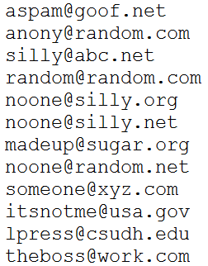
Email list server
Server
Subscriber list
…
Notes:
Email list servers or listservs are one of the oldest Internet applications.
They have been around since 1986 and were in common use by the time the Web was invented.
List servers are very simple -- once you’re subscribed, you can send a message to every other subscriber by emailing it to the server.
The server maintains a list of the email addresses of the subscribers and forwards the incoming message to each of them.
A Yahoo Group is a listserver and more.

Slide 5
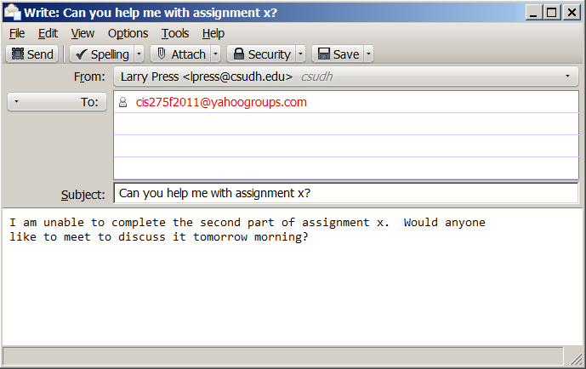
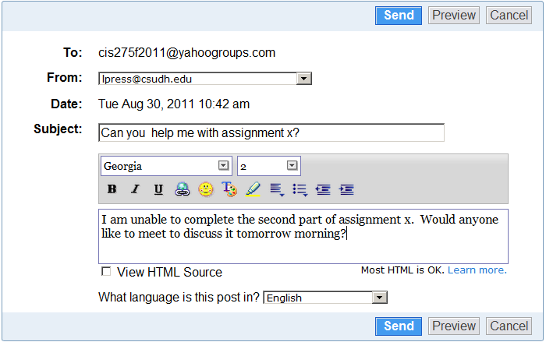
Two ways to send a message to the list
Notes:
Yahoo Groups is a list server and more.
There are two ways to send a message to a Yahoo Group.
You can send an email to the group address or go to the Group Web site and compose the message using a miniature word processing program.
Either way, your message is forwarded to the entire group.

Slide 6
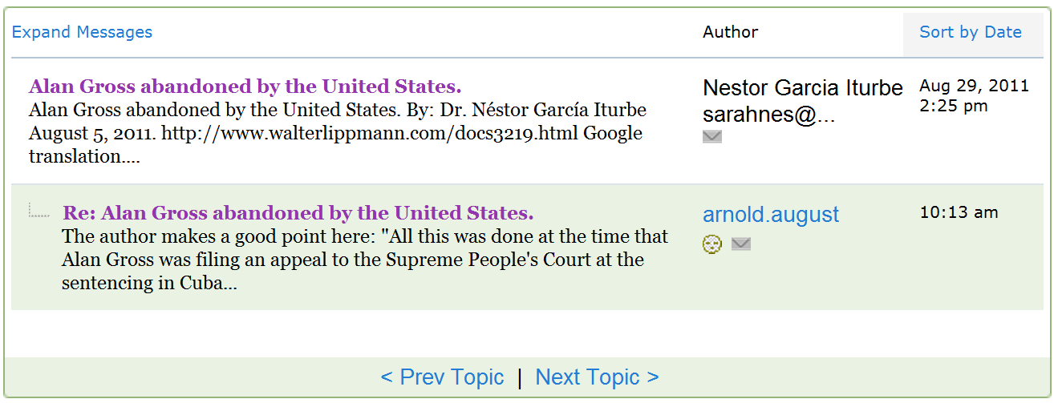
Threaded discussion
Notes:
When you reply to a message, your reply is associated with that message.
The original message plus the replies associated with it are grouped together in a thread.
Yahoo refers to those original messages as “topics.”

Slide 7
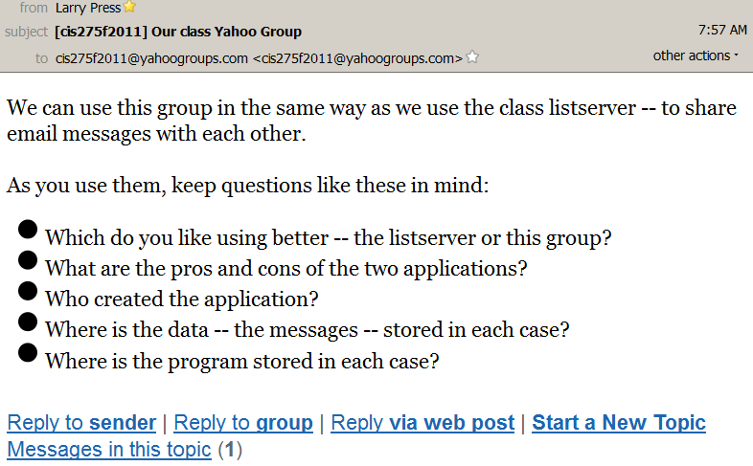
Four ways to respond to a message
Notes:
Here we see a message I sent to our class group.
There are four ways to reply.
To sender: send an email to the person who posted the message, not the entire group
To group: send a message to the group, including it in the topic thread
Via Web post: same as above, but compose the message using the mini-word processor
Start a new topic: start a new discussion thread

Slide 8
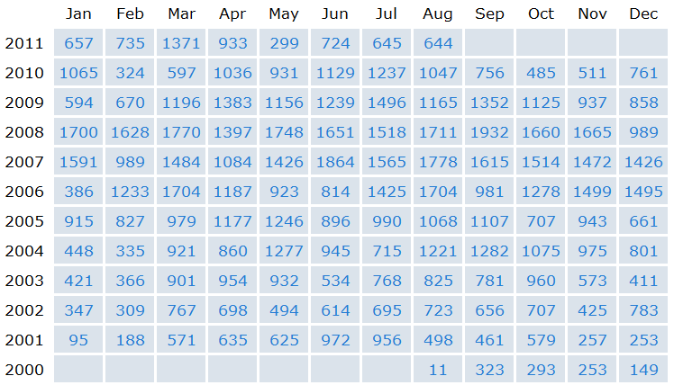
Message archive and other features
Notes:
Yahoo Groups has other features.
For example, messages that have been sent are saved in an archive, and you can retrieve them by author, date or text search.

Slide 9
Message archive and other features
Notes:
You can also post documents and pictures for the group to share.

Slide 10
Create your own group
http://groups.yahoo.com/
Notes:
Developing applications for the Internet can be extremely easy.
The mechanics of creating a Yahoo Group takes only a minute or two and requires no experience.
Start by going to http://groups.yahoo.com/ and creating an account if you do not already have one.
Once you are logged in to your account, creating a Yahoo Group is a simple, three step process.
First you place your group in a category like Education>University>California.
Second you pick a name for your group.
The name will be used in the URL so it must be unique.
Finally, you write a short description of the group and its purpose.
That is all there is to it.

Slide 11
Product development at Facebook (2:11)
Notes:
While the mechanics of setting up a Yahoo Group are easy, designing the group is not.
In this short video, Mark Zuckerberg talks about one tradeoff they made in designing Facebook when it was still exclusively being used on college campuses.
He decided to restrict the groups to people from the same campus rather than trying to include all the students from all campuses on a large group.

Slide 12
Summary
Notes:
The Yahoo Groups service has more capability than a simple list server.
You can send messages to the group by email or the Web, and there are several ways to reply to a message.
Messages on a given topic are grouped together, forming a threaded discussion.
Yahoo maintains a searchable archive of past messages for each group and you can also share documents and pictures with the group.
The mechanics of setting a group up are simple, but designing it is difficult.

Slide 13
Self-study questions
Are old Yahoo Groups messages stored, and, if so, where?
Where is the mini word processing program used in composing messages stored?
How difficult was it for me to establish this Yahoo group?
How might students use a Yahoo group?
How might an organization use a Yahoo group?
Who owns the computer where the class list server runs?
Who owns the computer where the Yahoo Group runs?
Who can create a Yahoo Group?
Who can create a list server at CSUDH?
What are the advantages and disadvantages of simple list servers versus Yahoo Groups?
Yahoo Groups is a free service – how does Yahoo pay for it?
Why did Mark Zuckerberg decide to restrict his initial groups to single college campuses?
Who was the visionary who realized that communication networks would one day support collaboration within communities of common interest and supported government research on personal computers and networks?

