Slide 1
CIS 275 Discussion
Last week’s class
Assignment feedback
Current events
Anonymous study-habit surveys
None yet

Slide 2
Discussion
Last week’s class
Assignment feedback
Current events
Anonymous study-habit surveys
Week 2

Slide 3
My email address is lpress@csudh.edu – you can’t reach me through Blackboard.

Slide 4
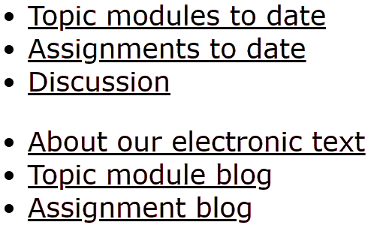
The Electronic Text portion of the class home page:
http://som.csudh.edu/fac/lpress/275/
Presentations you should study
Assignments with due dates
Weekly discussion – feedback & current events
Organization of the topic modules & assignment
Many topic modules – only study those I assign
Many assignments – only do those I assign
Question from Angelica Anaya and Adam Maldonado

Slide 5
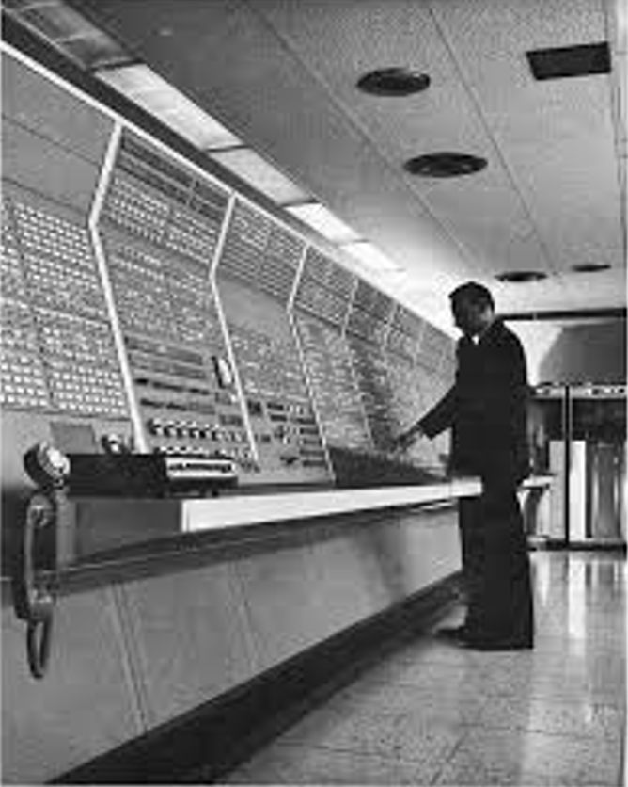
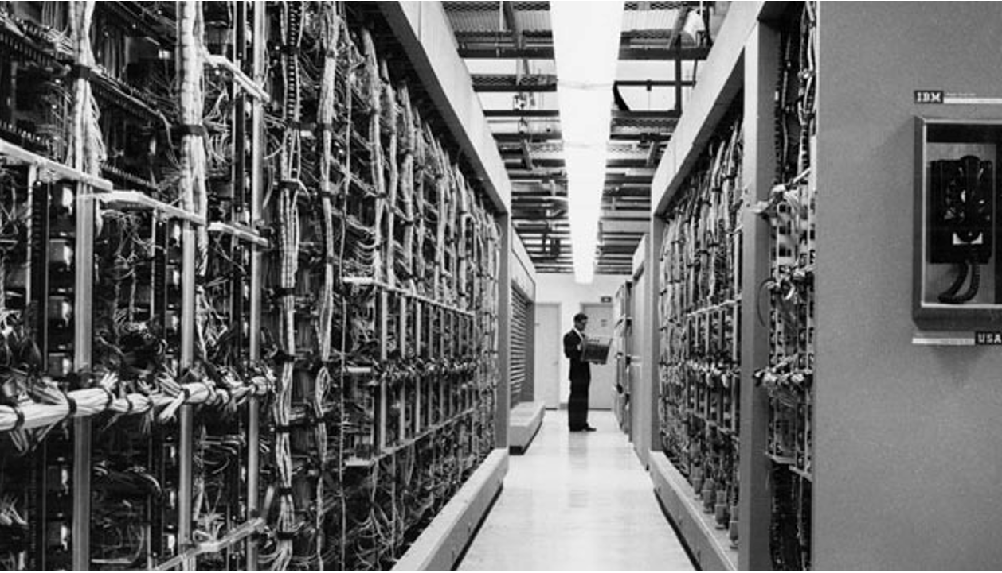
The computer I used for my dissertation, the IBM AN/FSQ-32
Built 1961-3
Memory
Fast: 1.5 Megabytes
Slow: 1.6 Megabytes
Storage
18 tape drives
The Q3 weighed 98.8 tons, occupied nearly an entire floor of a large office building and was said to use 1/20 of the power of Santa Monica.
Operator’s console
The computer -- the room behind the console
Source
Notes:
The computer I used for my dissertation – it was not in the room, it was the room.
It cost millions of dollars to build and operate, so it was shared my several users at connected terminals. That was called “timesharing.”

Slide 6
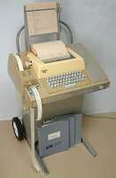
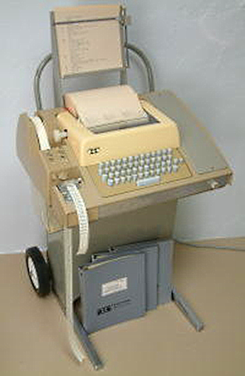
Timesharing
Upstairs
Downstairs
Teletype user terminal
Notes:
With time-sharing, a computer gave a tiny slice of time to users one at a time. If a user was idle, he or she would be skipped. If the computer was fast enough, each user had the illusion that the compuer was his or hers full time.

Slide 7
Assignment 3 was messed up (twice).
What happened?

Slide 8
Why did James Morton get extra credit?

Slide 9
These people did assignment 1 on time:
Morton, James (Wednesday evening)
Herschler, Jeffrey
Gonzalez Cordova, Francisco Jr.
Westby, Tyon
Luis Zaragoza
Reyes, Alondra
Gonzalez, Jesus
Hepperle, Dylan
Anderson, Nicole
Martinez Silva, Sofia
Evans, Lisa
Escobedo, Jaime (Friday at 9:55 PM)
One person did it 3 times
Two people did it twice
Why the repeats?
Notes:
Note that the time you completed the survey was recorded without your knowledge. Anything else?

Slide 10
Who are you?
CIS 275 background survey results
I’ll post the results tomorrow so you can see who might be able to help you.
Notes:
Survey!!!1940

Slide 11
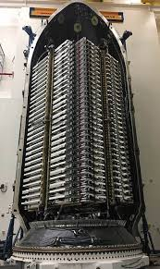
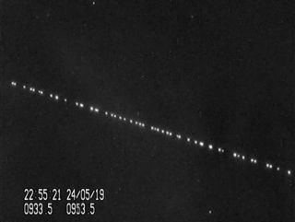
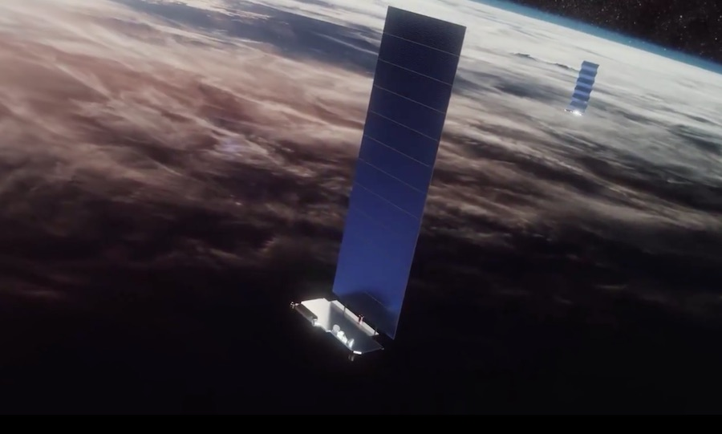
SpaceX launched 60 broadband Internet satellites this morning
Shortly after deployment
Satellite with solar panel
Starlink separation (1 minute)
The entire launch (1 h 15 m)
Ready to launch
Notes:
They now have about 240 in orbit and plan to launch 120 per month.
Service will start late this year.

Slide 12
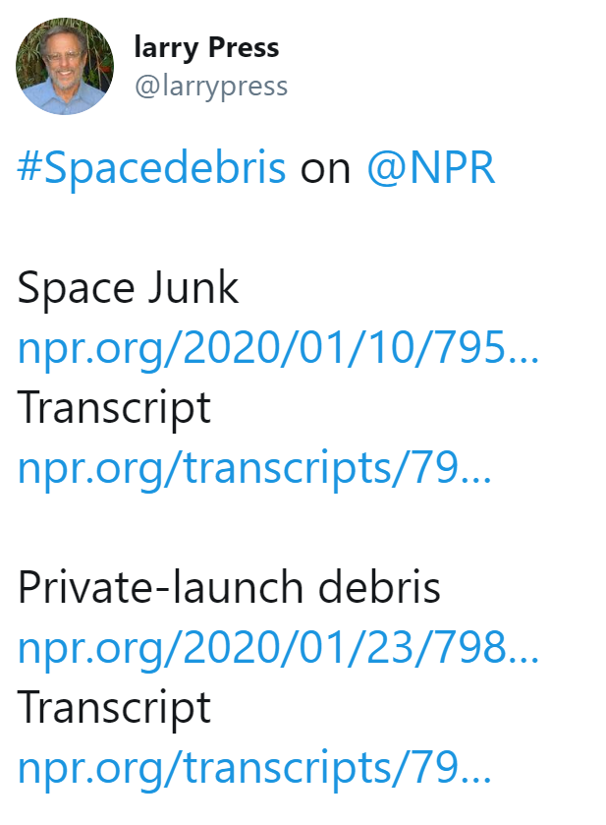
NPR segments on space debris

Slide 13
Who asked about the Space Force last week?
Podcast on space defense

Slide 14
Class Twitter feed and hashtag
I will post things I come across that are relevant to our class.
You can too.
Example of collaboration using Twitter
Get an account and play around with Twitter.

Slide 15
Internship opportunity
The DSCC is the branch of the Democratic Party committed to electing more Democrats to the United States Senate. We are seeking energetic and hard-working undergraduate students to join our DSCC internship program to help accomplish the goal of retaking the Senate majority for the upcoming sessions.

Slide 16
Anonymous survey feedback
Last
Time
Expected
A | 58% | 21%
B | 34% | 24%
C | 8% | 45%
D | 0% | 6%
F | 0% | 3%
*
**
* Hard to do ** really hard to do
Several people did not turn in an answer.
Notes:
If you decide to stop the class, be sure to officially drop or your grade will be a U – equivalent to an F – and I cannot change it.
If you are taking this class to fulfill a requirement and are not really interested in the topic, remember that it is pretty easy to get a C, so put your effort into a class that you find interesting or relevant to your career.

Slide 17
Anonymous study habit survey
Did you study the Course Overview presentation that I presented in the last class?
No
Yes, but I only looked at the slides, not the notes on each slide.
Yes, I read studied the notes on each slide as well as the slide itself.
Yes, and I stopped and thought about the questions marked with “stop sign” icons.
Both C and D
2. Did you watch the video of the talk by Peter Norvig? (yes/no)
3. Did you take notes during our last class? (yes/no)

Slide 19
Discussion
Last week’s class
Assignment feedback
Current events
Anonymous study-habit surveys
Week 3

Slide 20
Assignment feedback
Assignment 1:
I gave you credit even if you did it late. I will never be so nice again.
Several people failed to answer the questions and some others gave unsatisfactory answers. You can still get half credit if you turn in correct answers to the question.
You do not have to print out the completion message – I only included that to make the point that some of you did not carefully read the assignment – a reminder that both you and I need to slow down and be mindful when online.
Assignment 2: You can still get half credit if you submit an answer to the question at the end of the assignment.
Assignment 3: I gave you credit if you subscribed to the list, but did not submit the confirmation notification. I will never be so nice again. The same goes for assignment numbers.

Slide 21
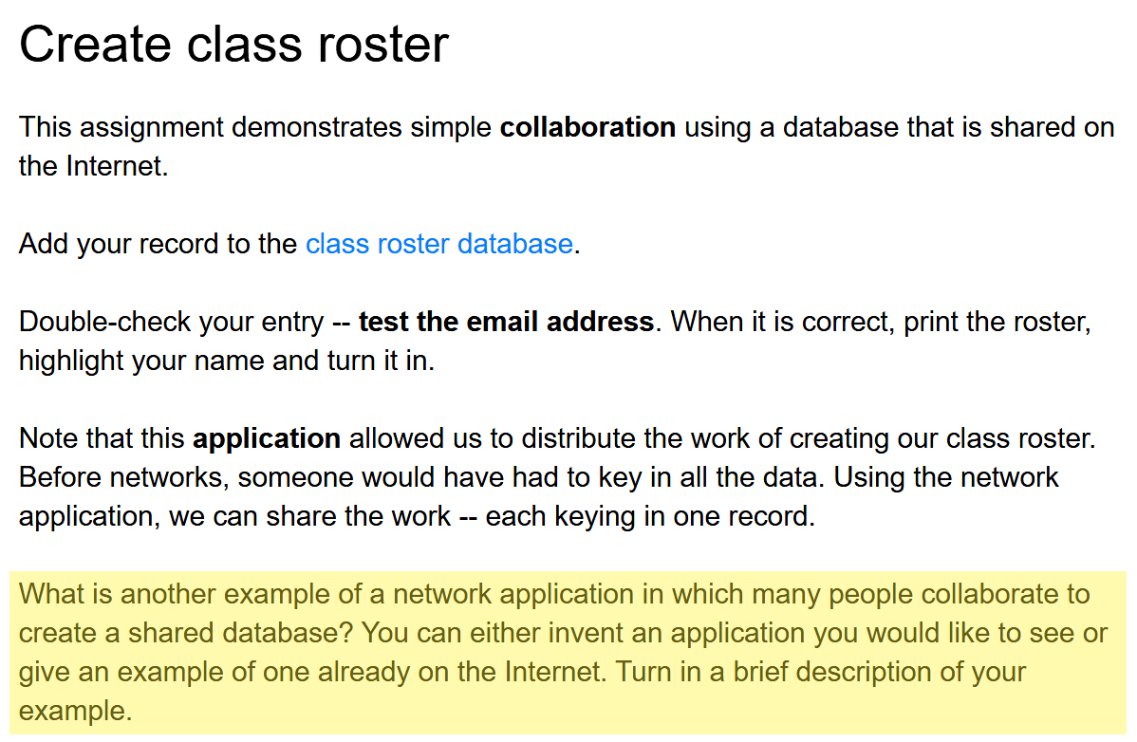
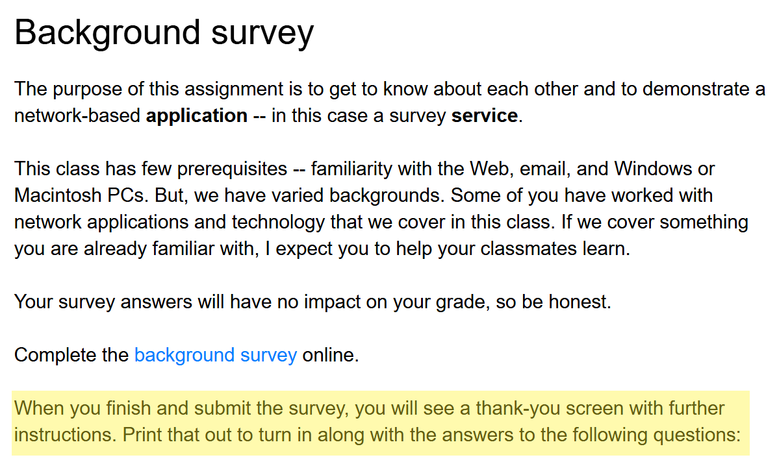
We tend to skim, not read when online – especially on phones.
Phones are better at consuming content than creating content.

Slide 22
Assignment feedback – restatement of the ground rules
Assignments are due at the start of class on the due date.
The assignments should be submitted separately and if there are multiple pages, staple them together.
Put your name and the assignment number on the front page.
It’s OK to work together even if it is not a group assignment. If you do, submit one copy with everyone’s name.
You can use any resource – a friend, Google, whatever.
Don’t wait till the last minute – it will be too late to get help.
Don’t turn in things you don’t understand – use your own words.
Do assignments properly without rushing – be proud of your work.
Ask me what Steve Job’s father told him when he was a kid and they were building a fence together.

Slide 23
Assignment 1 questions
What is the name of the company that provides the survey service we used?
Where are the survey questions stored?
When you complete the survey, where are your answers stored?
The survey you completed had one Likert-scale question? What was its question number?
As you see below, some survey questions have radio buttons (round) and others have checkboxes (square). What is the difference between them?
1, 3 and 5 have specific answers which are easily found.
Only 2 and 3 are at all interesting.
It’s not knowing the answer, its realizing you don’t know and knowing how to find the answer.
If you were unclear on 2 or 3, how could you find and explain the answers?

Slide 24
Do you know how to find the assignment scores?

Slide 25
Groups
1 | Gonzalez,Jesus Martin | Espinoza, Ramon | Escamilla, Ymelda | Grice, Ralph | Gonzalez Cordova,Francisco Jr
2 | Herschler,Jeffrey | Luna,Marlene | Brown, Caitlin | Kuti, Adebayo
3 | Morton,James Paul | Zavala, Adrian | Evans, Lisa | Martinez Silva, Sofia
4 | Reyes,Alondra | Hepperle, Dylan | Anderson, Nicole | Balding, Robert
5 | Westby,Tyon | Escobedo, Jaime | Luis Zaragoza | Grier, Natalie

Slide 26
Research results repeatedly shows that tutors gain more than tutees.
Ask me what Professor Herbert Simon told me many years ago.

Slide 27
Quiz feedback
Do you know how to find the past quizzes?
Why do I give the quizzes?
Did you answer “IDK” to any of the questions, and if so, what if anything did you do to find the answer?

Slide 28
Quiz guidelines
Write clearly and use pen or dark pencil – if I can’t read it it’s wrong.
Print your name.
The quizzes are closed book – no notes or computers.
The purpose is self-diagnostic – if you do not know the answer, how do you plan to learn it?
If you do not know the answer, write “IDK” and don’t feel bad – it means you learned what you don’t know – what you need to learn. Now, go learn it.
You don’t have to repeat the question – just number your answers.
I consider the quiz questions important so they might guide your study.
You can suggest quiz questions and I will use them if I agree that they are getting at something important.
(You can also suggest exam questions).

Slide 29
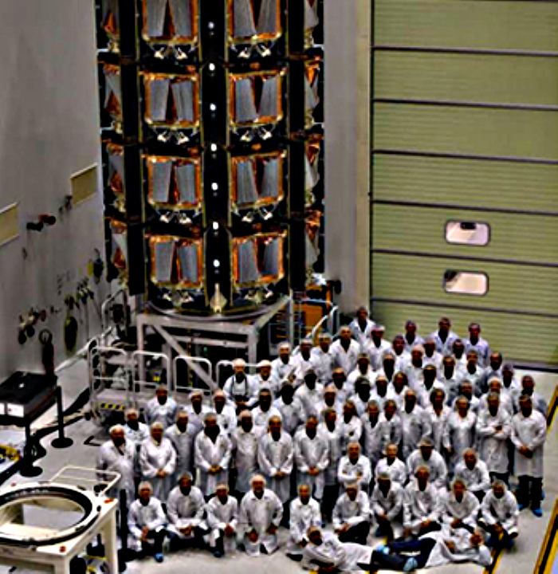
OneWeb plans to launch 34 LEO Internet-service satellites tomorrow.
SpaceX
Goal: funding Mars settlement
Organization: vertically integrated
OneWeb
Goal: connecting the unconnected
Organization: working with partners and suppliers

Slide 30
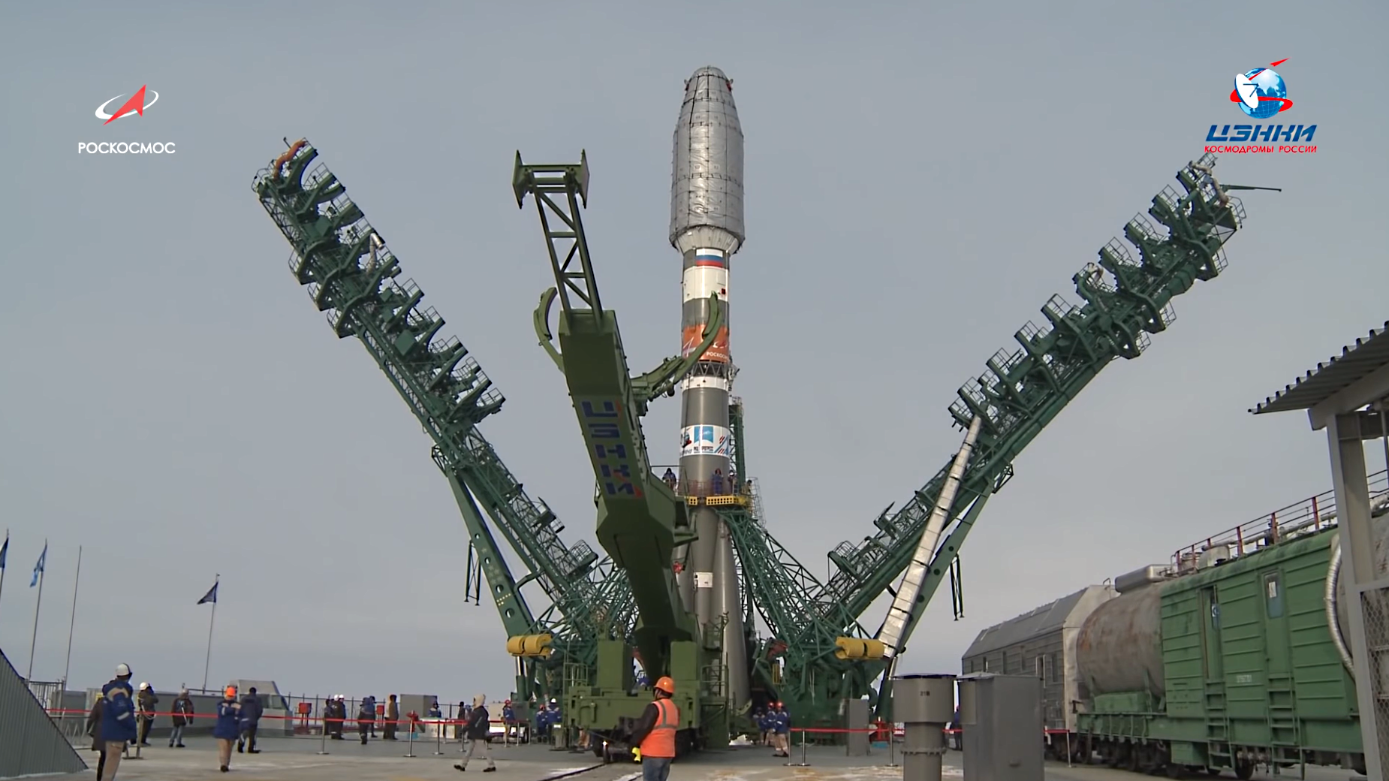
Satellites are inside the fairing.
A Russian rocket being launched from Khazikstan
Main booster
Side boosters
Geek out – watch the launch
Notes:
This will give you a sense of the scale of these things.

Slide 31
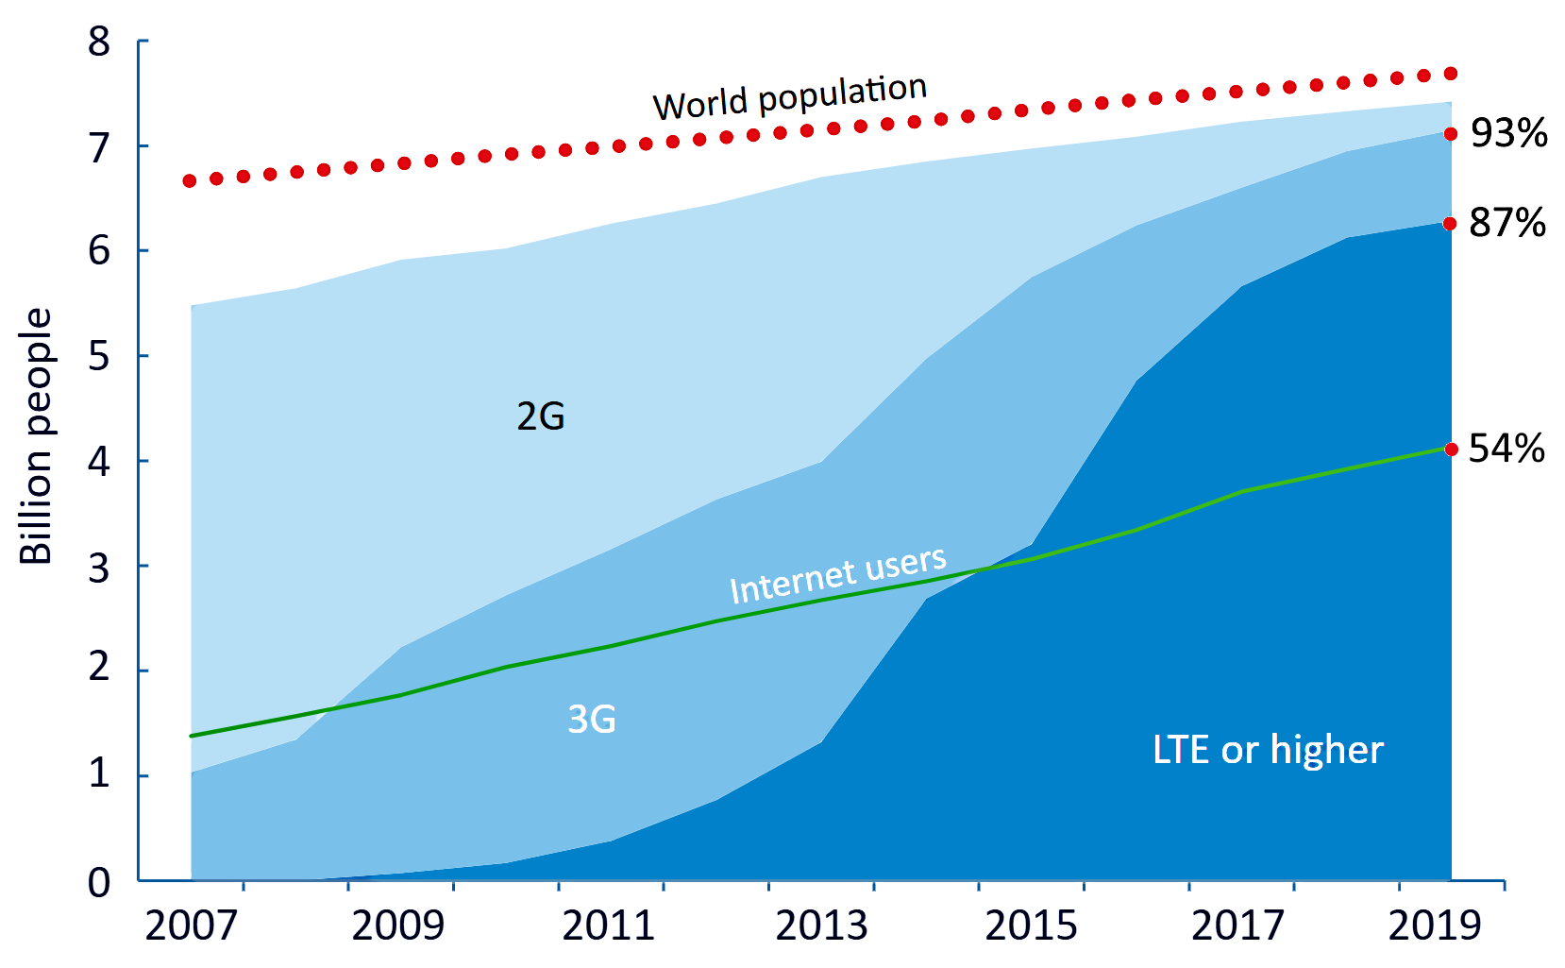
Measuring digital development, 2019
97 percent of the world population now lives within reach of a mobile cellular signal.
53.6 percent use the Internet.
What are 2G, 3G and LTE? Which do you have?
What is the ITU?
International Telecommunication Union (ITU)

Slide 32
Anonymous study habit survey
Did you study the Course Overview presentation that I presented in the last class?
No 5
Yes, but I only looked at the slides, not the notes on each slide. 16
Yes, I read & studied the notes on each slide as well as the slide itself.
Yes, and I stopped and thought about the questions marked with “stop sign” icons.
Both C and D
2. Did you watch the video of the talk by Peter Norvig? (yes/no) 7/14
3. Did you take notes during our last class? (yes/no) 10/11

Slide 34
Discussion
Last week’s class
Assignment feedback
Current events
Anonymous study-habit surveys
Week 4

Slide 35
Who …
Asked about the Space Force?
Asked about Space debris?
Asked about the Survey Gizmo server after class last week?

Slide 36
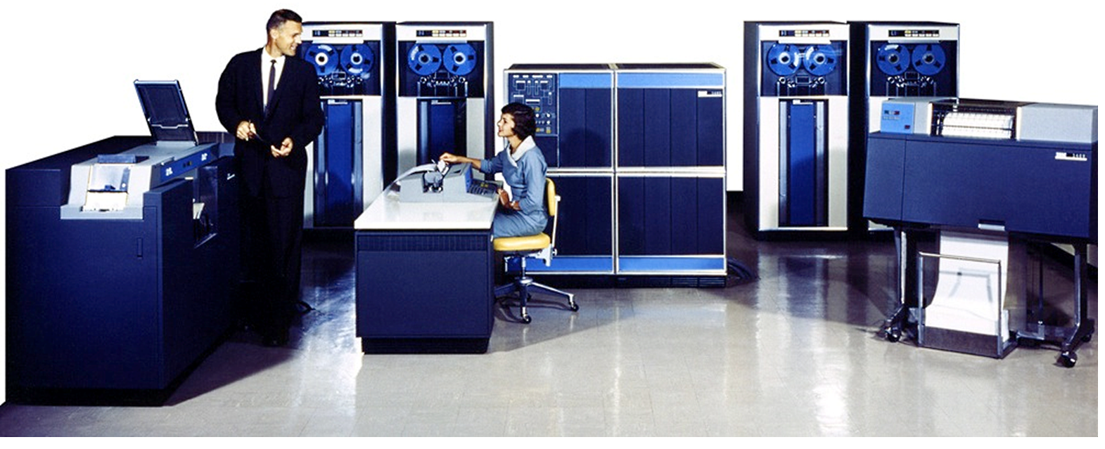
Input device: card reader
Memory and CPU
Storage devices: magnetic tape drives
Output device: printer
Output device: card punch
Operator’s console: keyboard (input) and printer (output)
IBM 1401, 1959-1972, 12,000 sold or leased
Notes:
Sample application – weekly payroll processing.
Employee personnel records (name, address, pay rate, year-to-date salary, social security number, etc.,) were stored on magnetic tape.
Programs were loaded into memory from punched cards.
Weekly payroll data (employee number, number of hours worked, etc.) were read from punch cards.
The program would read a card, calculate pay amount and print a check and store the updated year-to-date information on tape for next week.
Source: https://www.semanticscholar.org/paper/The-Legendary-IBM-1401-Data-Processing-System-Garner-Dill/ca22ce9329c884e6064024cb025e8717bc50b7ff/figure/0
Mmm

Slide 37
Capacities (my laptop)
CPU
Input
devices
Memory
(programs and data)
Output
devices
16 GBytes
Storage devices
(programs and data)
What is the capacity of the Internet?
What is a Byte? A is a Gbyte?
512 GBytes
Notes:
The storage capacity of my laptop is greater than the memory because it holds all of the programs I have installed plus all of the data file I have created. The memory only holds the programs and data I am currently using. This was enough capacity for me, but if I were using my laptop for a lot of video editing, I would have paid more for more greater. What are the memory and storage capacities of your home computer? Your phone?

Slide 38
Typical data transfer rates
CPU
What are bits?
About 13,000 Mbits per second
Input
devices
Memory
(programs and data)
Output
devices
About 500 Mbits per second
Storage devices
(programs and data)
What is the I/O device transfer rate?
What is transfer rate to and from the Internet?
Notes:
Data transfer between memory and the CPU is ,much faster than between memory and storage, but both increase as technology improves over time. The speed of the Internet link depends upon cost of and technology used in the link. The speed between the local area network in your home and your Internet service provider is much lower than the speed of the link between our campus and our ISP.
Note that the rate of transmission is the amount of data per unit of time. In this case millions of bits per second.

Slide 39
Typical data transfer rates
CPU
Inconceivably fast – depends on technoolgy
Input
devices
Memory
(programs and data)
Output
devices
Very fast – depends upon technology
Storage devices
(programs and data)
What is the I/O device transfer rate?
What is transfer rate to and from the Internet?
Notes:
Data transfer between memory and the CPU is ,much faster than between memory and storage, but both increase as technology improves over time.
The speed of the Internet link depends upon cost of and technology used in the link. The speed between the local area network in your home and your Internet service provider is much lower than the speed of the link between our campus and our ISP.
Note that the rate of transmission is the amount of data per unit of time. In this case millions of bits per second.

Slide 40
Mobile
Fixed
Average download speed, 12/2019, in megabits per second (Mbps)
Rank | Nation | Speed
1 | South Korea | 103.18
2 | United Arab Emirates | 86.77
3 | Qatar | 79.21
4 | Canada | 70.74
5 | China | 67.71
...
32 | Serbia | 43.38
33 | Oman | 42.97
34 | Hungary | 42.31
35 | Montenegro | 41.25
36 | United States | 41
Rank | Nation | Speed
1 | Singapore | 200.1
2 | Hong Kong | 164.9
3 | Monaco | 148.9
4 | Romania | 144.9
5 | South Korea | 144.4
6 | Switzerland | 144.3
7 | Liechtenstein | 139
8 | Taiwan | 137.9
9 | France | 131.3
10 | Sweden | 131.1
11 | United States | 130.8
Source
What is a bit? A megabit?
Is this surprising?

Slide 41
Global averages
Mobile: download 32.01, upload 12.02 Mbps
Fixed: download 73.58, upload 40.39 Mbps
Why is average upload speed lower than average download speed?

Slide 42
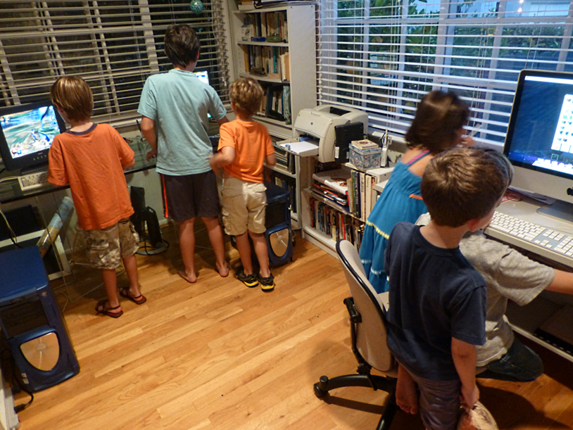
What was unusual about Peter Norvig’s online class at Stanford?
Ten MOOC Web sites
Notes:
These are my grandchildren playing online.
Oscar (arrow) and two friends worked through Algebra 2 on the Khan Academy site the summer before he entered high school.

Slide 43
Evolution of Google’s word processing program
How do these differ? Which is the most recent version? What has enabled the change?

Slide 44
Groups
1 | Gonzalez,Jesus Martin | Espinoza, Ramon | Escamilla, Ymelda | Grice, Ralph | Gonzalez Cordova,Francisco Jr
2 | Herschler,Jeffrey | Luna,Marlene | Brown, Caitlin | Kuti, Adebayo
3 | Morton,James Paul | Zavala, Adrian | Evans, Lisa | Martinez Silva, Sofia
4 | Reyes,Alondra | Hepperle, Dylan | Anderson, Nicole | Balding, Robert
5 | Westby,Tyon | Escobedo, Jaime | Luis Zaragoza | Grier, Natalie

Slide 45
If you want others to see a file in Google drive, be sure to share access to it!

Slide 46
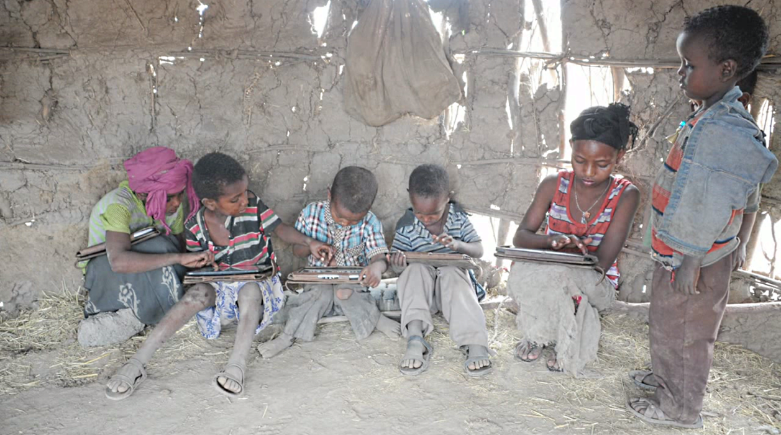
Who can help you out?
Survey results

Slide 47
Michael Wesch comments

Slide 48
OneWeb launches 34 operational satellites
Press release – success and in communication with all 34

Slide 49
OneWeb system design
Source

Slide 50
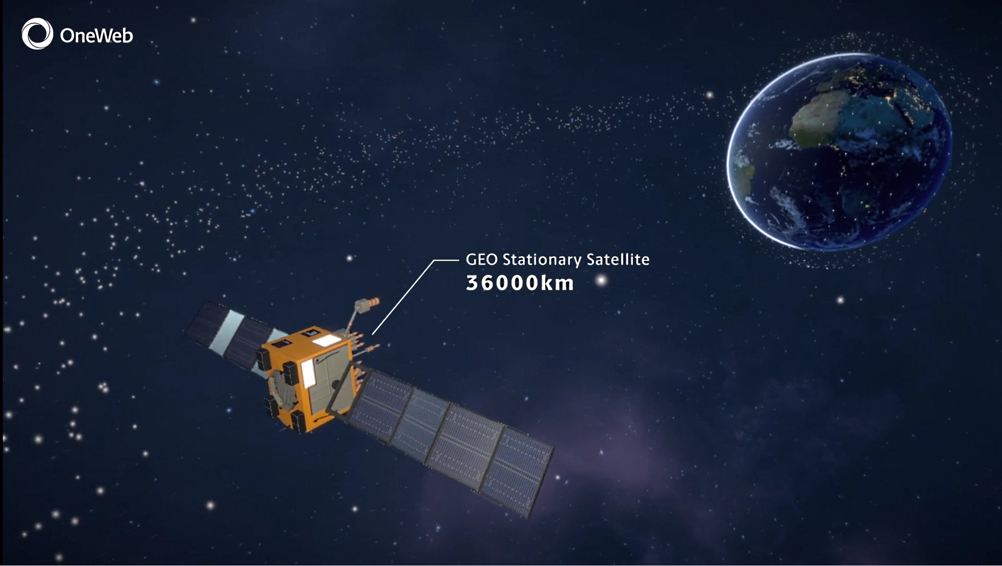
Geo-
Stationary (GEO)
satellite
Notes:
Geostationary satellites take 24 hours to circle the Earth so, since they are at the equator, they appear to remain stationary in the sky. Antennas do not have to move once they are installed and pointed at the satellite.
That’s the good news. The bad news is that at that distance a signal takes about a quarter of a second to travel between the satellite and Earth. That time is called the “latency” of the signal. (Not to be confused with the transmission rate).
More good news – being up that high, the satellite can “see” a larger portion of the Earth. It has a large “footprint” on the ground.
Bad news again – it takes more power to send a signal a long way and satellites depend upon solar power. (The “wings” on the satellite shown here are solar collectors).

Slide 51
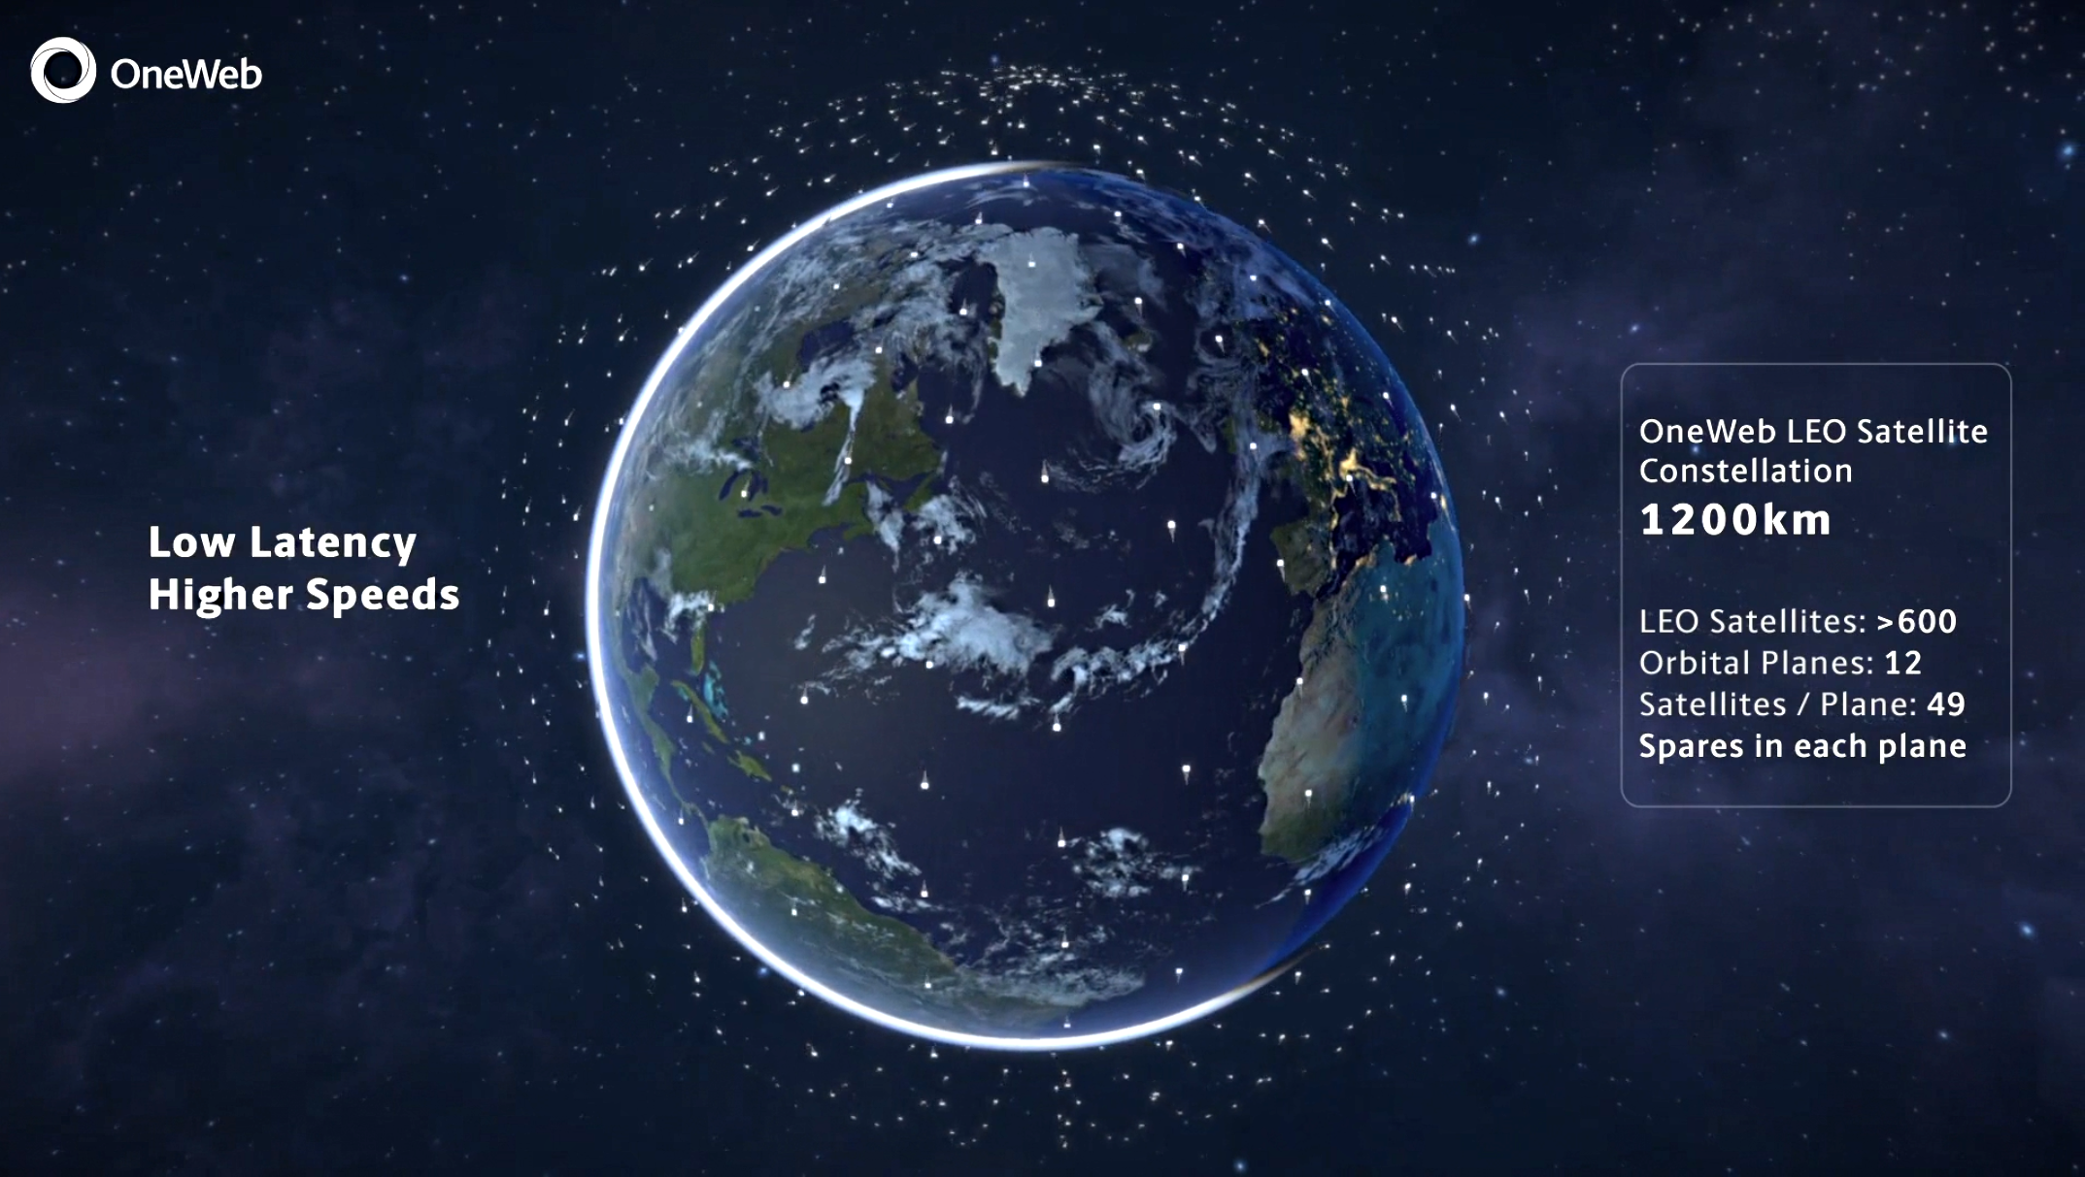
Low-earth
Orbit (LEO)
Notes:
LEO satellites are under 2,000 kilometers which means that a signal to or from Earth travels much faster and requires less power.
The bad news is that the satellites move across the sky so antennas on Earth must track them – either by physically tilting or by pointing an electronically-shaped and pointed beam. It also requires a handoff to another satellite when one that is connected goes out of sight.
More bad news – since LEO satellites are relatively close to the Earth, their footprints are small so many more – a “constellation” -- are needed to cover the entire planet.

Slide 52
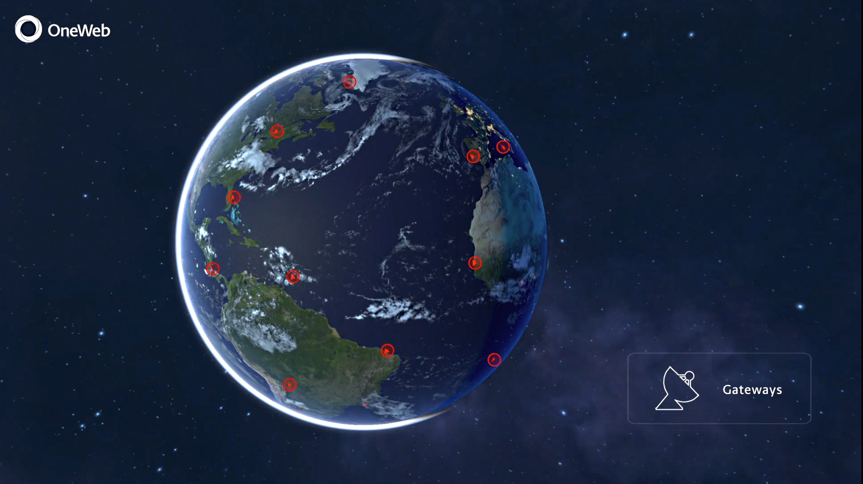
Gateways
Notes:
To provide Internet service, the satellites connect to gateways on Earth that are connected to the terrestrial Internet.

Slide 53
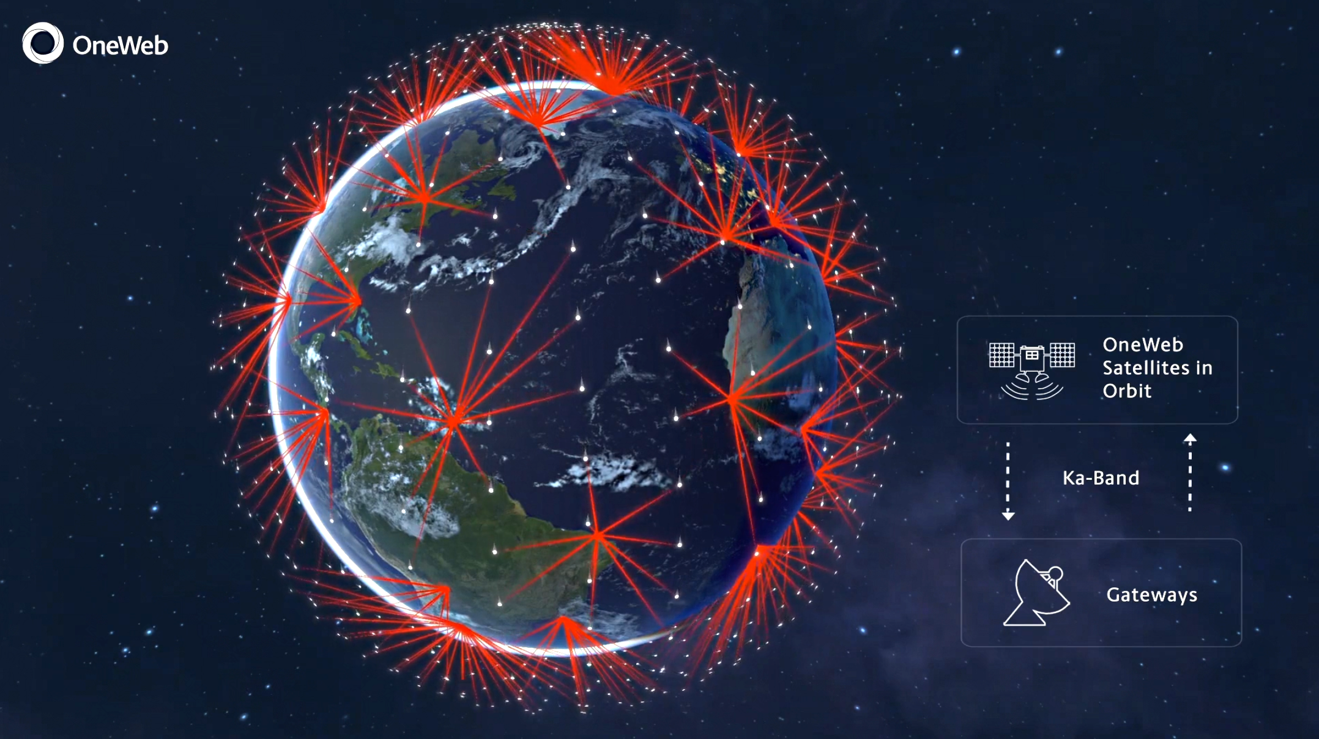
Ka links
to gateways
Notes:
Relatively hi-frequency “Ka-band” radios are used to communicate with the gateway. All things being equal, they can transmit data faster than lower-frequency “Ku-band” radios.
That’s good news. The bad news is that they require more power than Ku-band radios and the signals are more readily blocked.
(Light is very high frequency so it can be blocked by clouds).

Slide 54
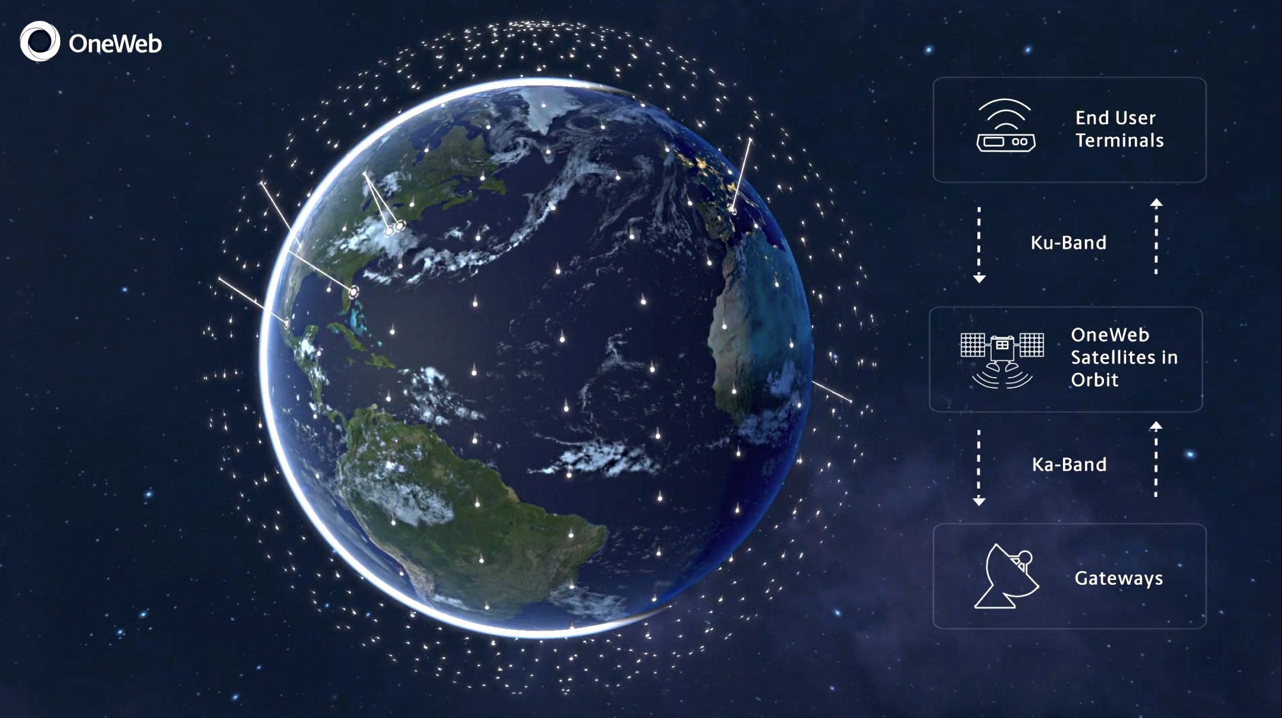
Ku links to
end users
Notes:
End users connect to the satellites using slower Ku-band radio frequencies.

Slide 55
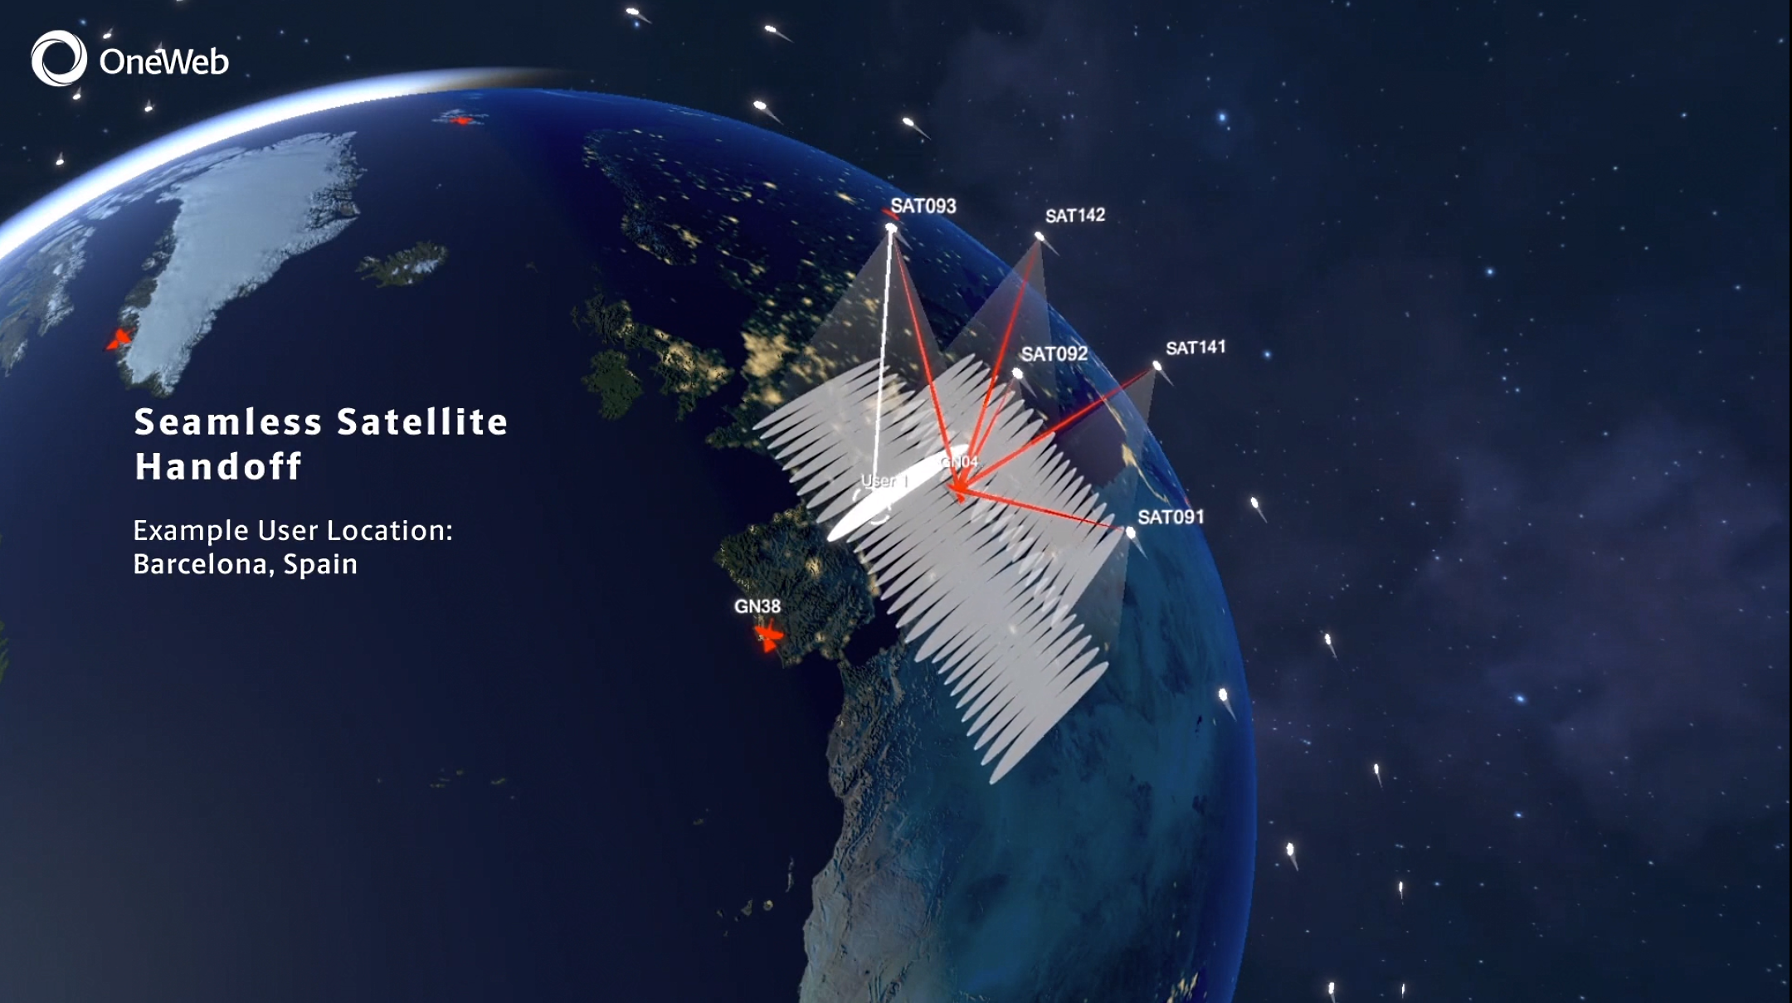
Before handoff
Notes:
Since the satellites are moving and the Earth is rotating. seamless handoffs must be made between satellites.
The same is true when you are driving in your car and talking on a cell phone. If all goes well, you do not notice when you are handed off from one mobile phone tower to another.

Slide 56
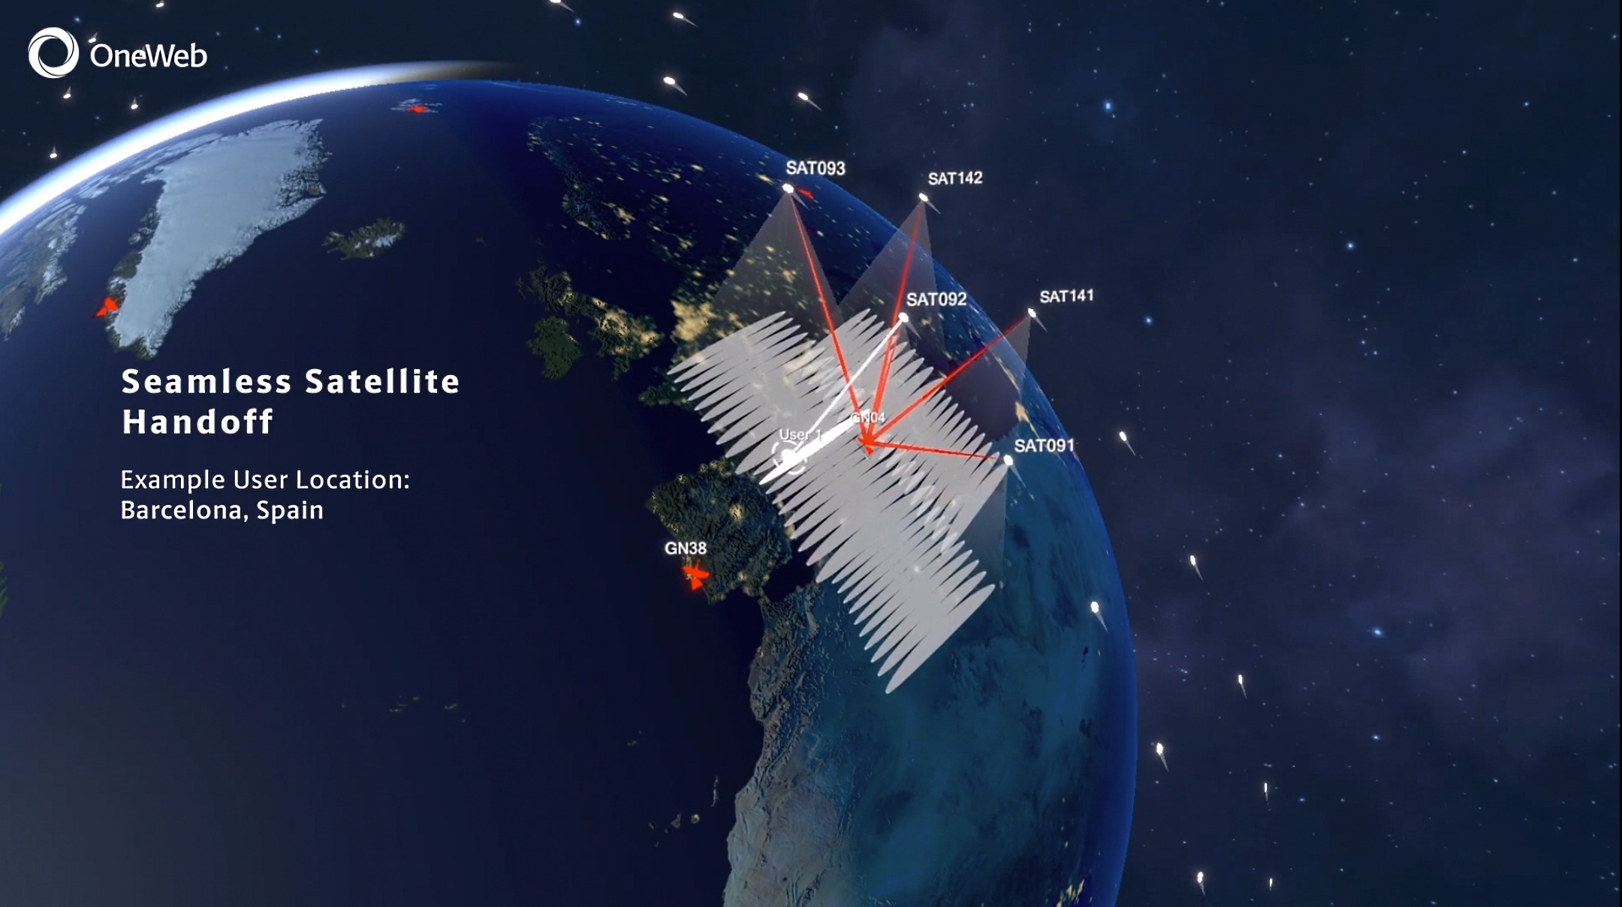
After handoff

Slide 57
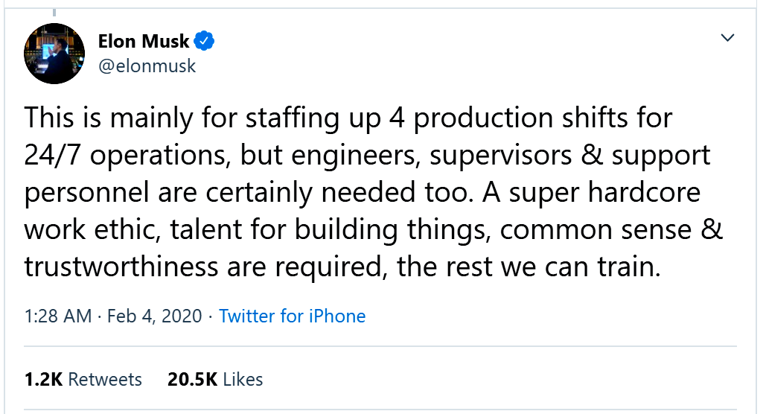
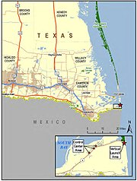
SpaceX Boca Chica launch and manufacturing site
Source
Notes:
SpaceX will essentially build a small city here – like Cape Canaveral in Florida. It will not remain a typical rural Texas town.

Slide 58
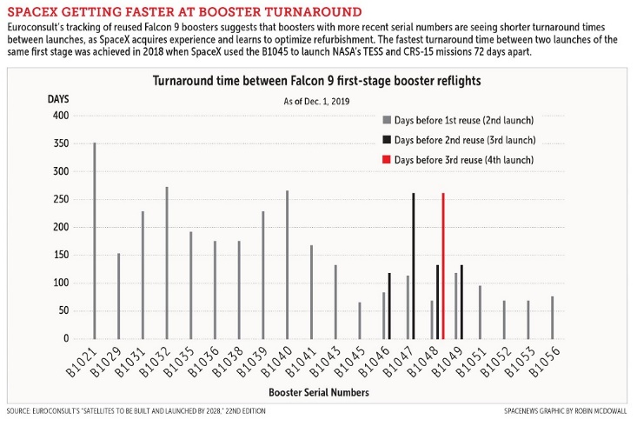
How technology improves
Turn-around drops as SpaceX learns.
Amazon will learn too.
Source

Slide 59
Before SpaceX could improve rocket reuse, they had to learn how do do it in the first place.

Slide 60
Space Force created
The Space Force and other government agencies will fuel the space industry
A good introduction
Space Force careers

Slide 61
A study-habit fact
As of 6:30 this evening, five people had looked back at Quiz 2.

Slide 62
Anonymous study-habits survey
The last two week’s quizzes are now online.
How many have you looked at? (0, 1, 2)
Have you followed up on any of your “IDK” questions? (Y, N)
Have you searched for our class hashtag #DHNetLiteracy on Twitter? (Y/N)

Slide 64
Discussion
Last week’s class
Assignment feedback
Current events
Anonymous study-habit surveys
Week 5

Slide 65
Typical data transfer rates
CPU
Inconceivably fast – changing technologies
Input
devices
Memory
(programs and data)
Output
devices
Very fast – changing technologies
Storage devices
(programs and data)
What is the I/O device transfer rate?
What is transfer rate to and from the Internet?
Notes:
Data transfer between memory and the CPU is ,much faster than between memory and storage, but both increase as technology improves over time.
The speed of the Internet link depends upon cost of and technology used in the link. The speed between the local area network in your home and your Internet service provider is much lower than the speed of the link between our campus and our ISP.
Note that the rate of transmission is the amount of data per unit of time. In this case millions of bits per second.

Slide 66
Common storage technology (today)
Options:
Solid state drive plugged into USB port
Hard drive plugged into USB port
Solid state drive inside your computer
Hard drive inside your computer
Tradeoffs:
USB ports slow things down.
Solid state drives are faster and more reliable that hard drives.
Hard drives are cheaper and easier to recover data after a crash.
Bottom line:
Since we use the Internet more and more for storage, I use a laptop with solid state storage and keep an external (USB) hard drive around for occasional backup.

Slide 67
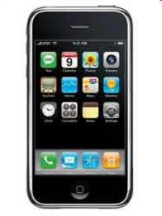
Mobile connectivity
Last
Week
The Internet
mobile user
How does the mobile user connect to the Internet?
Notes:
When away from their home or organization LANs, mobile users connect directly to their ISPs, through the cell phone network.
Cellular networks were originally deployed for voice calls using our cell phones.
But, today, the primary use of our cell phones is for Internet access.
Eventually, all voice communication will be over the Internet using services like Skype and WhatsApp, and traditional phone calls will disappear.

Slide 68
The path to the Internet – 1-4G
Radio
Fiber
Last
Week
Base Station
Internet
What would slow the connection?
Notes:
The radios in our mobile and portable devices connect to cell company radios. The backhaul connection to a cell company office is usually over over fast fiber – extra speed is needed because many users may be sharing a cell radio at a given time. In rural areas the backhaul might be over high-speed terrestrial or wireless links.
If the user is making a phone call, the connection is switched to the phone network; if they are working with data, the connection is switched to the Internet.
To roll out a new technology generation, cell companies must change the equipment at each base station as well as the offices the base stations connect to – a big capital investment.

Slide 69
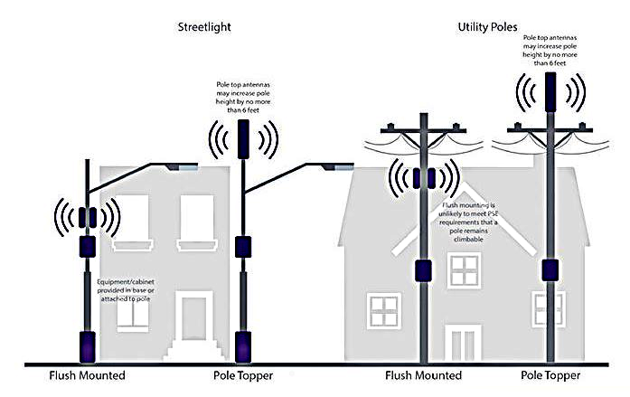
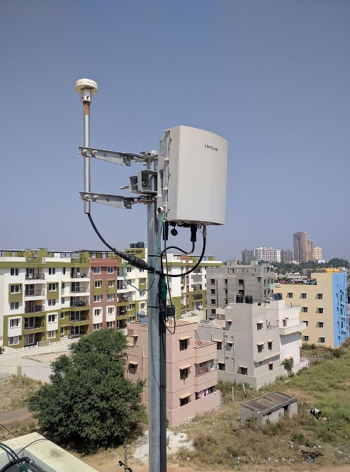
5G Small cells
Source

Slide 70
5G Small cells
High frequency
Fast transmission
Rapid attenuation
Poor penetration
Easy to install
Source

Slide 71
The path to the Internet – 5G
Radio
Fiber
Small
Cell
Base Station
Internet
What would slow the connection?
Notes:
Since high frequency signals do not carry for long distances, many small cells are needed to cover an area,

Slide 72
The path to the Internet – 5G
Radio
Fiber
.
Base Station
Small cell
Data center
Internet
What would slow the connection?
Notes:
Since high frequency signals do not carry for long distances, many small cells are needed to cover an area,

Slide 73
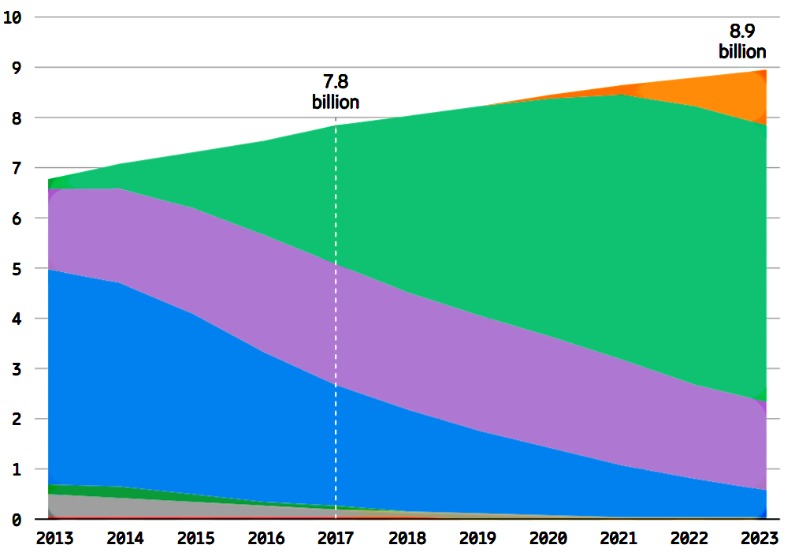
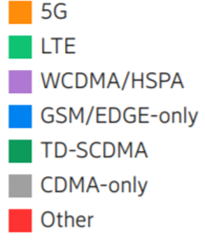
Mobile subscriptions
Source
Possible new 5G applications
Mobile broadband, like streaming movies
Fixed broadband, competing with fiber and cable to homes
Low latency, like autonomous vehicles
Internet of things, like thermostats and traffic signals

Slide 74
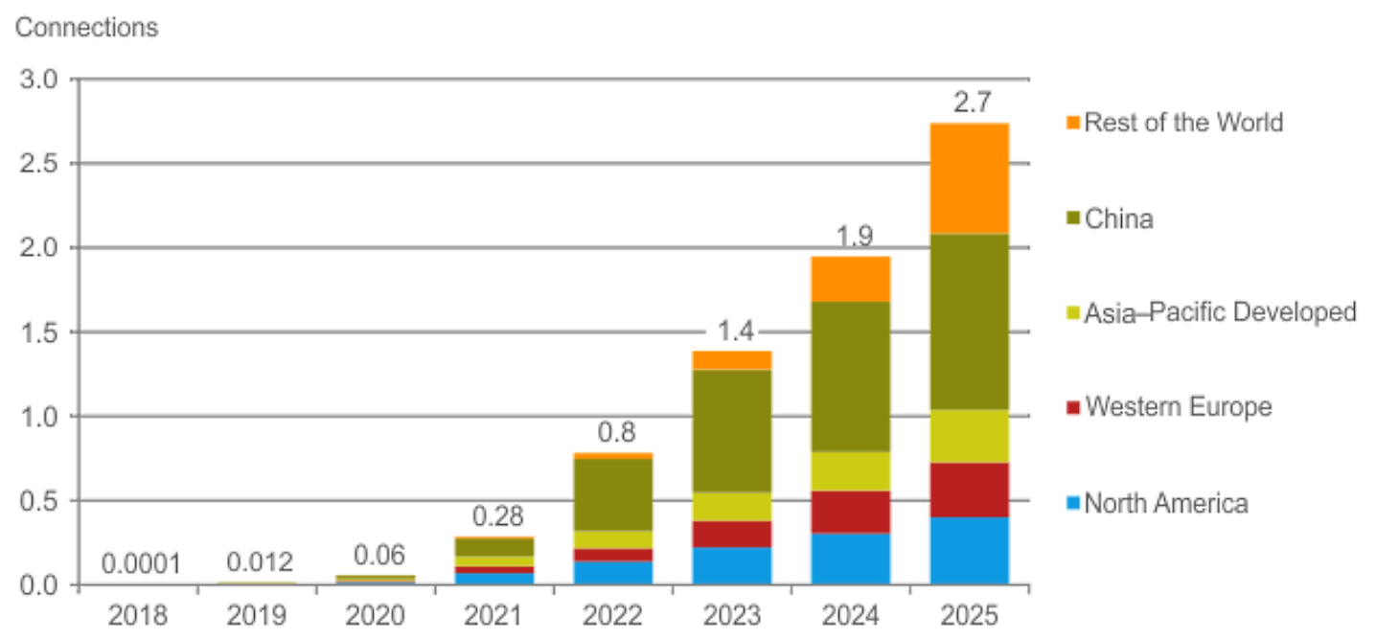
5G connections (billions)
Source

Slide 75
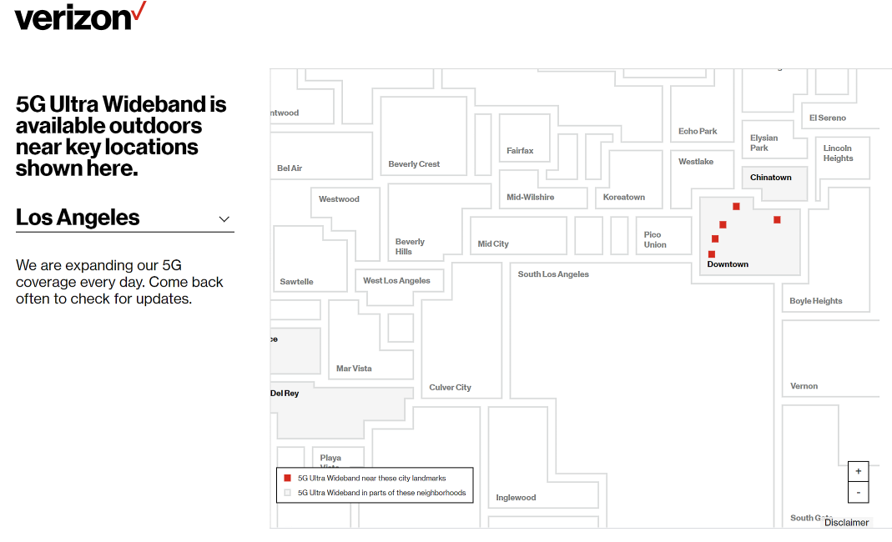
2/14/2020
Why is it only “outdoors?”
Source

Slide 76
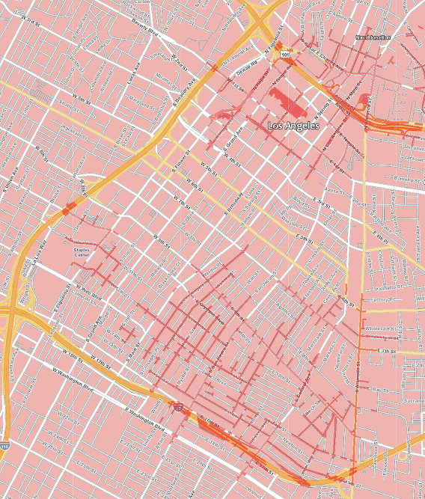
5G coverage detail
Pink: 4G
Red: 5G
Yellow: Freeways
White: Streets
Why downtown first?

Slide 77
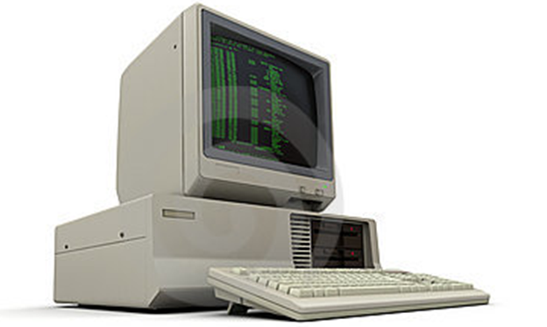
PC server
Notes:
Our school Web server started out on a Windows 3.0 desktop PC in my office.
I installed the Web server software and my students and I created the content -- pages for each professor, etc.
It was connected to the Internet through the school network.
I left the computer running 24 hours a day so people could visit the Web site when I was not around.
When I was in my office, I used the computer for things like word processing and spreadsheets.
There were not many Web users, so it didn’t slow down very much while I was using it.
In those days many people ran Web servers on home PCs, connected through their home ISP.

Slide 78
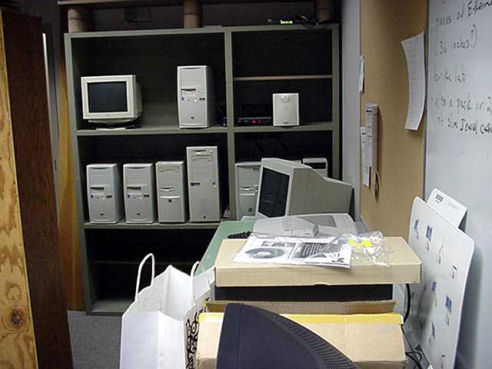
An early server room
Notes:
My desktop Web server was fast enough to keep up with the demand at first, but it became inadequate as the number of “hits” grew.
It also crashed frequently, and it stayed off line until I got there to restart it.
So, we moved it to the school server room, which looked something like this.
The computers were running Web servers, database servers, file transfer servers, and so forth.
Most important to me, they were the responsibility of a paid network administrator who kept them running and backed them up.
I was off the hook, but the university had to hire an employee and tie up a room.

Slide 79
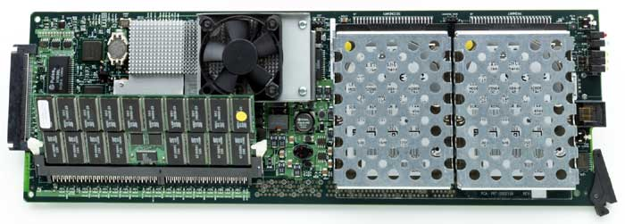
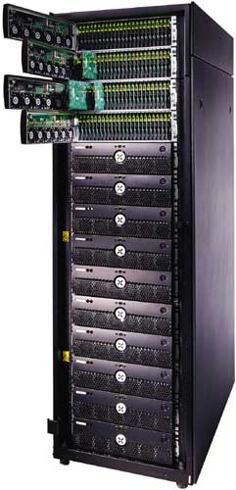
Servers on blades in racks
Notes:
Eventually, the number of servers grew to the point where the school installed a server rack like the one shown here.
The computers are mounted on “blades” that slide into racks in a cabinet.
This blade has two CPUs and two disk drives and the rack hold up to 280 blades.

Slide 80
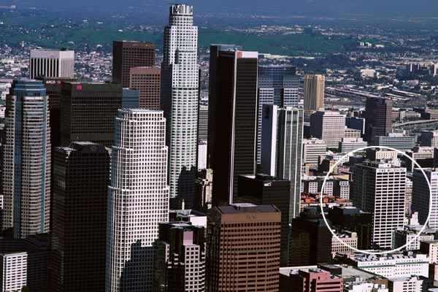
One Wilshire -- outside
One Wilshire -- inside
Notes:
One Wilshire is a large building in downtown Los Angeles. From the outside, it looks like an office building, but inside it is filled with racks of equipment and cables. Several hundred tenants connect with each other and the outside world at One Wilshire. Large organizations and ISPs exchange traffic (IP packets) at data centers like this one and there are similar buildings in cities around the world.
In addition to exchanging traffic, data centers often host servers for organizations. The data center staff are responsible for connectivity, power, security, fire protection, etc., but not the content. The content is maintained by the owner of the server. This service is typically very good, but the price is high.

Slide 81
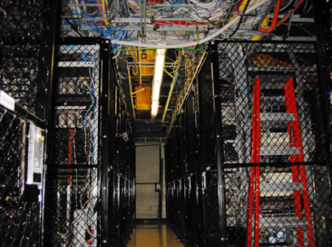
Servers in a data center
Notes:
While my school kept their servers on campus, other organizations moved theirs to data centers like this.
In a data center, you still own your own servers, but the physical space, Internet connection, air conditioning and backup power are taken care of for you.
Data centers also offer a speed advantage.
Data can be routed from one network to another at very high speed since they connected at the same location.
As such, these are sometimes referred to as colocation centers.

Slide 82
Inside a Google data center
Source

Slide 83
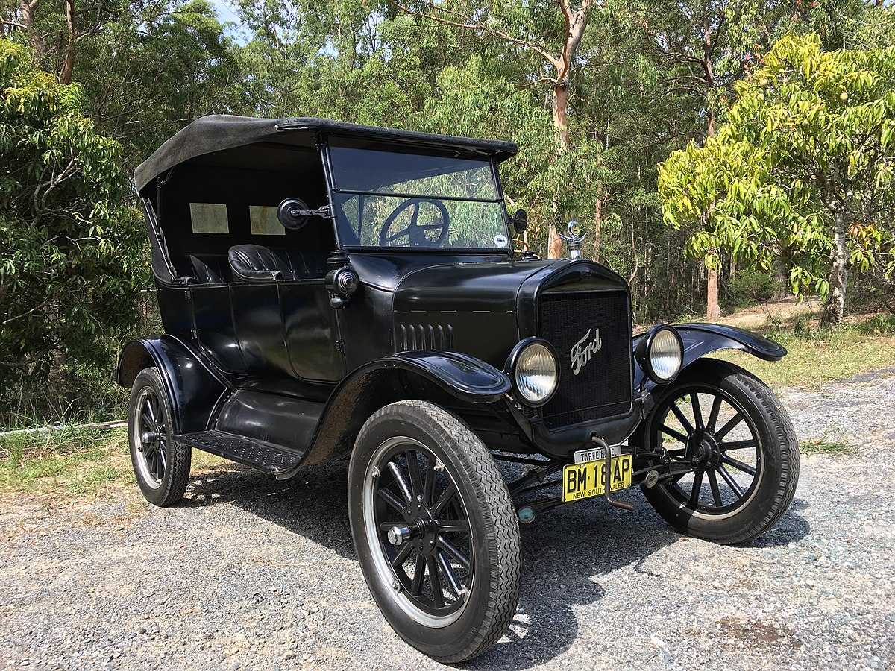
SpaceX launched another 60 satellites
Liftoff
Fairing deploy
Satellite deploy
SpaceX: 300
OneWeb: 34
But it will be a long race.
Ford had a huge lead with the Model T.

Slide 84
Budget proposal: $15 billion for Space Force
Job/training opportunity?
Is it consistent with your values?
Short term?

Slide 85
Need help with Twitter?
These people use Twitter at least once per week:
Anderson, Nicole
Escamilla, Ymelda
Escobedo, Jaime
Kuti, Adebayo
Martinez Silva, Sofia
Morton, James
Westby, Tyon

Slide 86
Anonymous study-habits survey
The last two week’s quizzes are now online.
1. How many have you looked at? (0, 1, 2) 5, 6, 6
2. Have you followed up on any of your “IDK” questions? (Y, N) 10, 7
3. Have you searched for our class hashtag #DHNetLiteracy on Twitter? (Y/N) 1, 16
---
One person gave 4 answers to the 3 questions.
One person said he or she had looked at 5 of the quizzes.
One person said he or she had watched “yes” of the 2 quizzes.
Be mindful – wake up!

Slide 87
Anonymous study-habits survey
1. Were you a Twitter user before this class? (Y/N)
2. I asked you to play with Twitter for an hour last week. About how much time did you spend?
0 minutes
1-15 minutes
16-30 minutes
31-45 minutes
46 plus minutes
3. We could not play videos in class last week, so I asked you to watch a short animation illustrating the operation of a low-Earth orbit (LEO) satellite Internet service at home.
Did you watch it? (Y/N)
4. Did you study the slides I made from stills taken from the animation? (Y/N)

Slide 88
Midterm in two weeks

Slide 90
Discussion
Last week’s class
Assignment feedback
Current events
Anonymous study-habit surveys
Week 6

Slide 91
Assignment feedback
6. The answers were uneven – I thought about making another assignment, but changed my mind.
I combined the group answers to assignment 6. Feel free to study them. Make edits or suggestions that you think would improve or correct them.
7. Let’s put your assignment 7 answers online too. Someone in each group should send me a link to your answer by Friday night. Don’t forget to make the link shareable.
8. I wanted you to focus on the difference between edits and suggestions in assignment 8. It was poorly written so I have revised it, hopefully making that clear. Be sure you understand the difference between suggestions and edits.

Slide 92
Anonymous study-habits survey
1. Were you a Twitter user before this class? (Y/N) 7/8
2. I asked you to play with Twitter for an hour last week. About how much time did you spend?
0 minutes 2
1-15 minutes 2
16-30 minutes 3
31-45 minutes 1
46 plus minutes 7
3. We could not play videos in class last week, so I asked you to watch a short animation illustrating the operation of a low-Earth orbit (LEO) satellite Internet service at home.
Did you watch it? (Y/N) 6/9
4. Did you study the slides I made from stills taken from the animation? (Y/N) 6/9
Were the slides helpful or was the video self explanatory?

Slide 93
More anonymous study-habit feedback
Only two people did assignment 10 before Monday

Slide 94
The path to the Internet
Quiz feedback
Radio
Fiber
This diagram was for mobile, not fixed connectivity.
Base Station
Internet
Notes:
The radios in our mobile and portable devices connect to cell company radios. The backhaul connection to a cell company office is usually over over fast fiber – extra speed is needed because many users may be sharing a cell radio at a given time. In rural areas the backhaul might be over high-speed terrestrial or wireless links.
If the user is making a phone call, the connection is switched to the phone network; if they are working with data, the connection is switched to the Internet.
To roll out a new technology generation, cell companies must change the equipment at each base station as well as the offices the base stations connect to – a big capital investment.

Slide 95
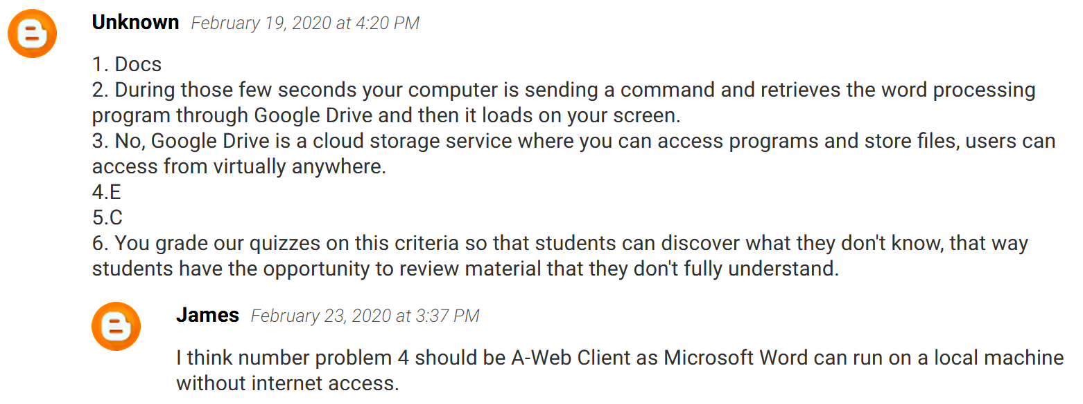
Comments on the Quiz 3 blog post
Who is “unknown”?

Slide 96
Your class roster
How long did it take me to add a field to this database?

Slide 97
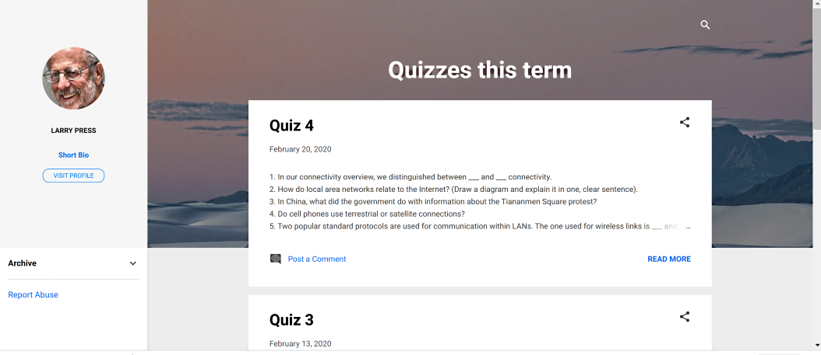
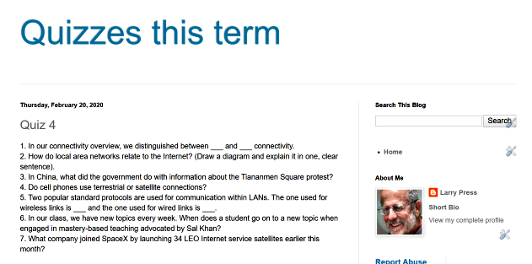
Same content, different appearance
How long did it take me to change the appearance of our quiz blog?

Slide 98
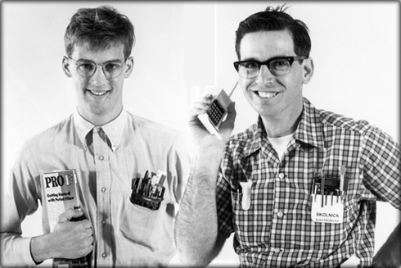
Application development skill
Batch processing and time sharing
Personal
computer
Internet
Four computing eras -- application development keeps getting easier, but we do more complex things.
Notes:
As technology improves, our tools improve and the kinds of applications we can create become more powerful.
During the early days of computing, we shared large, expensive computers by connecting terminals to them or submitting jobs in batches and waiting – usually several hours – to get the results.
In those days, programs were written by specialized engineers.
With the advent of personal computers, managers, teachers and others were able to develop applications using tools like spreadsheets or personal database managers.
Today, the general public can easily develop simple applications using tools like blogging, survey, database development services.
Modern technology makes new, complex applications possible and, while it is easier to develop simple applications, professional programmers are still needed to develop complex applications.
New programs were written by professional programmers in those days and I
This enables us to develop simple applications easily and frees us to develop previously impossibly complex applications.

Slide 99
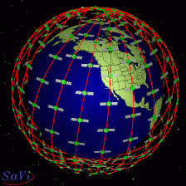
Cool Teledesic animation from around 1990
Note that
The satellites remain in the same orbital plane as they rotate around the Earth.
The Earth is rotating under them.

Slide 100
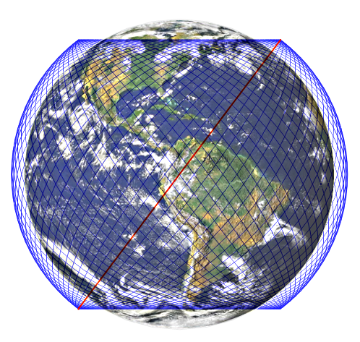
SpaceX Starlink, phase 1
1,584 satellites
72 orbital planes
22 satellites per plane
53 degree inclination
550 km altitude
Source
Notes:
The first phase satellites will orbit in 22 planes that are equally spaced around the equator.
They planes will be inclined at an angle of 53 degrees from the equator.

Slide 101
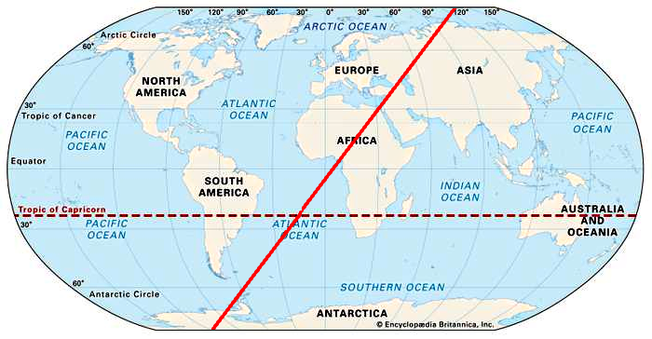
One of the 72 53-degree orbital planes
Will a given satellite continuously trace the same path over the Earth?

Slide 102
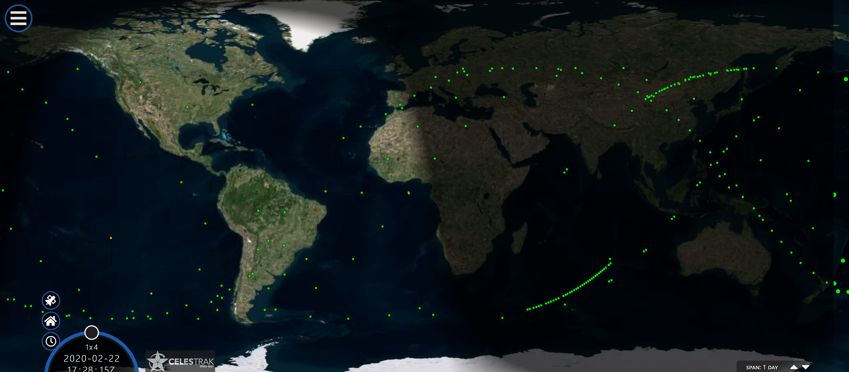
SpaceX Starlink satellites 2/22/2020
Source

Slide 103
SpaceX Starlink satellites, 2/22/2020
Source
Notes:
This figure shows the orbits of the Starlink satellites. Note that they are at an inclination of

Slide 104
Simulated coverage of SpaceX’s Starlink Internet-service constellation
Expected coverage, mid 2020
Expected coverage, late 2020
Source
Assuming a 120 satellite per month launch cadence -- will marketing and support be ready?

Slide 105
Video of Starlink deployment
Reflected light concerns astronomers
Will the satellites stay this bright? This close together?
Video (39 sec.) shot immediately after deployment.
Source

Slide 106
Moriba Jah
Interview of Moriba Jah
Moriba’s TED Talk
Do you listen to podcasts? Do you know about TED conferences?
Notes:
Moriba Jah is an internationally known expert on space debris and space law. I “know” him through email and Twitter exchanges, but have never seen him in person.
The image above is from a short TED talk on space debris. The talk is interesting and relevant to our class, but the interview is personal – about his biography and beliefs. He is exceptionally honest and moral. You can learn from him.

Slide 107
An example of asynchronous collaboration using Twitter comments
Why is this man smiling?
Broadband-pricing chat
Notes:
The discussion started with a post by Tim Farrar, a telecommunication consultant
Geoff Goodfellow was one of the early developers of the Internet
Bigwifi is a small ISP
I’ve never met any of these folks in person and do not know where they live, but we have a common interest..
Note that my first contribution was to ask a dumb question – Tim Farrar had talked about “SAC” and I did not know what that stood for.
As JCR Licklidder we are a small “community of common interest, not of common geography.”
http://memex.org/licklider.pdf

Slide 108
What will on-line interactive communities be like? In most fields they will consist of geographically separated members, sometimes grouped in small clusters and sometimes working individually. They will be communities not of common location, but of common interest.
The Computer as a Communication Device, April 1968
J. C. R. Licklidder was a scientist and saw the potential value of the Internet as a tool for scholarly collaboration. He did not anticipate that it could also be a tool for terrorists or propagandists.

Slide 115
Discussion
Last week’s class
Assignment feedback
Current events
Anonymous study-habit surveys
Week 8

Slide 116
Assignment feedback
10. Had three parts -- tweet something, find out how to do a search, and recommend a person to follow. Only three people did all three.
11. Turn in one answer with three names on it for a group assignment.
12. “Domain name” is a geek term – it just means the name of a computer that is connected to the Internet.
Team assignments – some people are freeloading, and that may be good news for them.

Slide 117
4G base station on campus

Slide 118
Cookies
Suggested by James Morton
Have you noticed messages like this on Web sites you visit?

Slide 119
Cookies
We use cookies to improve your website experience. To learn about our use of cookies and how you can manage your settings, please see our Cookie Policy. By continuing to use the website, you consent to our use of cookies.
Strictly Necessary Cookies
Performance Cookies
Functionality
Targeting or Advertising
Take away – cookies are used for more than targeting ads. I typically click OK.

Slide 120
The Billion-Dollar Disinformation Campaign to Reelect the President
Atlantic monthly article by McKay Coppins
Journalist Details 'Brazen Ways' Trump Will Use His Power To Get Reelected
Podcast with transcript: Terry Gross interviews McKay Coppins
@mckaycoppins
During the coming week either read the Atlantic Monthly article, listen to the podcast or read the podcast transcript.
Notes:
Micro-targeting Facebook ads. Trump

Slide 121
Nancy Pelosi crude fake
With commentary by UC Berkley Professor Hany Farid
At first, Facebook refused to take the video down, but later relented.
Was this free speech? Satire? Would you want Facebook employees deciding what can and cannot be published? The government?

Slide 122
The impact
Trump saw the clip on Fox News and retweeted it. His tweet was “liked” 94,000 times, retweeted 30,100 times and 63,200 commented on it.

Slide 123
This week’s crude fake
A deceptively cut excerpt from a speech

Slide 124
The uncut excerpt

Slide 125
Tweeted by Daniel Scavino Jr. , the White House Director of Social Media and Assistant to the President.
Flagged by Twitter
Facebook: “partly false”
Many views and comments
Notes:
Due to a Twitter bug, the Manipu;ated media tag appeared in people’s timelines, but not on Scavino’s Facebook page: https://twitter.com/DanScavino/status/1236461268594294785

Slide 126
Application development skill
Batch processing and time sharing
Personal
computer
Internet
Four computing eras -- application development keeps getting easier, but we do more complex things.
Notes:
As technology improves, our tools improve and the kinds of applications we can create become more powerful.
During the early days of computing, we shared large, expensive computers by connecting terminals to them or submitting jobs in batches and waiting – usually several hours – to get the results.
In those days, programs were written by specialized engineers.
With the advent of personal computers, managers, teachers and others were able to develop applications using tools like spreadsheets or personal database managers.
Today, the general public can easily develop simple applications using tools like blogging, survey, database development services.
Modern technology makes new, complex applications possible and, while it is easier to develop simple applications, professional programmers are still needed to develop complex applications.
New programs were written by professional programmers in those days and I
This enables us to develop simple applications easily and frees us to develop previously impossibly complex applications.

Slide 127
A more realistic, bi-partisan fake video
The mouth is critical,
Footage is required for training.
These are just talking heads.
Experts can detect fakes today.
Rep. Don Beyer (D-Va.)
Source
Rep. Michael Waltz (R-Fla.).
Notes:
Two Congressmen -- a Republican and a Democrat – team up on a fake video for the House Science subcommittee.

Slide 128
Excellent interview of Professor Hany Farid
Democratization of audio, video and image fake technology
Detection of fakes
Practical and legal considerations
Podcast
What happens when the crude fakes become good, “deep” fakes and are easy for anyone to make?
Notes:
We have noted

Slide 129
Earth Observation
Source
Suggested by Ramon Espinoza
Antarctica summer
Antarctica winter
Leads to stable, global currents
Notes:
Earth observation data is downloaded to and distributed throg
These are stills from a PBS Nova video on satellites used for Earth observation.
Extremely precise observations of the Earth, Sun and atmosphere have enabled scientists to model and understand the Earth as an integrated system – an almost inconceivably large, old and until recently slowly evolving organism.
You can argue that without Earth observation, we may have perished and with it we may not. That’s a pretty important application.
To get a little sci-fi and spacey, you can imagine the Earth as an evolving organism with the Internet as its brand new nervous system. In that picture, we people are neurons, routing traffic through the nervouls system – similar to the way Interne routers route data packets.

Slide 130
Full coverage
Geostationary
Low-Earth orbit constellation
Notes:
The traditional geostationary Earth orbit satellites are relatively large, expensive and custom designed.
Smaller satellites are small, cheap, and utilize many standardized components.
Both have a place, but small satellites are booming.
This is reminiscent of the evolution of computers from the mainframe to the minicomputer to the desktop personal computer to the laptop to the tablet to the mobile phone to the Internet of things.

Slide 131
This is a class about the Internet – what does Earth observation have to do with the Interent?

Slide 132
Starship spacecraft
Will build in Los Angeles
Go to Mars or
launch 400 Internet-service satellites at once
Fully reusable
One-week turnaround for LEO
Ready in about a year
Plan large fleet – about 1,000 Starships
Source

Slide 133
Anonymous study habit survey
Did you listen to the biographical interview of Moriba Jah? (Y/N)
Did you watch his TED talk on space debris? (Y/N)

Slide 135
Discussion
Last week’s class
Assignment feedback
Current events
Anonymous study-habit surveys
Week 9

Slide 136
Assignment feedback
Several people created brown blogs rather than blue.
Several people have still not created blogs. You will need them for future assignments. Many people have created blogs – get help from classmtes!

Slide 137
Toronto symphony plays Appalachian Spring from their homes.
Source
This performance was edited together from clips.
With future network latency, simultaneous performance may become possible.
Source

Slide 138
Guantanamera
An earlier example: over 75 Cubans around the world joining together to sing Guantanamera.
Source
Notes:
The Internet was envisioned and built by researchers who saw it as a tool to facilitate collaboration among scientists and engineers. Bush and Engelbart were thinking of tools they themselves could use to facilitate their own work, to “scratch their own itch” or as the geek saying goes they wanted to “eat their own dogfood.”
https://en.wikipedia.org/wiki/Eating_your_own_dog_food
https://en.wikipedia.org/wiki/The_Cathedral_and_the_Bazaar (See lesson 1).
Of course, Licklidder and others understood other sorts of collaboration would be valuable – he wrote “What will on-line interactive communities be like? In most fields they will consist of geographically separated members, sometimes grouped in small clusters and sometimes working individually. They 37 will be communities not of common location, but of common interest.” (https://web.stanford.edu/dept/SUL/library/extra4/sloan/mousesite/Secondary/Licklider.pdf).
The Internet has indeed fostered collaboration in many areas – this slide illustrates one that I bet didn’t occur to licklider.
Professor Chris Chafe (http://chrischafe.net/) at Stanford University is working on special purpose client hardware to enable relatively small groups to jam together online using today’s Internet.

Slide 139
US supercomputers available to global researchers
Source
One world -- global collaboration and resource sharing
Source
(A petaflop is one thousand million million (10¹⁵) floating-point operations per second).

Slide 140
COVID-19 impact on the Internet
Bob Cringley, an old time Silicon Valley reporter, predicts that COVID-19 will kill a ton of startups.
OneWeb is cutting workers.
OneWeb may consider bankruptcy.
SpaceX will have to slow production from their current 24x7 work schedule.
Tim Farrar, a space industry financial analyst things SpaceX needs to raise more money.

Slide 141
Anonymous study habit survey
Did you listen to the biographical interview of Moriba Jah? (Y/N) 4 people did
Did you watch his TED talk on space debris? (Y/N) 7 people did

Slide 142
Anonymous study habit survey
1. Did you read McKay Coppins’ Atlantic Monthly article on the disinformation campaign to reelect the president? (Y/N)
2. Did you listen to the podcast of Terry Gross’s interview of Coppins? (Y/N)
3. Did you read the transcript of Terry Gross’s interview of Coppins? (Y/N)
Notes:
Micro-targeting Facebook ads. Trump

Slide 144
Discussion
Last week’s class
Assignment feedback
Current events
Anonymous study-habit surveys
Week 10

Slide 145
The vast ACM Digital Library will be freely accessible through June 30, 2020.
The Association for Computing Machinery (ACM) is an international learned society for computing. It was founded in 1947 and is the world's largest scientific and educational computing society.
Source

Slide 146
Terrific, in-depth interview podcasts
Fresh Air with Terry Gross
Stay Tuned with Preet Bharah
Do you listen to podcasts? If so, which ones do you like? Why?

Slide 147
Tools
Google Drive Forms
Forms is like the SurveyGizmo survey service (class background survey) and the Zoho Creator database service (class roster).
Forms is limited compared to them but free and good enough for many applications.
A sample application: Positive Internet applications in the time of COVID-19:
Form
Entries

Slide 148
Assignment feedback
New rule: full credit for late assignments after #15 due to COVID-19 (but don’t procrastinate)
Extra credit will double at the end of the term.
Two people still do not have blogs – if you know them, reach out
One blog is pink – make it blue like the others
I’m open to new ways to generate extra credit

Slide 149
Class changes
Weekly meetings for discussion and questions only.
Study topic modules offline before the class meeting.
Do assignments before the class meeting.
Give me feedback on the relative value of videos and PowerPoint presentations.
Read your email frequently.

Slide 151
Discussion
Last week’s class
Assignment feedback
Current events
Anonymous study-habit surveys
Week 10

Slide 152
Assignment feedback
I will grade the image editing assignments and give you feedback by the weekend.
If you want to make up past assignements, email me a note with the assignment number as the subject line and attach what you would have turned in if we had been in class.
Were your Ping times to South Africa different during the day and the evening? If so why?
Were you able to create a square headshot of your face?

Slide 153
Next topic and assignment
We are moving on to a new skill – audio editing.
Your first audio assignment is to install and play around with Audacity, an audio recording and editing program.
I posted topic modules on audio editing and Audacity and I also created a video of me playing around with Audacity. Study the topic module presentations then play around with Audacity. If you have trouble, watch the video and let me know if it is helpful.

Slide 154
Tools
Screenrec: a simple, fast, free screen recorder
Five minute tutorial
Recording is immediately available on the Screenrec server
2 GB free storage on the server
Download the video for local editing
For Mac, Windows and Linux.​
Screenec.com

Slide 155
The digital divide:
Online school
Source
Many rural and students lack home computers and Internet access.
Many poor students lack home computers and Internet access.
Has a lack of access during the shutdown affected you personally?
Notes:
Lack of Intene access and on-campus access to Windows PCs has made it impossible for all CSUDH students to use the same image processing and audio editing software.

Slide 156
One interim solution
The Austin, Texas Independent School District Is rolling out 110 buses equipped with Wi-Fi in neighborhoods with limited Internet access (source).
Today’s WiFi has about a 300 foot reach.
Connections slow down when distance increases.
Is Internet access a necessity or a luxury? A human right?
Should we subsidize Internet access?

Slide 157
Questions and Discussion

Slide 159
Discussion
Last week’s class
Assignment feedback
Current events
Anonymous study-habit surveys
Week 11

Slide 160
Assignment feedback
When you post assignments on your blogs, be sure to:
Click “publish” when you are done – “save” and “preview” do not publish the post.
Title the post with the assignment number and title, for example “Assignment 20: Install and play with Audacity”.
Note that post labels are like hashtags:

Slide 161
Microsoft Windows [Version 10.0.17763.1158]
(c) 2018 Microsoft Corporation. All rights reserved.
C:\Users\LPress>ping www.ucla.edu
Approximate round trip times in milli-seconds:
Minimum = 16ms, Maximum = 40ms, Average = 28ms
Minimum = 15ms, Maximum = 61ms, Average = 29ms
Minimum = 14ms, Maximum = 104ms, Average = 49ms
Minimum = 25ms, Maximum = 75ms, Average = 48ms
Minimum = 23ms, Maximum = 200ms, Average = 83ms
Minimum = 16ms, Maximum = 31ms, Average = 25ms
C:\Users\LPress>
Six Ping commands in 30 seconds
(from Carpinteria)
Each was different, averaging 25-83 milliseconds.
Notes:
I Pinged UCLA from Carpinteria six time in about 30 seconds. Each line represents four Ping attempts. – all are different even at nearly the same time of day.

Slide 162
Two Pings from Carpinteria at different times on the same day
C:\Users\LPress>ping www.ucla.edu Pinging gateway.lb.it.ucla.edu [164.67.228.152] with 32 bytes of data
C:\Users\LPress>ping www.ucla.edu Pinging gateway.lb.it.ucla.edu [2607:f010:2e8:228:0:ff:fe00:152] with 32 bytes of data
Do you notice something weird about the UCLA IP addresses?
Notes:
We have said that IP addresses were like 164.67.228.152 – four numbers separated by dots.
In the second Ping example, UCLA’s IP address is shown as 8 groups of letters/numbers separated by colons.
The Internet is migrating from Internet protocol version 4 ot version 6.
UCLA has made the change to version 6, but many other organizations have not so UCLA has two IP addresses – one for version 4 and a second for version 6.

Slide 163
IP v4 versus IP v6
IP version 4 addresses are 32 bits long, giving
4,294,967,296 (2^32)
unique addresses
IP version 6 addresses are 128 bits long. Giving 340,282,366,920,938,463,463,374,607,431,768,211,456 (2^128)
unique addresses
Why do we need more unique IP addresses?
Notes:
IP v4 was defined and deployed in the 1970s. No one expected billions of computers would be connected to the Internet.
Today, many things like cars and temperature sensors and doorbells are being connected to the Internet. More addresses are needed for the “Internet of things”.
Geek majors will recognize the version 6 addresses as being written in hexadecimal. If you don’t know what that means,, don’t worry – just know that the addresses are different

Slide 164
How to get the answer – if you don’t know something, ask someone.
(The hardest part is often knowing that you don’t know.)
Source
Notes:
Since the first say of class, I’ve been stressing that it is not knowing the right answer, but knowing you are confused and knowing how to get the right answer.
I wondered how the domain name service decided which IP address to substitute for www.ucla.edu, so I posted a question on a bulletin board.
I did not get a satisfactory answer, so I asked a networking guru I know.
(I’d been shy to ask him because it seemed like a dumb question).
It turns out he does not know and has asked some he considers his IP naming guru.
The moral of the story is don’t be to proud to ask a question – like I was.

Slide 165
Traceroute from Carpinteria to UCLA
11 hops
2 congested routers
C:\Users\LPress>tracert www.ucla.edu
Tracing route to gateway.lb.it.ucla.edu 2607:f010:2e8:228:0:ff:fe00:152
1 2 ms 1 ms 1 ms 2600:8802:5202:3d00:deef:9ff:fe1f:5403
2 29 ms 22 ms 53 ms 2600:8802:52ff:ffff::1111
3 58 ms 41 ms 40 ms 2001:578:400:fff0:7000::28
4 33 ms 69 ms 38 ms 2001:578:400:fff0::1a
5 31 ms 35 ms 37 ms 2001:578:1:0:172:17:249:32
6 56 ms * 40 ms 2001:470:0:40a::1
7 34 ms 29 ms 30 ms 2001:468:e00:801::1
8 100 ms 28 ms 37 ms 2607:f380:1::118:6a41:8871
9 88 ms 57 ms 48 ms 2607:f010:bff:f005:0:ff:fe00:1
10 * * * Request timed out.
11 22 ms 42 ms 22 ms 2607:f010:2e8:228:0:ff:fe00:152
Trace complete.
C:\Users\LPress>
Notes:
Traceroute sends three packets to each upstream router.
If any of them exceed a specified Ping time, it displays an asterisc.
If three exceed the limit, it goes on the next upstream router.

Slide 166
A significant change to SpaceX Starlink
They have applied for significantly lower orbits.
Source
Notes:
That will mean smaller footprints so fewer satellites will be visible at any time and lower latency between the Earth and satellite.

Slide 167
COVID stuff
Notes:
COVID-inspired ways to use the Interent.

Slide 168
Sharing music
#Songs of Comfort
PBS segment
Notes:
Cellist Yo-Yo Ma started the #songsofcomfort hashtag.
Famous and amateur musicians from all over the world have posted clips.
Look for the #songsofcomfort hashtag on Twitter, Instagram, YouTube etc.

Slide 169
Getty Quarantine Art Challenge
Watch this PBS segment about the project (3m 38s)
Check out the art at #GettyMuseumchallenge

Slide 170
Funny things

Slide 171
One more excellent in-depth interview podcast
Why is this Happening with Chris Hayes
Notes:
Previously I recommended Terry Gross and Preet Bhara as excellent podcast interviewers. Here is one more.

Slide 172
Folding at home
Jeffrey Herschler

Slide 173
Target store update

Slide 174
Next week

Slide 175
Retrieving a modern, complex Web page
Notes:
We have seen what happens when you request, retrieve and display a simple Web page, but modern Web pages contain embedded images, video, audio and programs and each embedded object requires a separate request from the client to the server and subsequent file transfer from the server to the client.

Slide 176
This week’s image processing assignments -- layers and transparency
Instead of demo videos, I prepared annotated slide presentations – let me know which works better.
Notes:
Two assignments this week illustrate multi-layer images and transparency. You will also learn to use the Magic Wand tool to select irregular shapes.

Slide 177
Installing an .mp3 encoder in Audacity
Notes:
Because of copyright restrictions, Audacity cannot export files in the popular .mp3 format when you first install it.
So, the first time you try to export an .mp3 file, it will pop up the dialog box on the right.
If you just click OK and do what it says, it will download and install the .mp3 encoder.
You only have to do this once – the first time you export a file.
Note that saving a project is not the same as exporting an audio file.
When you save a project, it saves your initial recording and all of the changes in the editing history.
That way, you can work on a project, save it, and later pick up where you left off.

Slide 178
Questions and Discussion

Slide 180
Discussion
Week 12
Assignment feedback
Current events
Next week
Coming attractions
Questions or comments

Slide 181
Assignment feedback
Now that you are posting assignments on your blogs, I asked you to title the posts with the assignment number and title, for example: “Assignment 20: Install and play with Audacity ,” but some of you did not do so. I will no longer even look at assignments for which you do not do that.
If you submitted an assignment before last Sunday and did not get credit for it, you should have a comment stating what was wrong.
I added one more audio editing assignment today and that will be the last one of the term.
May 10 is the deadline for posting assignments.

Slide 182
Current events

Slide 183
Winners and losers
How will
Amazon
Apple
Microsoft
Google
Facebook
do post COVID-19?

Slide 184
Old news
New news
Source
Source
A used rocket launches 60 Starlink satellites and lands safely on a barge at sea.
Elon Musk announced the Starlink beta test schedule. In six months, when the public beta begins, they will have over 700 satellites in orbit.
Notes:
This rocket had been flown three times prior to this launch, It is now news when they fail to reuse a rocket. No other company has succeeded in recovering a rocket that reached orbit altitude, but eventually others will too. SpaceX has a big lead, but it is not forever.

Slide 185
The orbits of these first satellites are inclined 53 degrees from the equator.

Slide 186
Simulated coverage of SpaceX’s Starlink Internet-service constellation
Expected coverage, mid 2020
Expected coverage, late 2020
Source
Heaviest coverage will be at 53 degrees latitude, but LA (34 degrees north) will have coverage in 6 months.

Slide 187
Next week
Compression
Internet of things
Analog data
Data + a code => information

Slide 188
90 % reduction
Both have the same number of pixels – explain the loss of information.
Notes:
The original on the left 359 by 381 pixels and 106 kilobytes..
The compressed version on the right is also 359 by 381, but it is only 10.7 kilobytes, a 90% reduction in file size, Lucas’ forehead looks a little mottled and the highlight in his hair is a bit less pronounced.
Still, at first glance, the difference between the original and the compressed version is pretty small.
When the changes are subtle, you need to focus on specific detail to spot differences.
The application and users expected viewing device will determine the amount of compression you can get away with.
If an image is a minor illustration on a page, compress it strongly. If it Is for a high quality Web site like National Geographic, don’t compress it at all.

Slide 189
96% reduction – obvious information loss
Both have the same number of pixels – explain the loss of information.
Notes:
This compressed image is down to 3.8 kilobytes, a 96% reduction in file size.
The pixilation is obvious.
We have thrown away most of the information in the picture.
Note that the size of the image has remained the same – 359 by 381 pixels.
The information loss was due to a reduction in the size of the color palette -- the number of different colors a given pixel could be.
For example there are only five shades of brown in Lucas’ face in the compressed image.
When we looked at text-encoding another example of the same thing – each character in a text message conveys more information if it is from a 128-character alphabet than if it is from a 64-character alphabet.
Loss of variety, means no information even with the same number of pixels.

Slide 190
All files can be compressed
Image
Numeric
Program
Text
Audio
Video
Which require lossless compression?
Notes:
All data and program files can be compressed, and information may (or may not) be lost during compression.
In most image, audio and video applications, we can afford lossy compression, in which some information is lost.
With lossy compression, there will be a tradeoff between file sized and the quality of the result.
If we are compressing other data types, for example a program or text or numeric data, we require lossless compression.
With lossless compression, the file can be de-compressed to create an exact duplicate of the original.
No information is lost during compression.

Slide 191
The Internet of things Input and output to and from things, not people
CPU
Input
Devices
(sensors)
Memory
(ROM or RAM)
Output
Devices
(effectors)
Storage devices
(programs and data)
Notes:
With a laptop or desktop computer, the user interacts with the input and output devices, for example typing information on a keyboard, pointing at the screen with a mouse, or reading printed or displayed information.
The computers that are embedded in special purpose devices have the same functional components, but the inputs, outputs or both are often to and from things, not people.
Computers can acquire data from sensors of temperature, altitude, orientation, acceleration, speed, moisture, cameras, etc. etc.
They can output commands to effectors – start motors, turn off lights, turn on air conditioning, stop a car, open an elevator door, etc. etc.
Note that we distinguish between two types of memory, ROM and RAM.
These are acronyms from the early days of computing – read-only memory and random-access memory.
We have been talking about RAM throughout the semester – it is the memory that holds the programs and data a computer is currently working on. As such it changes whenever a user enters some new data or starts a new program. Phones, laptops, etc. are general purpose devices and their programs can easily and quickly be changed.
ROM does not change., which is fine for a computer that is embedded inside a device. You never use your microwave oven as a word processor or audio editor – it just cooks food and is preprogrammed at the factory.

Slide 192
Which clock is digital? Analog?
http://som.csudh.edu/fac/lpress/presentations/clocks/clocks.html
Notes:
But, before it can be processed by a computer, the this analog signal must be converted to digital data.
So, before we talk about sound recording, we need to distinguish between analog and digital data.
To start, which of these clocks is digital and which is analog?
Which clock is the closest analog to the physical world?
Run the animation and try to answer the question before you go on.

Slide 193
Analog data is continuous, not discrete.
What is the temperature in this room right now?
Is it 70 degrees? 70.1? 70.12? 70.12567854? You get the idea.
What will happen if I turn the heater on?

Slide 194
A digital clock
…
00
01
02
03
04
01.49
It reads 12:00, 12:01. 12:02, 12:03, etc. Never 12:0149.
Notes:
The clock on the left is digital because it jumps from second to second, while the right hand clock runs smoothly between seconds
Digital data is discreet and jumpy, not smooth and continuous.
The digital clock cannot show the time between seconds, so it must round off to the nearest second.
It reads 01 until the half-way point between 01 and 02, then jumps abruptly to 02.
We will see that when we convert analog to digital data, this rounding causes a degree of inaccuracy.
Now, lets look at the audio recording process.

Slide 195
The world is analog, and today’s computers process digital data.

Slide 196
Recording and playing sound
Computer
Analog to digital converter
10010110 (150)
11001001 (201)
11000111 (199)
…
Computer
10010110 (150)
11001001 (201)
11000111 (199)
…
Digital to analog converter
Notes:
A microphone converts the sound it picks up into a continuously varying voltage.
That signal is fed to an analog-to-digital converter, a chip that measures the voltage and encodes it as a series of numbers.
Those numbers are fed into a computer, where they can be manipulated using an audio editing program like Audacity.
Playback reverses the process.
The computer outputs the numbers to a digital-to-analog converter which converts them to a continuously varying signal that drives a speaker.
Let’s look more closely at the recording process.

Slide 197
5 bytes of data
0100110001100001011100100111001001111001
01001100 | 01100001 | 01110010 | 01110010 | 01111001
What can you conclude from these two codes being the same?
Notes:
This data looks random, but it isn’t.
It represents a word – five letters.
Two of the letters have the same code. but – what does 01110010 signify?
We can decipher the message if we know the code that was used.

Slide 198
A code for text data
Notes:
This table shows the code that was used in encoding our data.
The repeated byte 01110010 represents the lower-case letter r.
Can you decode the text now?

Slide 199
Data + a code → information
0100110001100001011100100111001001111001
L | 01001100
a | 01100001
r | 01110010
r | 01110010
y | 01111001
L | a | r | r | y
Notes:
Using our character code, we can now decipher the 40 bits of data.
As you see, data plus a code yields information.
This was an example of a code for text data, but all data has to be encoded in a systematic, standardized way if it is to convey information.
Files with the extension .jpg are image files encoded in a standard manner.
Files with the extension .png are also image files, but they are encoded in a different manner.
Files with the extension .mp3 are audio files encoded in standard manner, etc. etc.

Slide 200
Coming attractions
Next week is the last week of class and the final is the week after that.
I’ve posted your last assignment and the topic modules for rest of the term so you can plan ahead.
Post any questions you have on the class email list, cis275s2020@lists.csudh.edu. I will check once a day between now and the final. You should do the same.

Slide 201
Questions or comments

Slide 203
Discussion
Week 12
Assignment feedback
Current events
Next week
Questions or comments

Slide 204
Assignment feedback
If you didn’t get credit for an assignment you think you should have, check the comment I left.
If there is no comment, make sure you have titled the blog post with the assignment name and description.
On the assignment 22, transparency, you must use the circle and ring images I provided. That will force you to get experience with the Magic Wand too which is used for selecting irregular shapes.
From now going forward, send me an email if you complete more assignments.

Slide 205
Current events

Slide 206
Ask me anything “webinar” with Zoom founder and CEO Eric Yuan
Many new use cases
Average daily meeting participants:
December 2019: 10 million
March 2020: 200 million
Could scale rapidly because of data transport and hosting infrastructure
Source
From the start, the Internet has enabled us to substitute communication for travel. Will that trend increase post COVID-19? Is there a new normal?
Notes:
Zoom was targeted initially to the business and enterprise market, but is now being used by families, schools, and others.
I cannot think of any business or technology that has grown as rapidly as Zoom.
It’s amazing that it has not crashed frequently – like Twitter in the early days.
It has been able to scale because there was slack in the transport and hosting infrastructure services – ISPs and Amazon or whoever hosts Zoom.

Slide 207
Winners and losers
How will
Amazon
Apple
Microsoft
Google
Facebook
do post COVID-19?
Notes:
On December 30, 2019 Amazon stock was selling for $1,847.84 per share and on May 1, 2020 it was $2,286.04, an increase of 23.7 percent (https://www.google.com/search?q=amazon+stock+price&oq=amazon+&aqs=chrome.1.69i57j69i59j35i39j69i60l5.8094j0j7&sourceid=chrome&ie=UTF-8). The government gave trillions of dollars to consumers and at the same time, told most brick and mortar retailers they had to close, creating a double windfall for Amazon and other online retailers. Amazon has already won as a retailer. But that is only part of the story. Amazon is known for retail, but they are a major infrastructure company, which is even more important in the long run.

Slide 208
Amazon is an infrastructure company (and a retailer)
Cloud hosting (Amazon Web Services)
Cloud storage
Shipping and delivery
Credit cards
Echo voice application platform
Affiliate retailer program
Satellite ground stations
Satellite launch service
Forthcoming satellite internet service
The invisible eye of the marketplace Amazon
Notes:
Since its inception, the Internet has enabled business and society in general to substitute communication for transportation. (See, for example, my 1998 pilot study at Hyundai USA, https://dl.acm.org/doi/abs/10.1145/276609.276611).. The rate of that substitution is a function of technological improvement and changing exposure and skill level of users and organizations. COVID-19 has led to the invention of new use cases for communication in lieu of transportation as well as the training of users. COVID-19 will cause a discontinuity in the gradual increase of the substitution of communication for transportation and that will mean increased demean for Amazon’s infrastructure.
More companies will establish affiliate retailer stores at Amazon.com and those that are already there will see increased sales. (In 2018, third-parties accounted for 58% of Amazon retail sales, https://blog.aboutamazon.com/company-news/2018-letter-to-shareholders). There will be increased demand for Amazon fulfillment and delivery services as well as their credit cards.
Organizations that need to tighten their belts to survive after COVID-19 will want to cut costs and staff, making Amazon Web Services (AWS) and Cloud Storage more attractive. Since many organizations will fail and people will lose jobs after COVID-19, we may see a spike in startups to exploit Internet use cases that have been discovered because of COVID-19. Many of those startups will be run out of Amazon datacenters.
While COVID-19 may diminish space investment in the short run, it is a long-term growth sector and Amazon will benefit from that as a space infrastructure company. They are investing heavily in the launch business and recently (along with two others) received funding as part of NASA’s ambitious lunar program (https://www.washingtonpost.com/technology/2020/04/30/jeff-bezos-elon-musk-win-contracts-spacecraft-land-nasa-astronauts-moon/). Amazon ground station service will be attractive for space startups with little cash to spend on building out their own ground infrastructure.
Amazon’s Echo voice platform is also the leader in the growing voice-application sector.
Amazon’s forthcoming broadband Internet service constellation (https://cis471.blogspot.com/2019/04/amazons-orbiting-infrastructure.html) got a boost with the recent bankruptcy of OneWeb, which was shaping up to be a major competitor. OneWeb says COVID-19 precipitated their bankruptcy and Amazon may purchase the company or a portion of its assets (https://cis471.blogspot.com/2020/03/oneweb-is-bankrupt-who-will-buy-their.html
Finally, in addition to generating revenue, Amazon’s infrastructure will yield increased amounts of information in the post-COVID era. That information will enable them to better allocate resources and investments and make dynamic pricing decisions.
All of this is good news for Amazon post-COVID, but if it is too good, they may face anti-trust action.

Slide 209
Private and publicly-owned infrastructure
The Internet: seeded by the government, but now privately owned
The Interstate highway system: public infrastructure maintained by gasoline tax
Notes:
Zoom was able to scale because of existing transport and data-center infrastructure, and that is a "good" thing that was seeded by public investment but made possible by subsequent private investment in infrastructure. On the other hand, publicly-owned infrastructure is another way to raise capital — for example the sidewalk in front of my house or the US Interstate Highway System.
Both have strengths and weaknesses in the short and long term. Both must be continuously monitored and revised as people inevitably learn to game the system whatever it is.
Maybe we will be clever enough to devise better systems or compromises. Years ago, I worked on a couple of studies of the Internet in Singapore where the government went beyond R and D — they were equity investors in ISPs. I don't know how that has played out. Municipal networks invest in common transport infrastructure and offer it to private retailers in many places. It seems like China funds private startups then lets them compete with each other.

Slide 210
Next week
Exponential growth
Technology progress
Evolution of application deployment
Introducing HTML

Slide 211
Linear versus exponential growth
Grow by the same amount in each time period
Grow by the same percent in each time period
Notes:
You may have heard the term “exponential” growth.
People often use it as a synonym for “very fast growth,” but it has a more precise definition.
It means is that something is growing at a constant rate rather than by a constant amount.
That sounds like a small difference but if as we have seen with COVID-19, when the number of cases was doubling every few days, it quickly got out of hand.

Slide 212
Transistor count – Moore’s Law
Is this linear growth or exponential growth? Explain your answer?
Notes:
Let’s consider a tech example of exponential growth.
The first CPU chips had about 2,300 transistors.
If that had gone up by a constant amount, say 2,000 transistors a year we would be up to about 80,000 transistors on a chip.
Instead, we are up to over 2 billion, because the number of transistors grew by about 50% per year.
In 1965, Intel co-founder Gordon Moore published a widely quoted article predicting that the number of transistors on an economically feasible silicon chip would double every 18-24 months.
That prediction has come to be called Moore’s Law, and it has held up well.
This plot shows Moore’s prediction (the straight line) to actual data.
Eventually the rate of growth for silicon chips will flatten, but by then we will hopefully have shifted to a new technology.

Slide 213
Technology refinement and technology shifts
Notes:
Technology progress occurs in two ways – improving current technology and shifting to new technologies that provide the same function.
When we discover a technology, we continuously improve it over time.
Technology shifts occur when we move from one technology to another – for example moving from punch cards to magnetic tape or disk for storage.
Let’s look at an example of improvement through technology refinement and another that is an example of a technology shift.

Slide 214
Technology refinement
1905
Today
Notes:
Internal combustion gasoline engines were used in early cars.
The early engines were inefficient and expensive, but engineers began improving them.
We are still using internal combustion engines in small planes and many cars, but they are much improved over the first generation.

Slide 215
Easter Parade, New York
1905
1913
What is the function of these technologies? Is this technology shift or refinement?
Notes:
Horse carts were used for personal transportation in New York in 1905. There is only one car in the image on the left.
In 1914 we see only cars and no horse carts being used for personal transportation.

Slide 216
PC server
Notes:
Our school Web server started out on a Windows 3.0 desktop PC in my office.
I installed the Web server software and my students and I created the content -- pages for each professor, etc.
It was connected to the Internet through the school LAN.
I left the computer running 24 hours a day so people could visit the Web site when I was not around.
When I was in my office, I used the computer for things like word processing and spreadsheets.
There were not many Web users, so it didn’t slow down very much while I was using it.
In those days many people ran Web servers on home PCs, connected through their home ISP.

Slide 217
Severs on and off premises

Slide 218
Servers inside of things
Notes:
When you configure your doorbell, home WiFi router, Roku video receiver or other things connected to the Internet, you are talking to a Web server inside the device you are setting up.

Slide 219
Four cloud computing benefits
Reduce fixed costs
Speed innovations to market
Scale flexibly
Extend collaboration
Match the icons with their captions.
Notes:
I took these icons and captions from an IBM magazine ad on the advantages of their cloud computing services.
Can you match the captions with their icons?
Collaboration is facilitated because single copies of the data and documents the team is working on are accessible at all times from any device connected to the Internet.
Fixed costs are reduced because you can start with one small virtual server and add more as demand increases.
You can quickly add or remove servers as demand rises and falls.
You can configure a server to deploy and test a new application from your desktop with a few keystrokes.

Slide 220
HTML – Hypertext Markup Language
Notes:
Hypertext and markup are simple ideas.

Slide 221
HTML -- Hypertext
Hypertext:
Linear text:
Table of contents
Chapter 1 1
Chapter 2 10
Chapter 3 20
. . .
Notes:
A hypertext has embedded links, and you can jump from page to page by clicking on a link.
We can contrast that to a conventional linear text, like a book or magazine article.
A linear text is intended to be read from page one to page two and so forth to the end.
You could think of the World Wide Web as a huge hypertext with trillions of linked pages.
That explains the “hypertext” in HTML, what about the term “markup?”

Slide 222
Markup – adding tags to control appearance
This word is bold.
This <b>word</b> is bold.
Notes:
When we mark up an HTML page, we add tags to control its appearance.
Here we began with the sentence “this word is bold.”
Next we added the tag <b> and </b> to our original sentence.
When the page is displayed by a Web client program, everything between the <b> and the </b> is boldface.

Slide 223
Markup – adding tags to control appearance
This word is bold.
This <b>word</b> is bold.
Notes:
When we mark up an HTML page, we add tags to control its appearance.
Here we began with the sentence “this word is bold.”
Next we added the tag <b> and </b> to our original sentence.
When the page is displayed by a Web client program, everything between the <b> and the </b> is boldface.

Slide 224
HTML tags control appearance, not content
Notes:
As we’ve seen in our earlier example and here, adding tags to a page does not change its content, just its format.
Each of these pages has the same words, but they differ in appearance.
The top page had no HTML tags added to it.
For the second one, I added tags to change the color of parts of the text.
In the third, I added more tags to change the layout of the page on the screen.
(The last one is a two-row, three-column table).

Slide 225
The Filezilla FTP client
My laptop
The Web server
Notes:
Once you have debugged and perfected a Web page on your development computer, you must copy it to a Web server so others can see it.
One of the oldest Internet protocol is FTP – the file-transfer protocol.
Here I am using an FTP client called Filezilla.
The listing on the left shows the files in the CIS275 directory on my laptop.
The listing on the right shows the files in the CIS275 directory on the server with the CIS275 Web site.
As you see, they are nearly the same – I “mirror” my Web site on my laptop.
When I have a page ready to be deployed, I simply copy it from the client (left side) to the server (right side).
Once I have copied the file to the server, it will be visible on the Web.
This also insures that I have a full backup of my Web site.
If I get a new laptop, I can copy the Web site files from the server to the new laptop using FTP.

Slide 226
Final Exam
Exam next Wednesday
Each timed separately – 90 minutes for multiple choice and 60 for short answers
Exams will be available from 6AM till 11:59 PM

Slide 227
Questions or comments

Slide 228
Questions or comments

Slide 238
The difference between 5G and previous generations of mobile services (4G, 3G) is that the latter use lower radio frequencies (below the 6 gigahertz range), whereas 5G also uses frequencies in the 30–300 gigahertz range.
Source

Slide 239
Speech interaction is becoming mainstream
Do you type or speak to your phone?
Do you talk to your car?
Do you have a speech recognition appliance in your home?
Notes:
I want a Kindle killer

Slide 240
The future of speech editing
Text to speech
Voice mimicking
This experimental system makes speech editing a snap, but it also makes creating fake speech a snap.
Video

Slide 241
Text to speech and speech to text, with translation
Video
Are there times when this would be good enough? Do you use text translation software now?

Slide 243
https://www.itu.int/en/ITU-D/Statistics/Documents/facts/FactsFigures2019.pdf
The Internet has been valuable during the pandemic.
Can we afford to have half the population off line?
https://itweb.africa/content/KPNG8v8Kbzdq4mwD

Slide 246
Why was Zoom able to scale so rapidly?
Steve song quote
Regulation generations quote
Why zoom was able to scale – transport and server infrastreuctuer -- AWS
https://dl.acm.org/doi/abs/10.1145/276609.276611
Source
If a trucking company gets a big new customer, they may need to hire more drivers and trucks, but the highway system is infrastreucture.
Notes:
Zoom was able to scale because of datacenter and transport infrastcutre.
That infrastrcuter is mostly private propert.
But all infrastructure is not private propert – for example the Interstate Highway system.
Data centers all over the world
Capital was raided and iinfrastructure built by private companies like Amazon and ATT
Their sharholders deserve reward for making the investments.
Their executuves and employees deserve reward for their risk taking, invention and hard work.
But they benefited from public edication and government sponsored R&D.
Governmente contrintes as an early customer.
What motivated Gates/Beos et al to take the risks and invest the time and money they did?
(use example of the joy of the engineers at Lynk)
.

Slide 247
Zoom bombing – ways to do it and ways to fight it
Zoom has hired Facebook’s ex security chief as a consultant.

Slide 248
More on WiFi congestion
Bush
Engelbart
Lick realied that the net would be for collabr
Remote login
File transfer
Email
Usenet news
Napster
SABRE online reservations for professionals
Voice conferenceing at ISI
Vocaltec Internet phone
Skype
Spam
Fraud
Propaganda
Sabatoge

Slide 249
Telesat has arctic coverered even if OneWeb is finshed
Does not inspire confidence to see major changes
Was it tied to onewen bankruptcy?
If no islls have they given up on the Wall street trader super low latency market?
Did wall street crash have anything to do with that?
Inability to deal with debris?
When, why decided?
Based on positive tests of Hall effect thrusters?

Slide 250
https://www.pbs.org/newshour/show/accentuating-the-positive-with-songsofcomfort
In this quarantine art challenge, creativity begins at home
03:38
In this quarantine art challenge, creativity begins at home
https://www.pbs.org/newshour/show/in-this-quarantine-art-challenge-creativity-begins-at-home
#GettyMuseumchallenge

Slide 251
Brows the applications catalog
Graphics-Photo > Editor > Paint.net
https://www.liberkey.com/
https://portableapps.com/

Slide 252
Screenshot when you open your phone
Google Translate:
Information notification [Seongdong-gu Office] 4.12 (Sun) The 13th to 16th confirmed cases occurred / Eungbong-dong Address 4 family members (resident in the United States), 4.10 Entry, home and surrounding quarantine completion, c19.sd.go.kr
Your translation:
The 'Information Notification' says that on 4/12/20, the 13th - 16th confirmed infected people were confirmed. They were a family of four that resided in Korea and just came back. They have disinfected their house and the surrounding area.
Are the four people the 13-16 th cases in that area of the city?
Are these four people US residents who are visiting Korea? Do they have a house in Korea? Is that where they are quarantined?
What’s up with the link to c19.sd.go.kr? Is that a public health site with a current database on infected people?
Your note:
But, the largely black photo is what I see when I open my phone, once or twice a day. It comes on even before I log in. So, I must see it.

Slide 253
Google Translate:
Please refrain from going out, ventilating and disinfecting the house, washing your hands and coughing etiquette, and keep the distance of 2m. 4:02 PM
Yongsan-gu Office] Corona 18th confirmed case (Yong Mun-dong, overseas immigrants) occurred. Under investigation. Please refer to the homepage and blog. blog.naver.com/
ysn blog 5:29 PM
(Are the above from April 5)?
Monday, April 6, 2020
[Seongdong-gu Office] 4.6 (Mon) 8th confirmed cases / Residents of Wangsimni-do Seon-dong (22 years old ) District A 18th or 8th?
Is your 10 square block sub-district “Wangsimni-do” or “District A”?
Naver.com is not focused on COVID-19 – is it commercial? Government?
---
This information is about my area, Yongsan. I guess it is 2 square miles. It's not like my street, but it's not half of Seoul either. That's how targeted this message is. It says an 18th patient was found in my area, Yongsan. And, then it gives the name of the subdistrict of Yongsan. If it is like my area, it's probably 10 square blocks, perhaps. This was a foreign person. They are researching where this person went. If you want more information, they ask you to go to the blog. blog.naver.com/ysnblog seems to be commercial??

Slide 254
The puke colored screen shot is the blog. It says, "Cheer Up Korea" We're going to overcome this together. Then it tells 1,321 people visited the site today. In total, 1,528,642 people have visited it. And, there is a blog with more detail than I could translate. It's not high tech. Its just a blog.

Slide 256
https://avc.com/2020/04/the-internet/
Internet traffic spike
Since the week of Feb 1030% 10: 30% increase in traffic in four countries with early lock-downs (China, South Korea, Japan, Italy)
Since the week of March 9th as more countries implemented lock-downs, global traffic saw 30% Y/Y growth vs. 3% on average
Peak traffic has more than doubled Year over year to 167 Tbps.
– AKAM execs calling it the “greatest spike in Internet traffic the company has ever experienced”

Slide 257
Voice synthesis
Can you tell the real Joe Rogan from the fake Joe Rogan?
Try it.
Comedian and podcaster Joe Rogan

Slide 258
Cisco annual Internet report
Report site
The report includes many statistics and resources including this Readiness tool

Slide 259
Democracy in Retreat
Freedom House: Freedom in the World 2019
The Internet has contributed to this trend.
What else?

Slide 262
Interactive map

Slide 263
The US remains free, but ranks below its peers.

Slide 264
Unlike previous presidential elections, the 2016 contest featured a significant amount of interference from a foreign power.

Slide 265
Thousands of free sound effects

Slide 266
Trump’s Digital Advantage Is Freaking Out Democratic Strategists
Source
geofencing, mass personalization, dark patterns, identity resolution technologies, dynamic prospecting, geotargeting strategies, location analytics, geo-behavioural segment, political data cloud, automatic content recognition, dynamic creative optimization.

Slide 267
Geofencing warrant example
Another geofencing warrant example
I checked my cell phone settings and found:
13 All the time
11 Only when in use
43 Denied
Source

Slide 268
So Musk is making the machine to make the machine. Musk has brought lessons learned from Tesla’s assembly line so workers do not burn out. They will work three 12-hour days and then have a four-day weekend. Then they’ll work four 12-hour shifts with a three-day weekend. Thus, with four shifts, the Boca Chica site can operate at full capacity 24 hours a day, seven days a week. SpaceX is throwing in hot meals every three to four hours, for free.
https://arstechnica.com/science/2020/03/inside-elon-musks-plan-to-build-one-starship-a-week-and-settle-mars/

Slide 269
SpaceX facility Boca Chica Beach, Texas
Source
Hired 252 people on February 23
More than doubled the work force
Four 12 hour days/week, 24/7
Plan to make 1,000 Starships
One per week by the end of the year
Each will launch 400 Starlink satellites
Musk learned manufacturing from Tesla
Source
Video of construction activity
Source

Slide 270
Satellite sizes – small is in these days
Type | Mass
Large geostationary | 7,000 kg
SES mPower MEO | 1,700 kg
SpaceX LEO | 227 kg
OneWeb LEO | 147 kg
Cubesats | 1.33 kg/unit
Source

Slide 271
Kepler Nano satellites
Internet of things
Maritime
Fixed locations
Source

Slide 272
Shotcut: a free, open source, cross-platform video editor
Shotcut.org

Slide 273
A minor problem in the past
Good news:
Only a problem while satellites are above the horizon after dark
Previous video at low altitude
SpaceX working to minimize the problem
This image is composed of 300 short 13-second exposures taken within 70 minutes from Waldenburg, Germany, on 12 August 2018. Source

Slide 274
What is latency?
When you turn the water on and the 100-foot long hose is empty, how long does it take the water to come out the other end?
That would be the latency of the hose.

Slide 275
What is latency?
How long would it take if the hose were a thousand feet long? A million? A billion?
A lot longer.

Slide 276
We are reminded of the story of the young mathematician Srinivasa Ramanujan who rose to fame and after writing Professor G.H. Hardy at Cambridge from his village in Southern India, http://s cienceworld.wolfram.com/biography/Ramanujan.html.

Slide 277
How 4 Chinese Hackers Allegedly Took Down Equifax
Scary article

Slide 278
Cisco Visual Networking Index database
Ericsson Mobility Report November 2018

Slide 279
Multi-Layer integration
An integrated Internet with terrestrial, atmospheric, LEO, MEO, GEO and deep-space layers
SES MEO/GEO integration
Telesat using Google Loon software
Devising standards for 5G mobile-satellite integration
This is the start of an ongoing project for many years
Source

Slide 280
Undersea cables – the nervous system of the planet*
FLAG: An in-depth look at the installation of the Fiberoptic Link Around the Globe.
Video on the installation of the second trans-Atlantic undersea cable in 1959.
Interactive version of this map
Map with cable characteristics
* If the Internet is evolving into the nervous system of an intelligent planet, people are routers.
Notes:
If the idea of the planet being an intelligent organism sounds like goofy science fiction, but is kind of alluring, read Isaac Asimov’s novel Foundation's Edge or check out Pierre Telhard de Chardin concept of the “noospher” at https://en.wikipedia.org/wiki/Noosphere.

